Slide 1
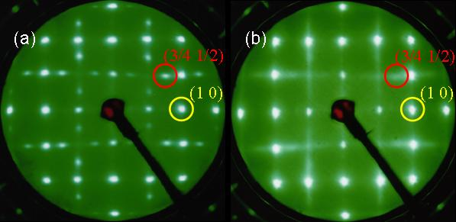
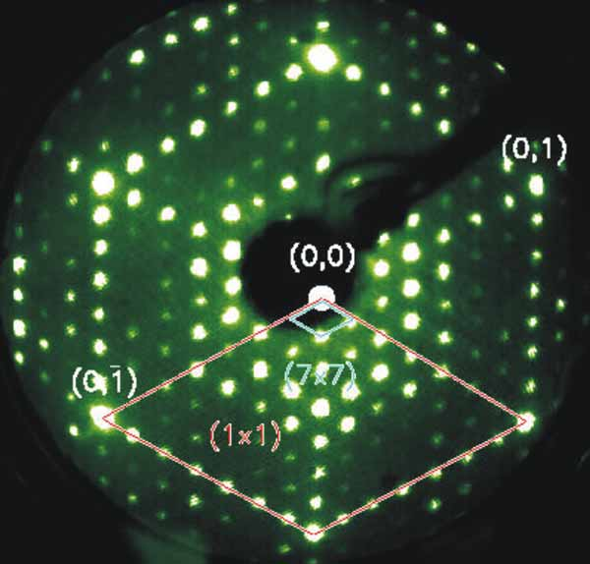
Particle-Wave Duality
Photon is particle. E = hν (Einstein)
Electron/Atom is wave. λ = h/p (de Broglie)
Evidences:
Low Energy Electron Diffraction

Slide 2
λ = h/p, p = mv
E_{K} = mv²/2 = p²/(2m), p = (2mE_{K})^{0.5}
λ = h/p = h (2mE_{K})^{−0.5}
<E_{K}> = 3kT/2 = 1.5 (8.314 J/K/mol) (300 K)
= 3.7 kJ/mol
for H atom, m=10⁻³ kg/mol
λ = h/p ≅ h (2mE_{K})^{−0.5} = 2.4x10⁻¹⁰ m

Slide 3
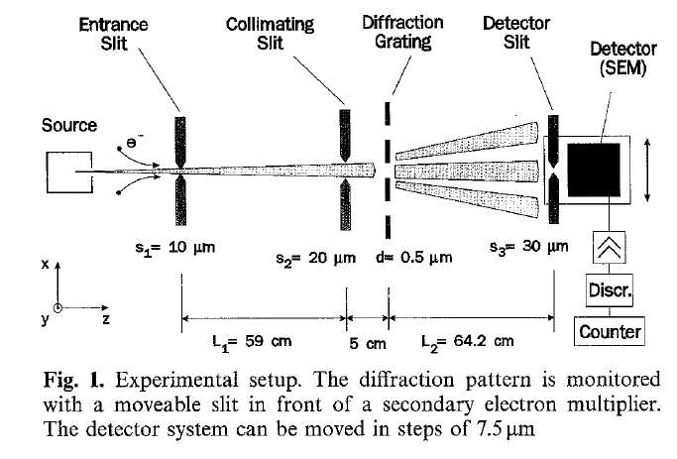
Applied Physics B, 1991, 53, 88–91

Slide 4
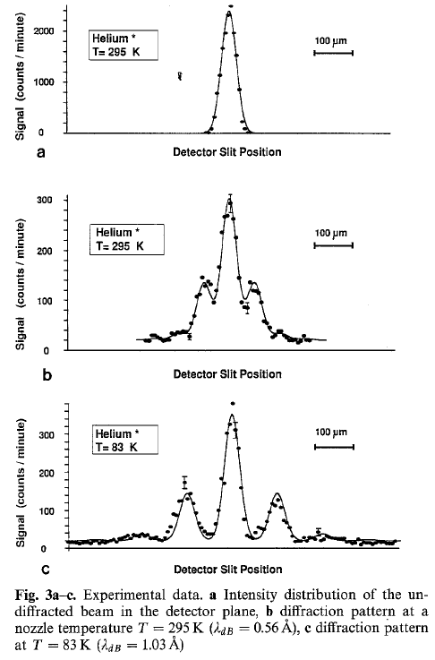

Slide 5
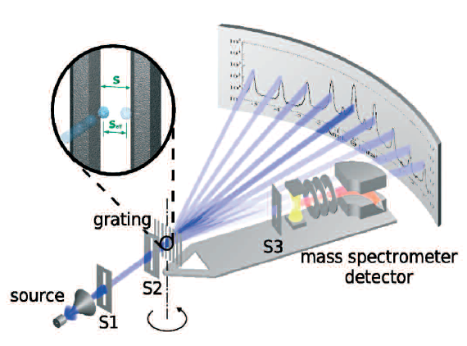
Oleg Kornilov and J. Peter Toennies,
EuroPhysicsNews 2007

Slide 6
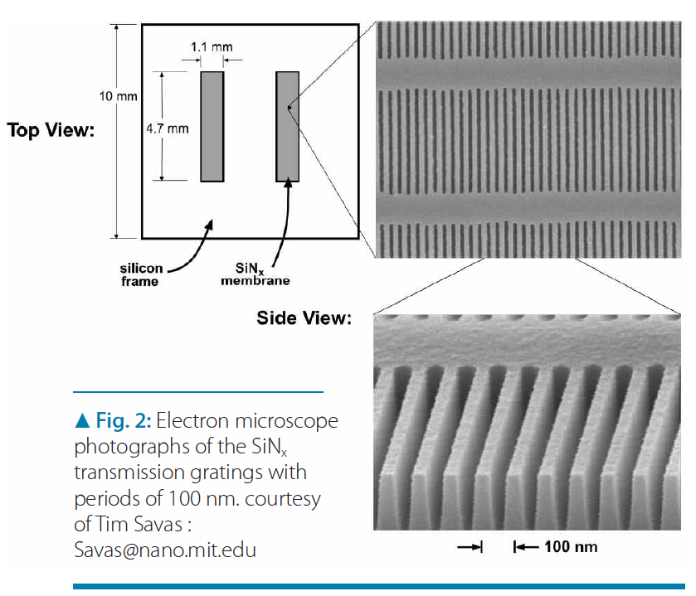

Slide 7
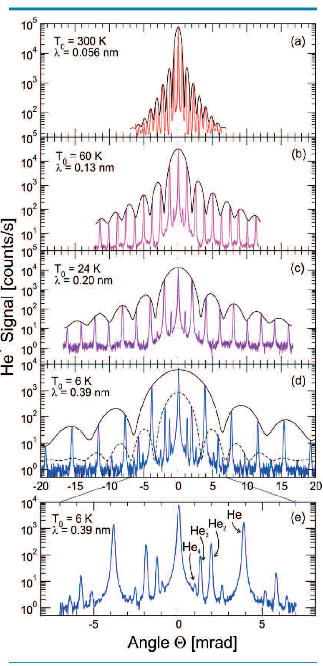

Slide 8
When does a matter need to be treated as a wave ?
Often in a confined space
Where λ is significant
(comparable to the dimension of interest).
Interference => standing wave
Example of confined spaces:
A chemical bond is not long.

Slide 9
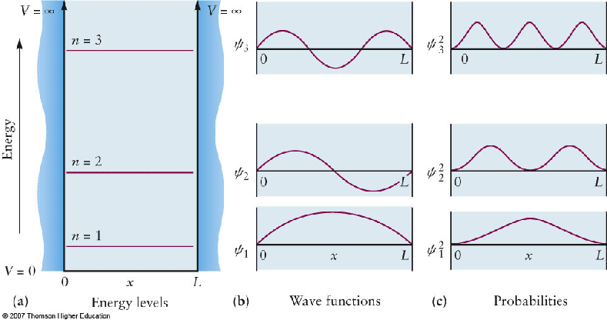
Particle in a box: 0 < x < L
0.5λ n = L
n = 1,2,3,…
Number of nodes
λ
p=h/λ E_{K}=p²/(2m)=h²/(2mλ²)

Slide 10
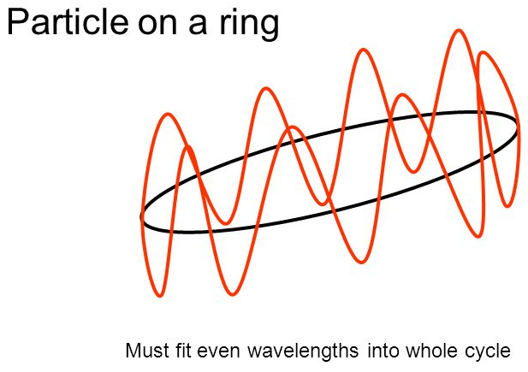
Particle in a ring
Rotational motion
Number of nodes
λ
mλ = L
m=0, 1, 2, …
p=h/λ E_{K}=p²/(2M)

Slide 11
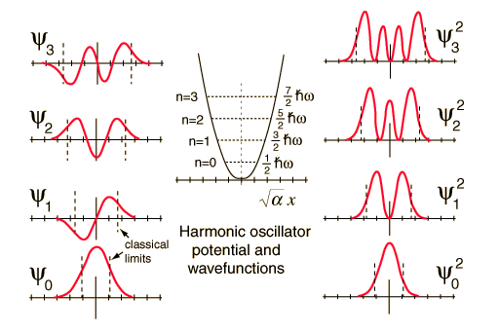
Vibration of a molecule
Number of nodes
λ

Slide 12
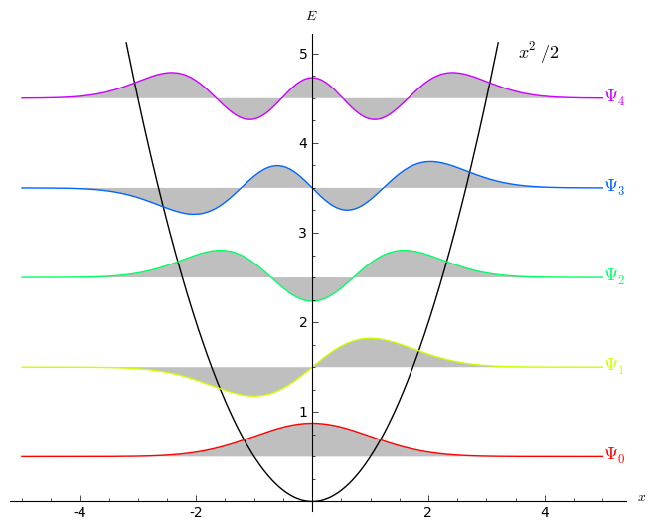
Number of nodes
λ

Slide 13
Particle in a ring
Number of nodes
λ
mλ = L
m=0, 1, 2, …
p=h/λ E_{K}=p²/2m

Slide 14
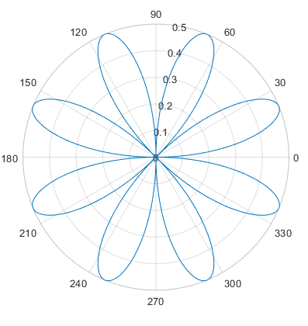
Polar plot

Slide 15
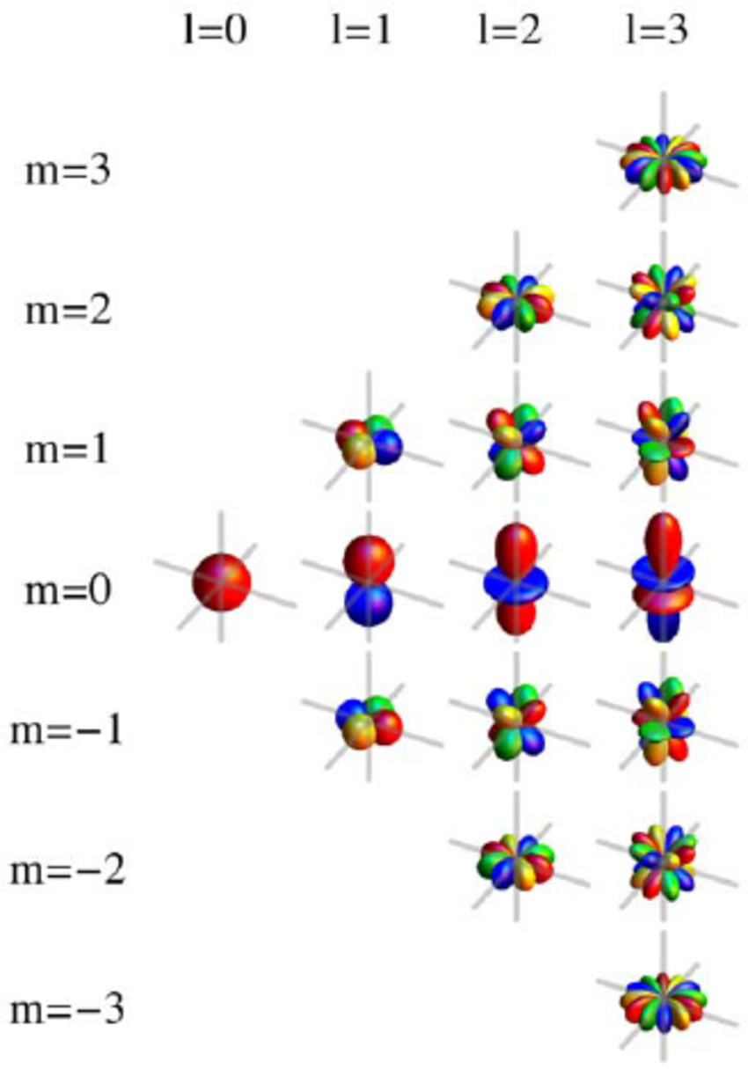
Rotation of a molecule
J
Number of nodes
λ
M_{J}

Slide 16
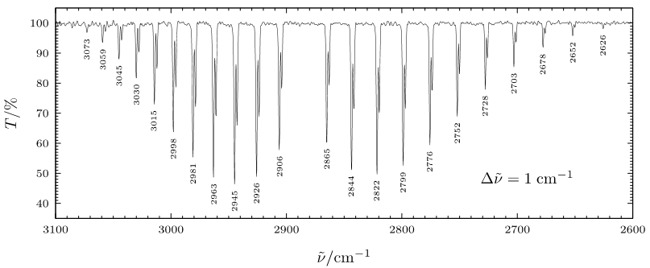
HCl (v”=0, J”) + hν → HCl (v’=1, J’=J”± 1)

Slide 17
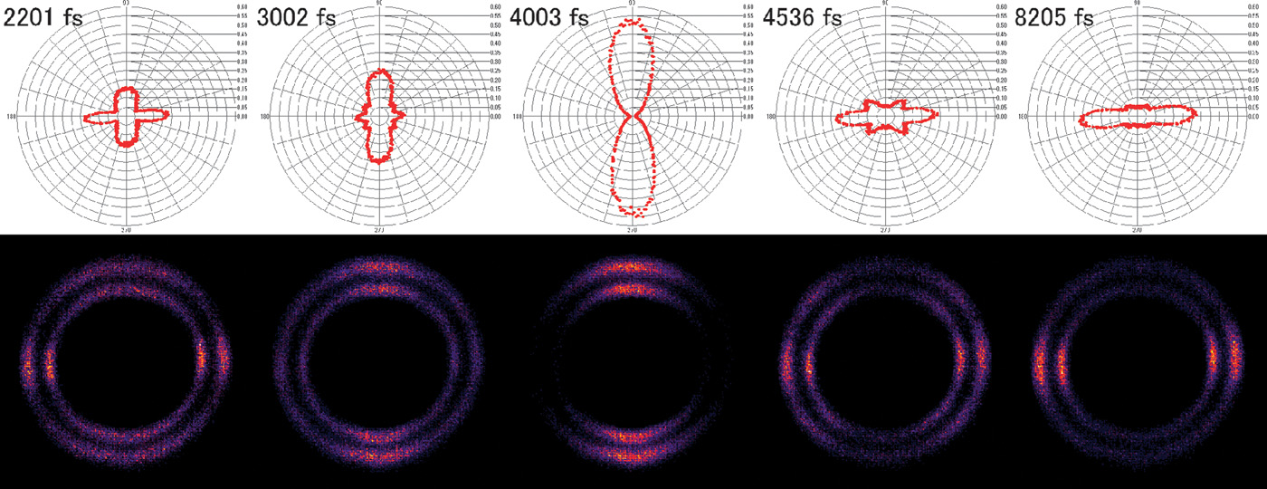
Kenta Mizuse et al. Sci Adv 2015;1:e1400185
(Bottom) Observed N³⁺ ion images (after the calibration). The double ring structure comes from the two channels of Coulomb explosion (N³⁺ from N₂⁴⁺ and N₂⁵⁺), in which higher-charge states lead to larger kinetic energy release (outer ring). (Top) Polar plots of the observed angular probability. The polarization of the pulse is vertical in this figure.

Slide 18
Of course, electron(s) in atom(s)
Next: When can an atom be viewed as a classical particle?
In Free Space? Usually Yes.
In a molecule? Sometimes

