Slide 1
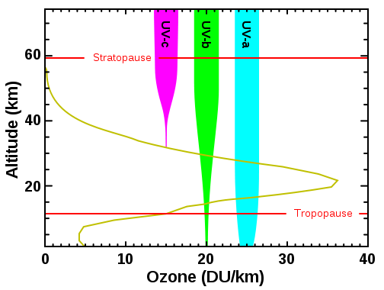
The ozone layer in the stratosphere blocks harmful high energy UV photons from the sun. This protection is due to two factors: large absorption cross section and high concentration of ozone.
Ref: Wiki: Ozone in Earth's atmosphere
Wiki

Slide 2
Beer-Lambert Law for light absorption
Note: There are two definitions for Absorbance A (base e Vs. base 10)

Slide 3
Cross Section
For a large object like a pen, its cross section depends on the angle of view.
For a molecule, the absorption cross section depends on the interaction between the molecule and light.

Slide 4
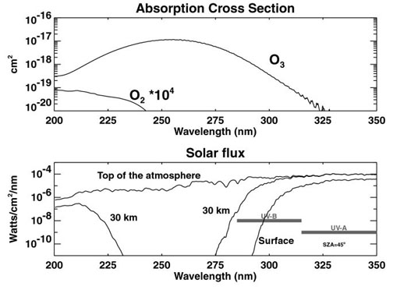
臭氧吸收
陽光強度
UV-B
UV-A

Slide 5
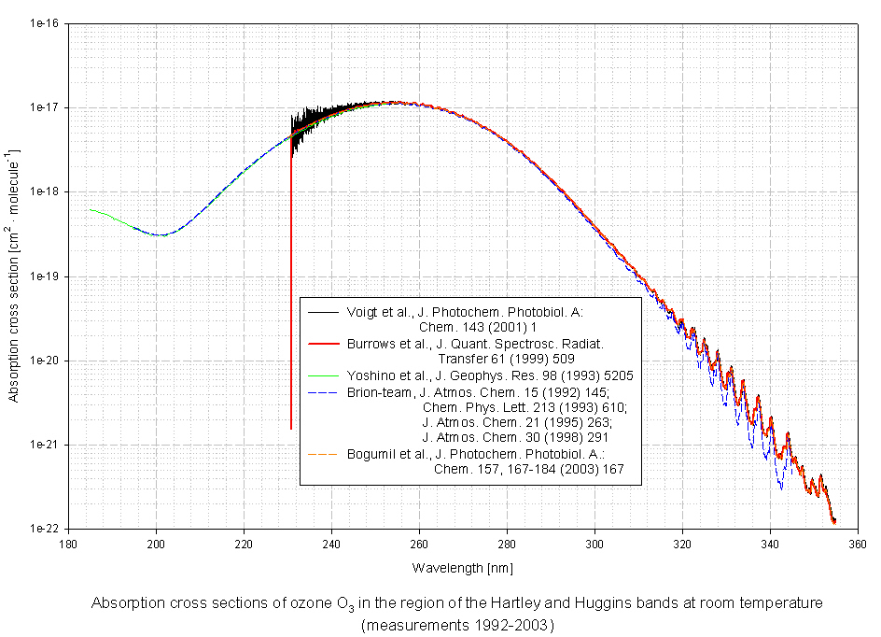
http://satellite.mpic.de/spectral_atlas/cross_sections/Ozone/O3.spc

Slide 6
Wiki: A typical column density of atmospheric ozone is about 300 Dobson Unit (DU). One DU is equivalent to 2.687×10²⁰ molecules per square meter.
Assuming the thickness (range in height) of the ozone layer is about 20 km, estimate the average number density (in molecules per cm³) of the ozone molecules. (=> Ans_1a)
Estimate the transmission of sun light (in %) through the ozone layer at 310 nm and at 300 nm at the noon of the day of summer solstice (夏至) (=> Ans_1b) and winter solstice (冬至) (=> Ans_1c) at Taipei city (緯度：25.0 經度：121.5). This also explains why it is less harmful to do sunbath in the winter or when the sun is low.
How is the ozone hole formed? Describe the chemical processes. Explain why the chemical processes are so efficient such that almost all the ozone molecules in the ozone hole are destroyed? (=> Ans_1d)

Slide 7
f₂(x) = 2^{x} , f₃(x) = 3^{x} , f_{e}(x) = e^{x}
slope at x=0

Slide 8
For light passing through an uniform media, intensity I should has a form of exponential decay.
100%*0.99=99%
99%*0.99=98.01%
98.01%*0.99=97.03%
97.03%*0.99=96.06%
0.99^10=90.4%
0.99^20=81.8%
0.99^40=66.9%
0.99^80=44.8%
0.99^160=20.0%
I₀
I

Slide 9
I₀
I
The decay rate should be proportional to
number density n (in molecule cm⁻³),
path length L (in cm),
and a molecular property σ.
σ n L must be unit less, thus
σ must be in cm² molecule⁻¹. It is in the unit of an area; scientists call it cross section.

Slide 10
Chemical reaction kinetics
reaction = RXN
For a RXN: A + B + … → Products
n+m = order of RXN
rate
rate coefficient
(rate constant)

Slide 11
1st-order RXN:
eg, a spontaneous process, like nuclear decay, fluorescence decay, …
A* → A + hν

Slide 12
2nd-order RXN:
eg, a process requires two molecules
A* + B → A + B
quenching of A* by collision with B
pseudo-1st-order RXN
In the above case, if [A*] << [B], such that
[B](t) = [B]₀ and k[B] does not vary with time.

Slide 13
A more realistic case for a fluorescence molecule A*
A* → A + hν fluorescence, k₁
A* → A (+ heat) non-radiative process, k₂
A* + B → A + B quenching of A* by B, k₃
If [B] >> [A*], such that [B](t) = [B]₀
(pseudo-1st-order)

Slide 14
Even there are three rate coefficients k₁, k₂ and k₃,
the decay of A* only shows single exponential decay.
Experimental observables
Decay rate k’ or lifetime τ =1/k’
Fluorescence quantum yield φ_{FL}

Slide 15
Practice:
If k₁ = 1x10⁶ sec⁻¹
k₂ = 1x10⁶ sec⁻¹
k₃ = 1x10⁻¹⁰ cm³ sec⁻¹
Estimate the fluorescence lifetime and fluorescence quantum yield at [B] = 3x10¹⁶ cm⁻³ and 1x10¹⁹ cm⁻³.
cm³ sec⁻¹ = cm³ molecule⁻¹ sec⁻¹
A* → A + hν fluorescence, k₁
A* → A non-radiative process, k₂
A* + B → A + B quenching of A* by B, k₃

Slide 16
Photochemistry
1. Estimate the protection of the stratospheric ozone layer.
Chemical Reaction Kinetics
2. Estimate the global production rate of CH₄.

Slide 17
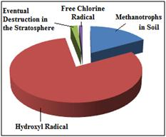
(2) It is known that the majority of atmospheric CH₄ is consumed by its reaction with OH radicals (see below). With http://kinetics.nist.gov, estimate the reaction rate coefficient at 25 degree C and at 0 degree C (=> Ans_2a).
A pie chart demonstrating the relative effects of various sinks of atmospheric methane.
https://en.wikipedia.org/wiki/Atmospheric_methane

Slide 18
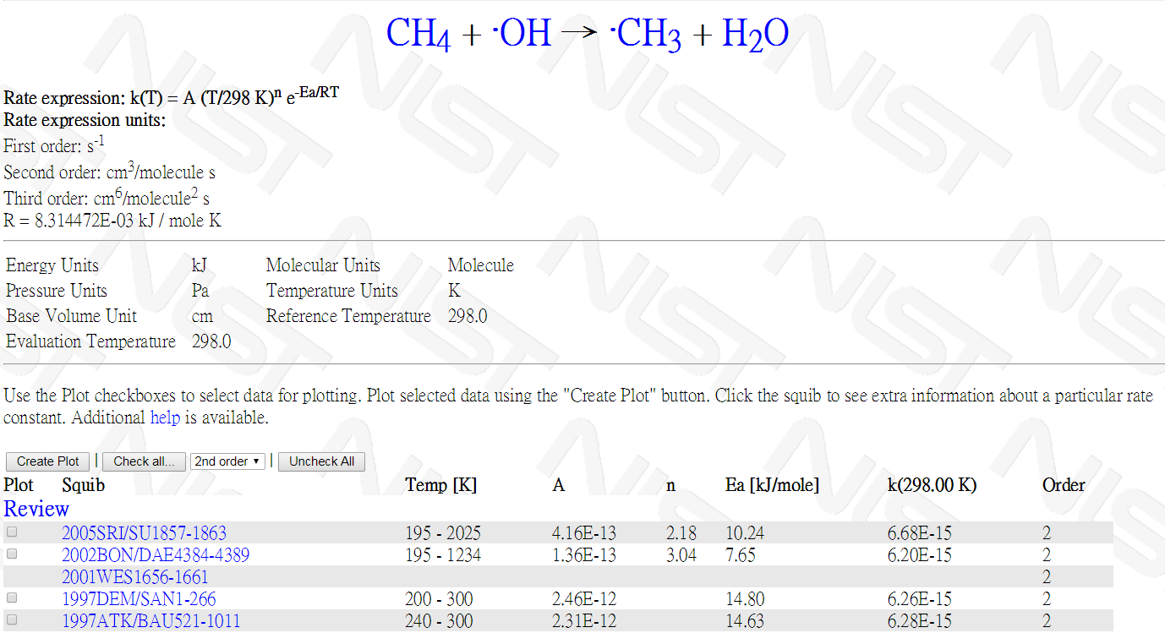
e = exp
6.68x10⁻¹⁵

Slide 19
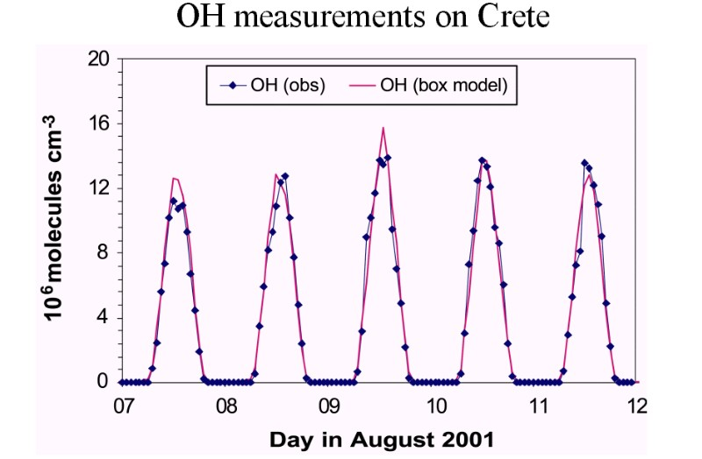
The concentration of atmospheric OH radicals can be measured by utilizing laser-induced fluorescence. For example,
Time profile of OH concentrations over several days.
Source: Presentation J. Lelieveld MPI Mainz 2003

Slide 20
if [CH₄] & k does not vary with time

Slide 21
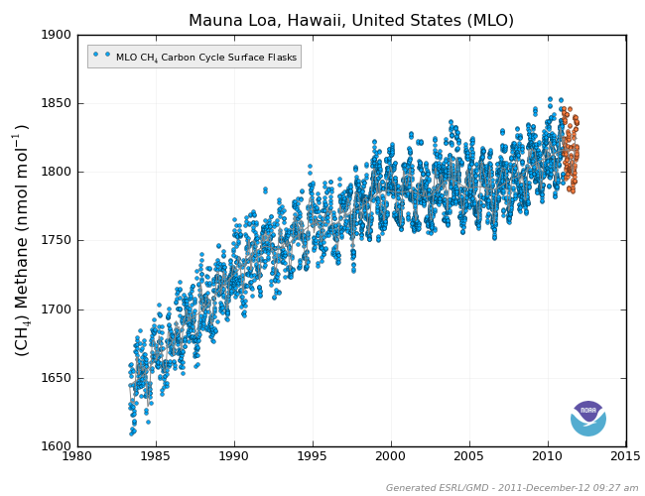
With these data and assuming T = 290 K, estimate the lifetime of atmospheric CH₄ (=> Ans_2b). Note that a lifetime usually means the reciprocal of the averaged first-order decay rate coefficient.
The CH₄ mixing ratio can also be measured. An example is shown in the following figure.

Slide 22
With the above information, we should be able to estimate the global CH₄ emission rate after making some reasonable assumptions (steady-state approximation). Describe your approach and give your answer in molecules/sec and also convert it to Tg/year (=> Ans_2c). Note that the major amount of air is located within 10 km above the sea level (recall the Boltzmann distribution of the air density as a function of height); the surface area of earth is 5.1×10⁸ km².
Considering the consumption rate of CH₄, is it faster in the winter or in the summer? How much faster (roughly)? Give your reasons. (=> Ans_2d)

Slide 23
Get a rough (not-too-bad) answer within a reasonable time.
A rough answer is much better than no answer.
A bad answer may be misleading!

Slide 24
Do better estimation by:
[CH₄] should be good enough.
Use k(T) instead of k(298 K)
Use better <[OH]>. Global Vs. Local
Both [OH] and k(T) depend on altitude.

Slide 25
Wiki: Methane as a greenhouse gas
Methane has a large effect but for a relatively brief period, having an estimated lifetime of 8.9±0.6 years in the atmosphere,[12] whereas carbon dioxide has a small effect for a long period, having an estimated lifetime of over 100 years.

Slide 26


