Slide 1
Kinetics of Criegee Intermediate Reactions with Alcohol and Dimethyl Sulfoxide

Slide 2
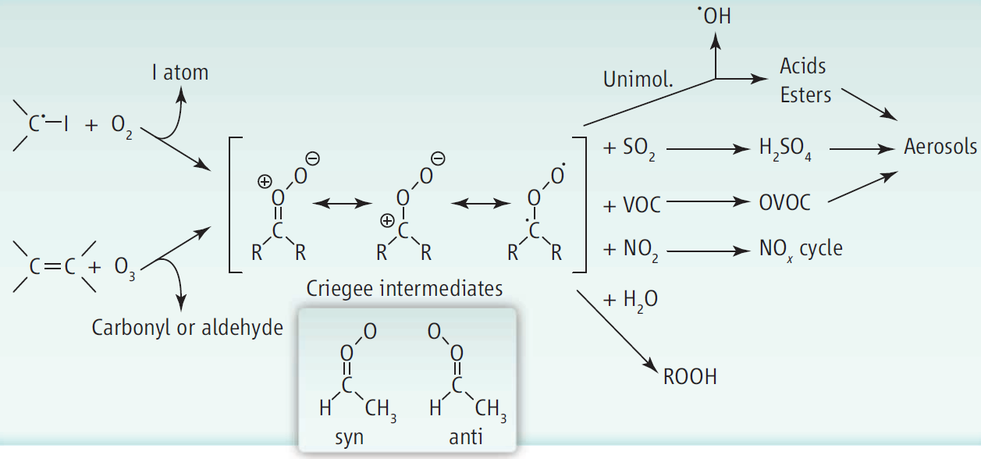
Criegee Intermediates are important.
Formic acid
HCl, HNO3
© Science 2013

Slide 3
Upper limit
JPC Lett, 9, 184 (2018)
Lin & Chao, Chem. Soc. Rev., 46, 7483-7497 (2017)

Slide 4
CH₂OO
4 μs
IO
Δ
196 μs
CH₂I₂

Slide 5
Lower concentrations
→ Slower reactions between radicals
But also weaker signal!
Solution: Use longer absorption path
out (#6)
in (#1)
(#4)
探測光束
(#3)
(#2)
(#5)
稜鏡
球面鏡
反應槽
65 cm x 8 = 520 cm

Slide 6
Probe CH₂OO with Time-resolved UV Absorption
Advantages: OK Selectivity:
σ (CH₂OO) ~ 1x10⁻¹⁷ cm²
>> σ (non radicals) @ 340−380 nm
Sensitivity: ΔI/I₀ = σ n L
~ (1x10⁻¹⁷ cm²) (2x10¹¹ cm⁻³) (500 cm) ~ 10⁻³
Can be performed at Near Atmospheric Conditions
(Relative Humidity: 0−80%)
Disadvantages: Little structure information (mass, conformer, …)

Slide 7
Wen Chao, master thesis, National Taiwan University 2017

Slide 8
Criegee Intermediate reacts with water or not ?
Controversial results in literature!
depends on preparation!?

Slide 9
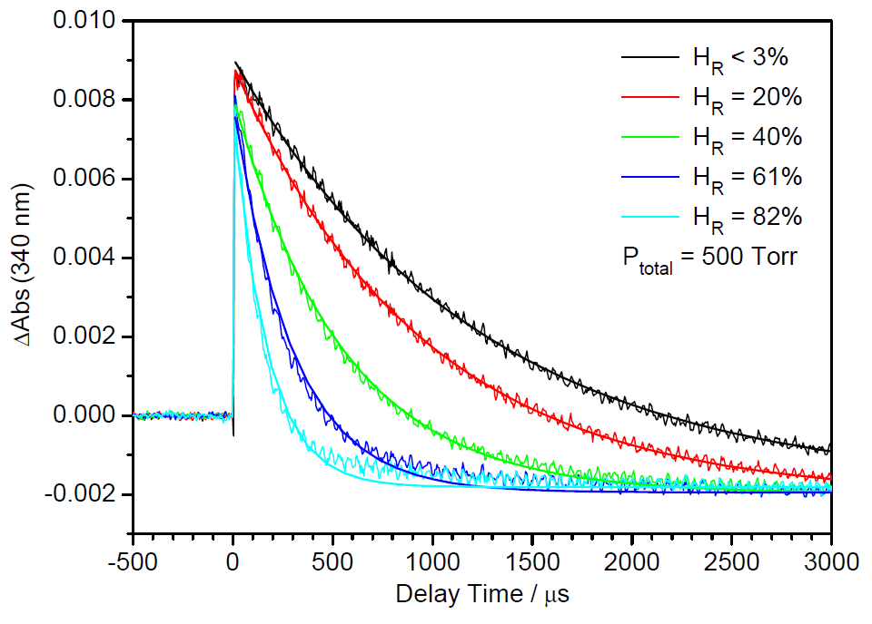
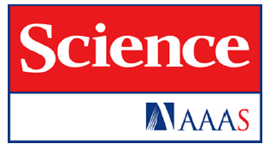
[CH₂OO] at various humidity
Relative Humidity
dry
wet
Science 347, 751 (2015)

Slide 10
Relative Humidity
Reaction with water dimer predominates for CH₂OO decay!
Science 347, 751 (2015)

Slide 11
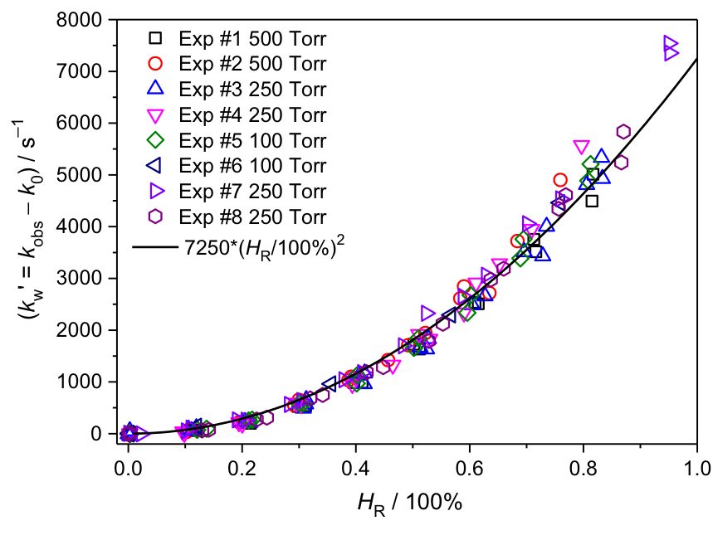
4% humidity
Relative Humidity
Science 347, 751 (2015)

Slide 12
by Kaito Takahashi & coworkers

Slide 13
CH₂OO + (CH₃)₂SO
similar to CH₂OO + SO₂?

Slide 14
B3LYP/6-311+G(2d,2p) by Kaito Takahashi’s group

Slide 15
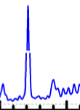
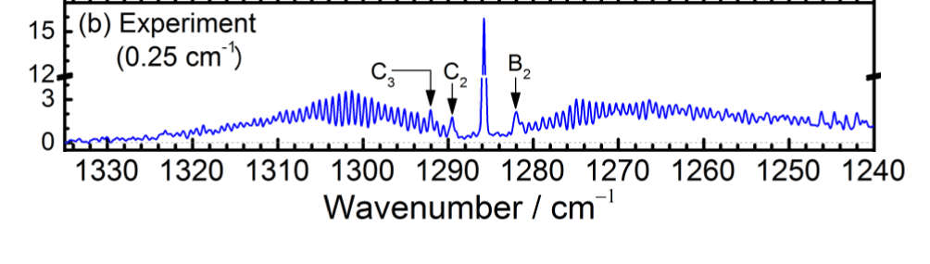
CH₂OO
Our IR Laser spectrum 0.004 cm⁻¹
1290
1288
1286
1284
1282
1280
FT-IR spectrum by YP Lee group
Huang et. al., JCP (2015)
1290
1288
1286
1284
1282
1280
ΔA / 10⁻³

Slide 16
YP Chang et al., Phys. Chem. Chem. Phys., 2018,20, 97-102
CH₂OO 4¹₀

Slide 17
YP Chang et al., JCP 146, 244302 (2017)

Slide 18
CH₂OO + (CH₃)₂SO 30 Torr @ Room Temp

Slide 19
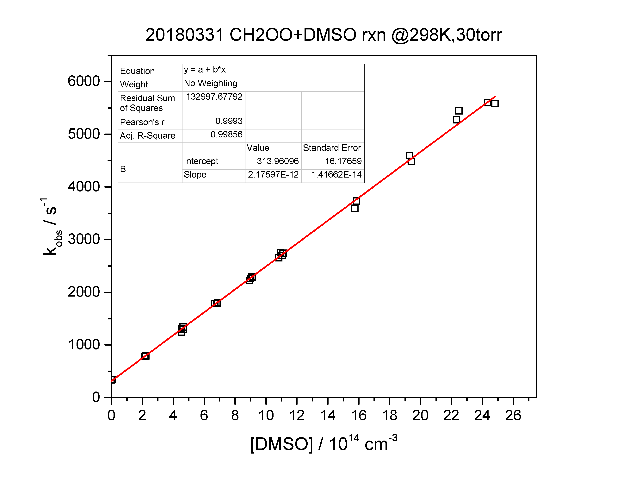

Slide 20
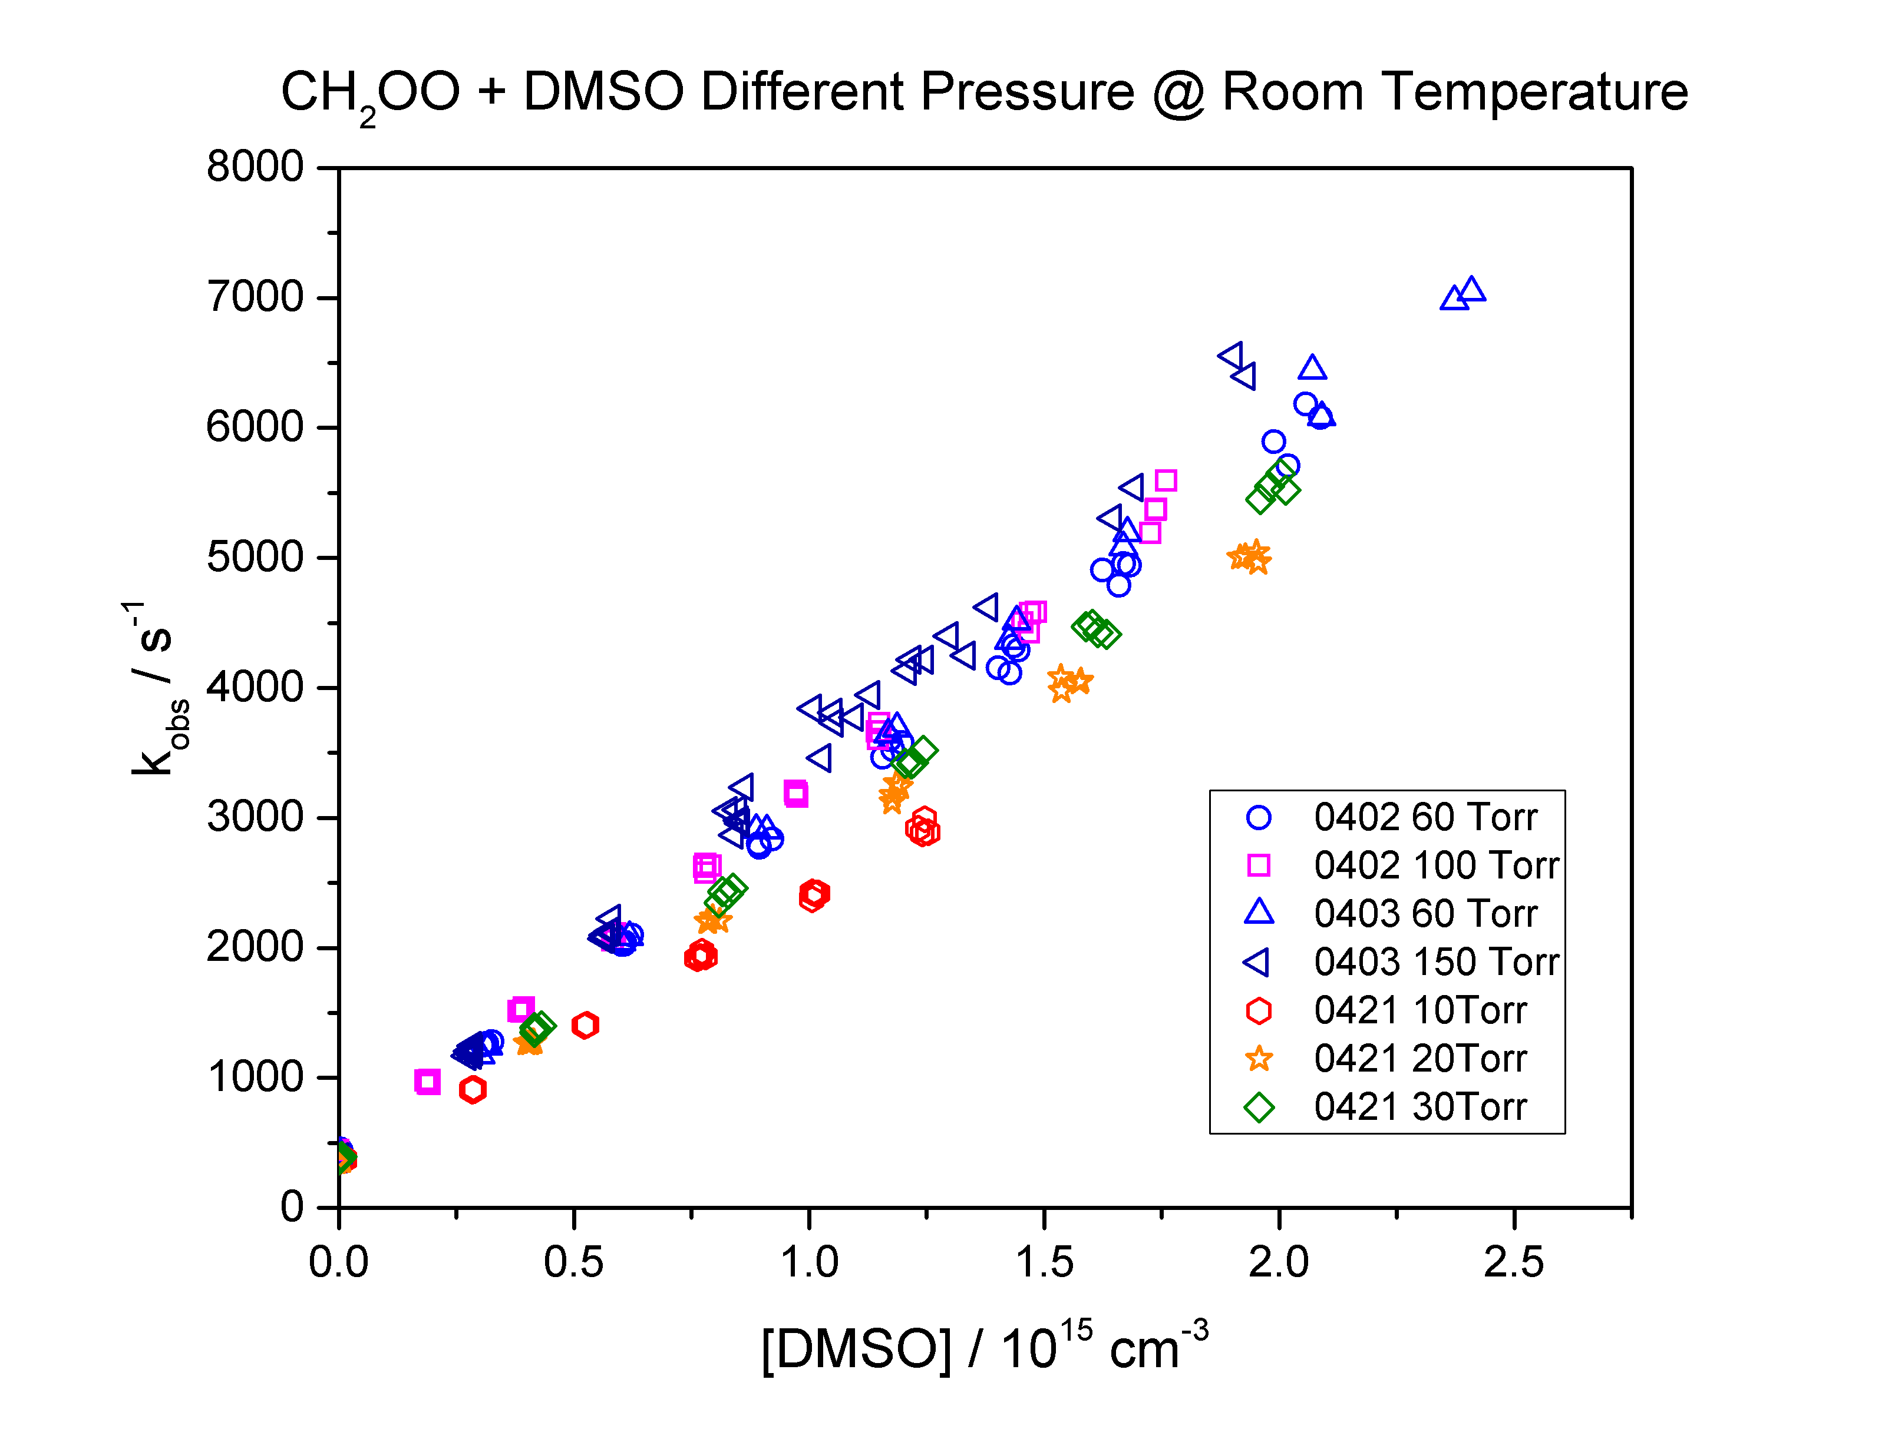

Slide 21
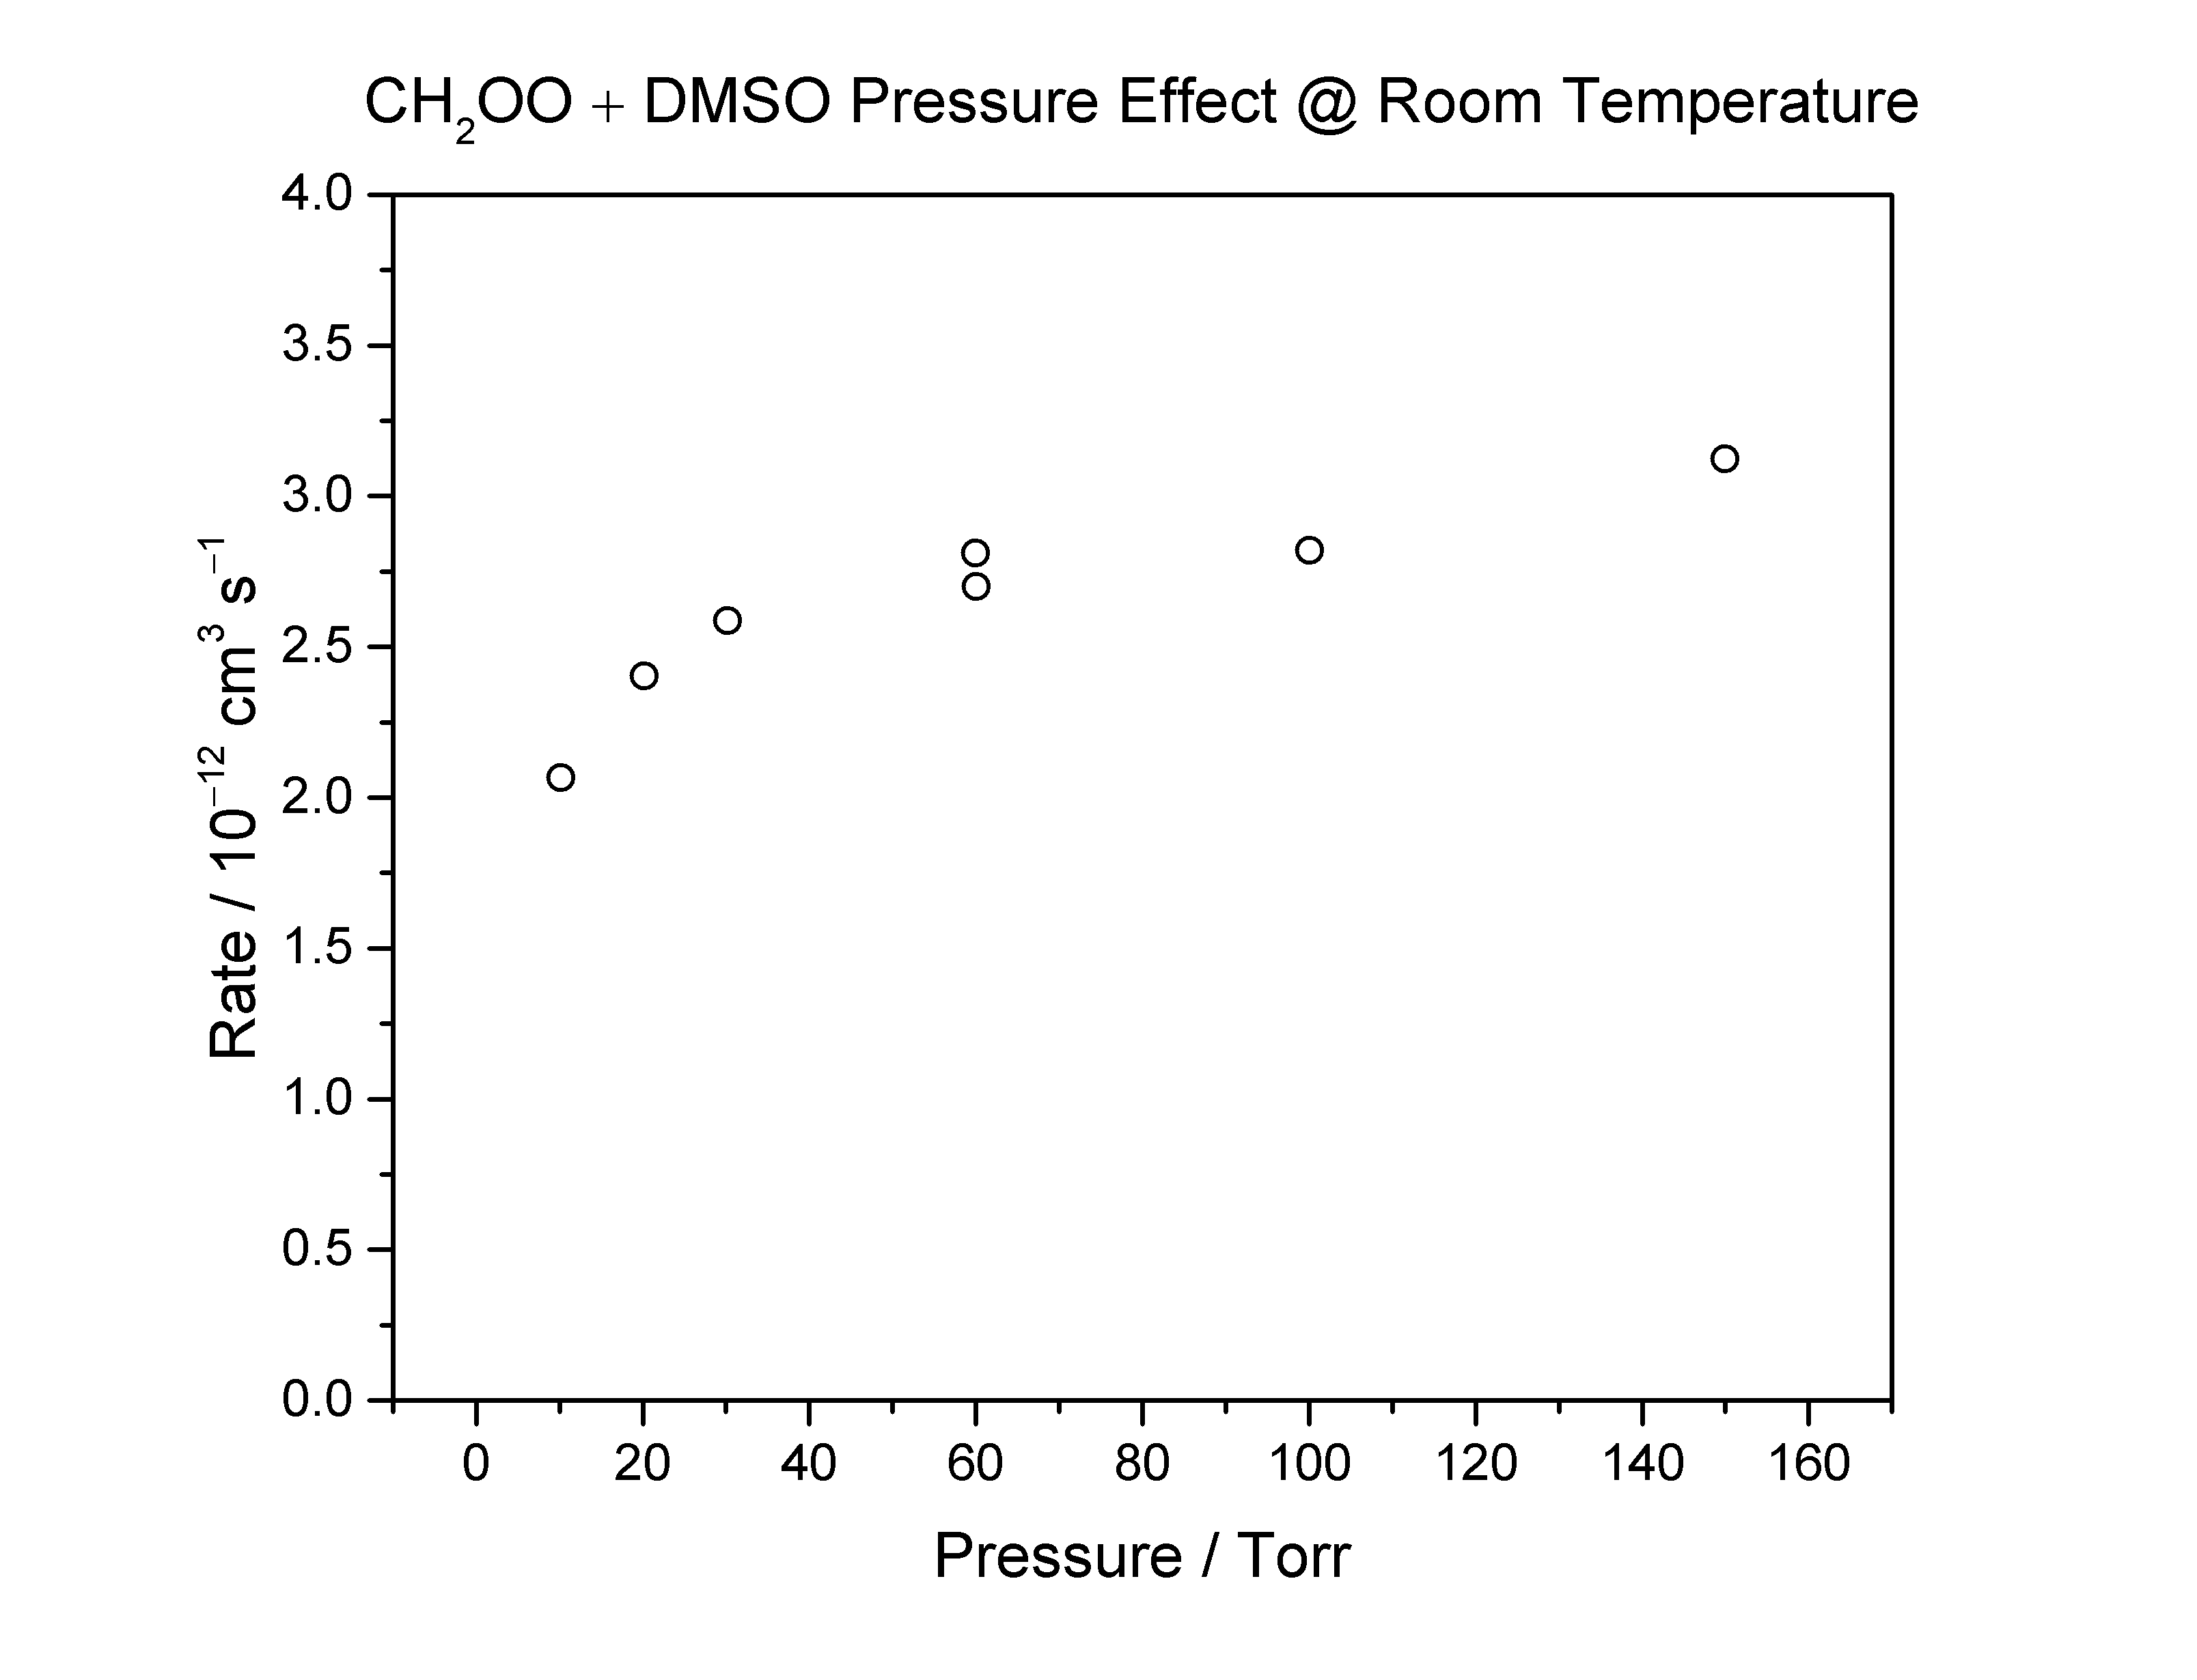

Slide 22
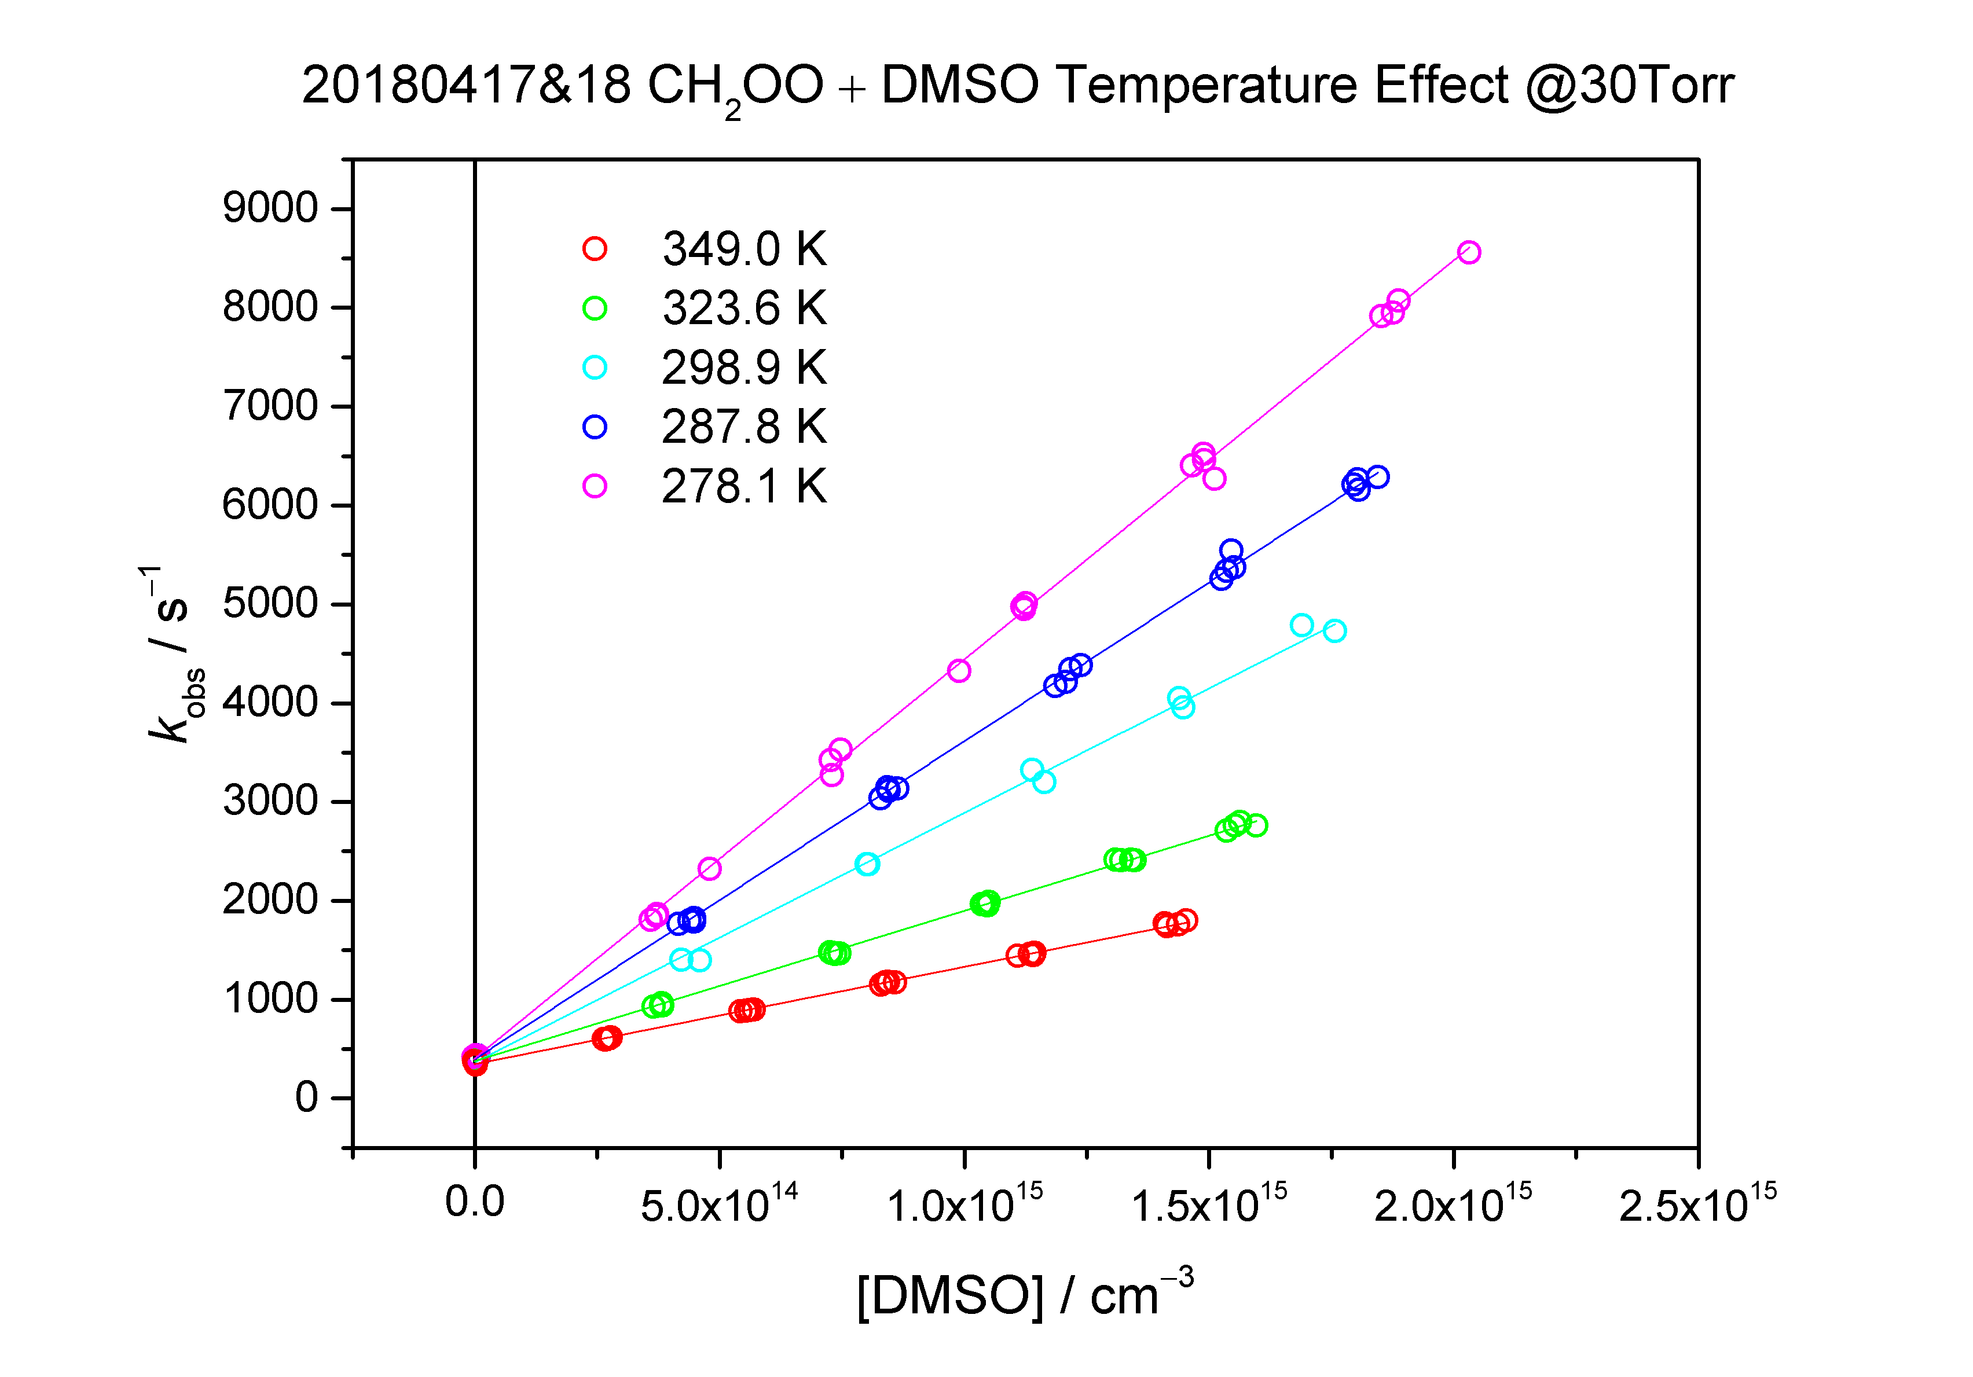

Slide 23
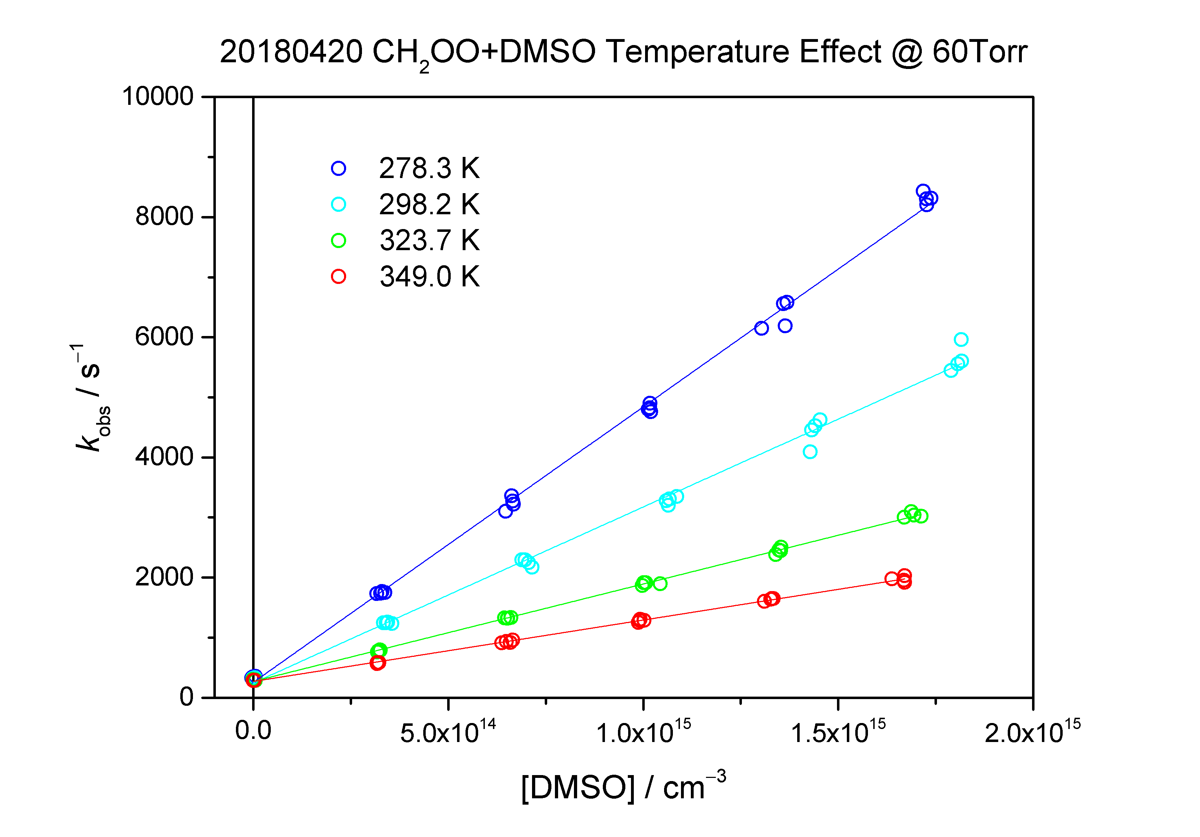

Slide 24
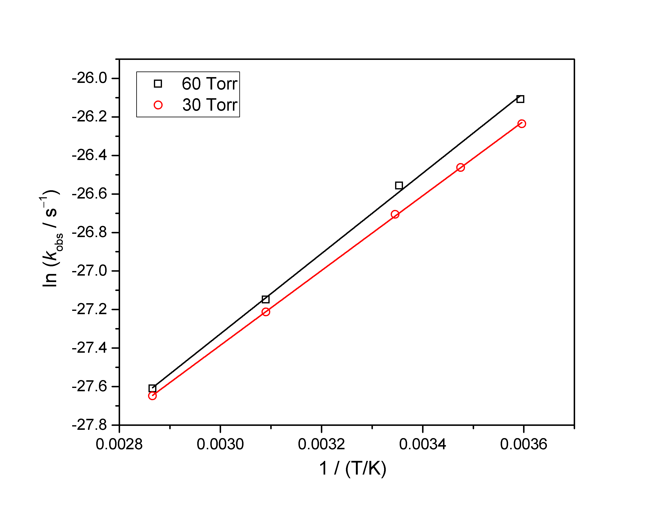
CH₂OO + (CH₃)₂SO _{@0417,0418,0420}

Slide 25
P / Torr | T / K | k / 10⁻¹² cm³ s⁻¹ | E_{a} / kcal/mol⁻¹
30 | 278.1 | 4.04 | −3.86
 | 288.95 | 3.2
 | 299.05 | 2.52
 | 323.75 | 1.52
 | 349 | 9.83
60 | 278.3 | 4.59 | −4.15
 | 298.2 | 2.93
 | 323.7 | 1.60
 | 349 | 1.02

Slide 26
Upper limit
JPC Lett, 9, 184 (2018)
Lin & Chao, Chem. Soc. Rev., 46, 7483-7497 (2017)

Slide 27
Anti/syn-CH₃CHOO + CH₃OH
analogous to CH₂OO + H₂O?

Slide 28
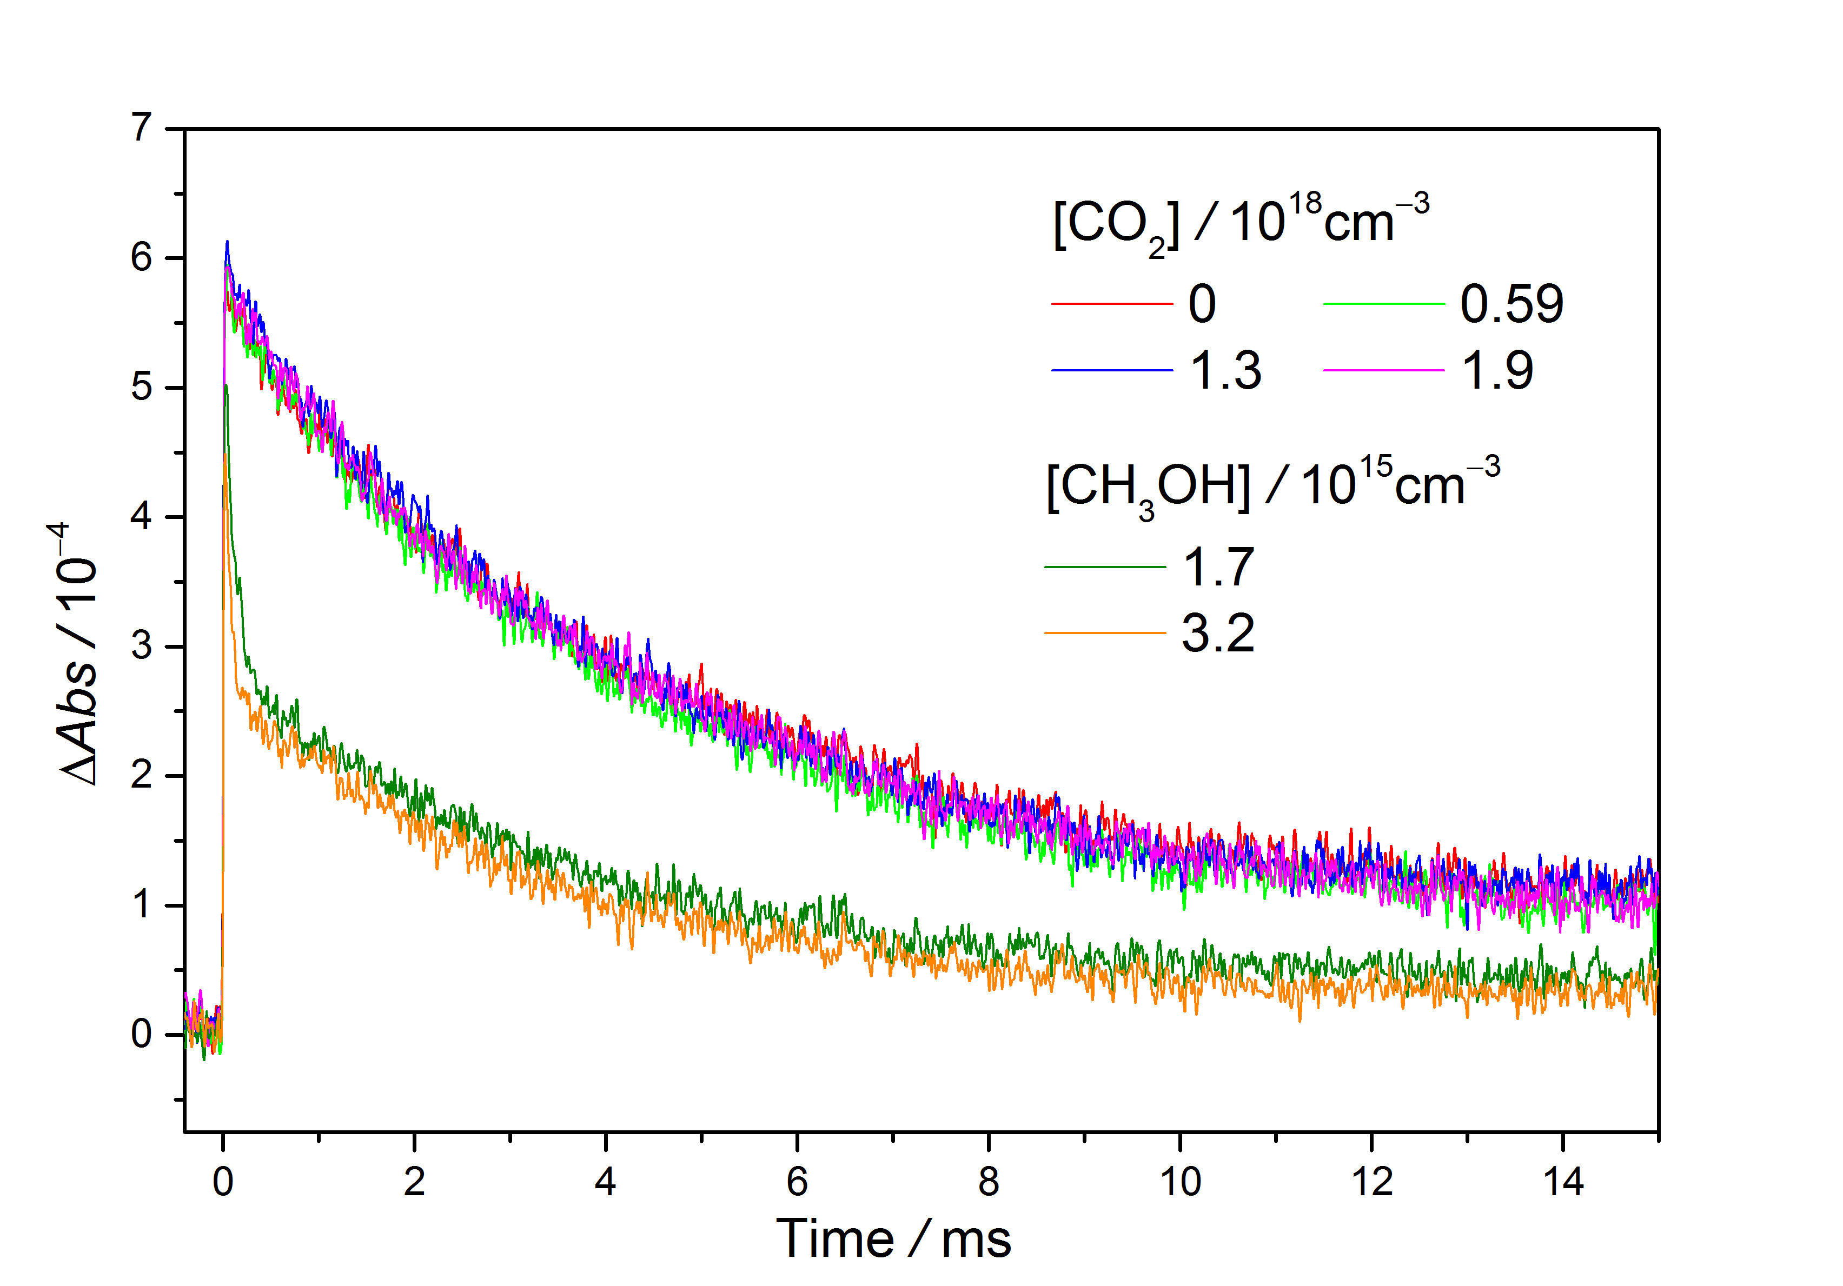
anti-/syn-CH₃CHOO @ 250 Torr

Slide 29
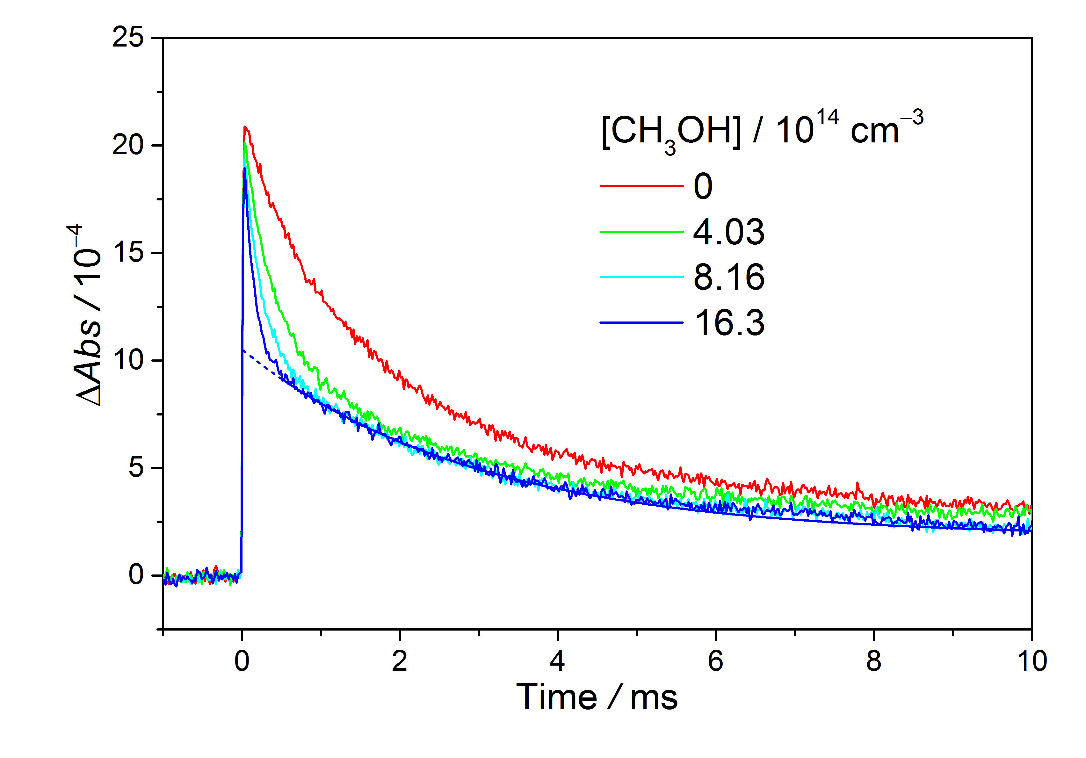
anti-/syn-CH₃CHOO + CH₃OH @ 100 Torr

Slide 30
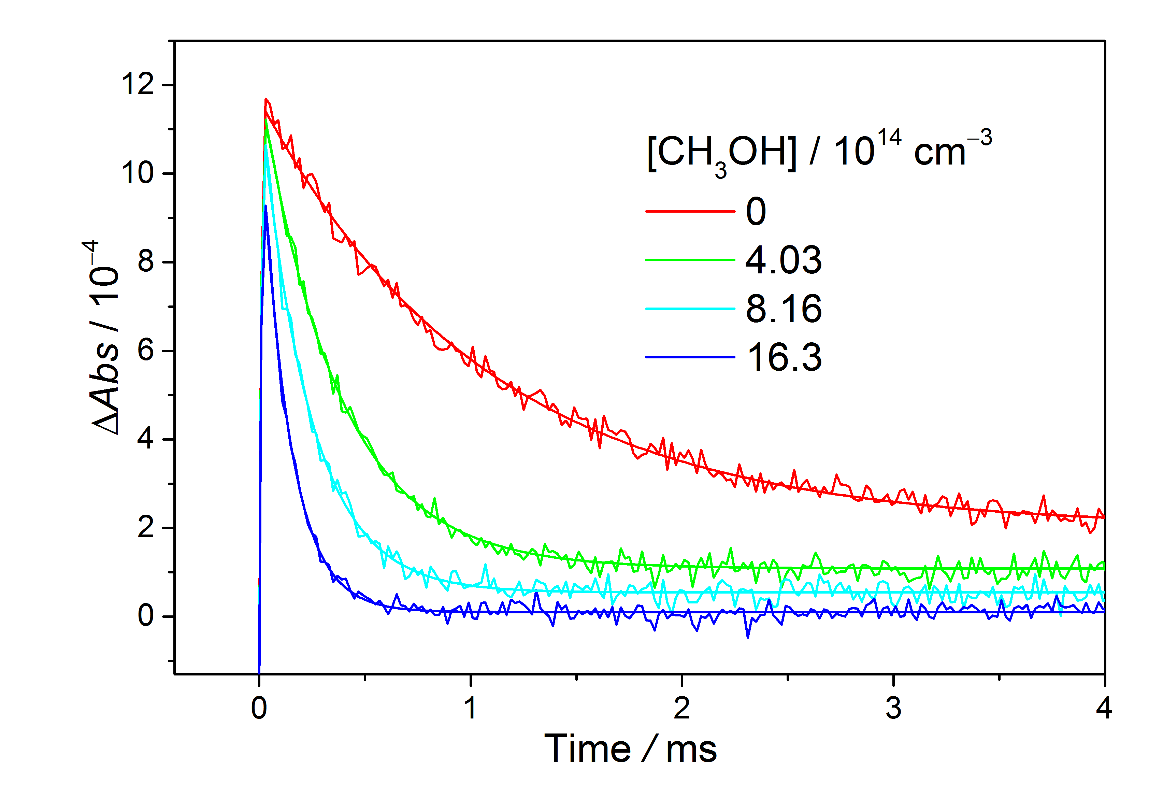
anti-CH₃CHOO + CH₃OH @ 100 Torr

Slide 31
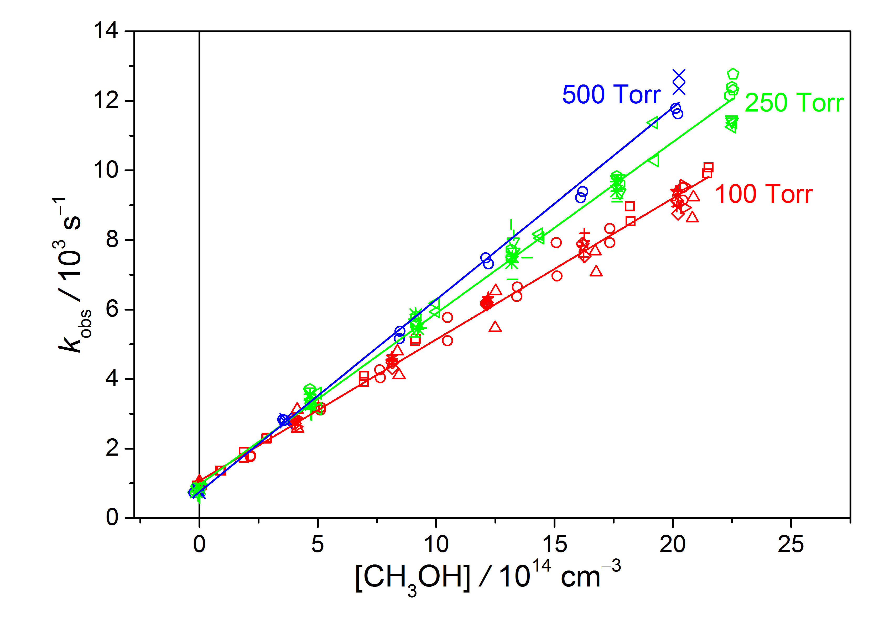
anti-CH₃CHOO k = 5x10⁻¹² cm³s⁻¹ @ 298 K

Slide 32
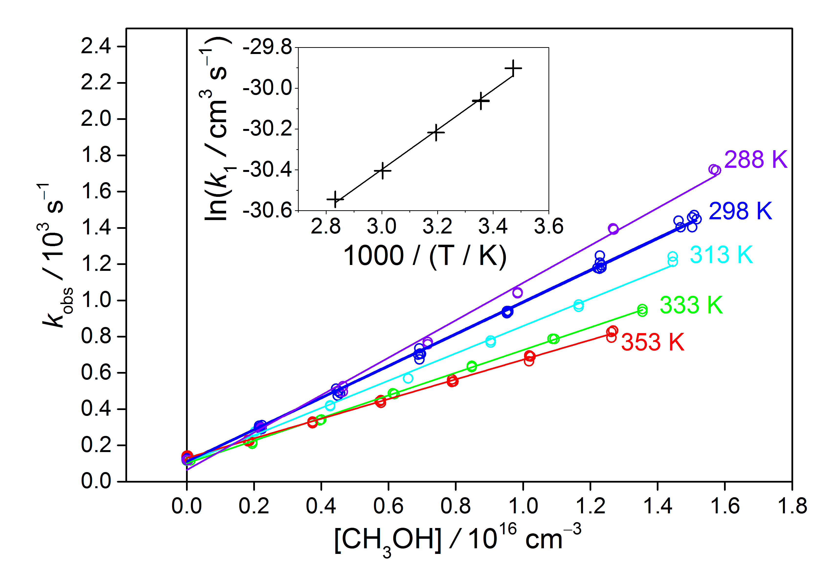
anti-CH₃CHOO + CH₃OH E_{a} = −1.9 kcal/mol

Slide 33
Upper limit
JPC Lett, 9, 184 (2018)
Lin & Chao, Chem. Soc. Rev., 46, 7483-7497 (2017)

Slide 34
Syn-CH₃CHOO + CH₃OH dimer
Analogous to
CH₂OO + H₂O dimer?

Slide 36
Syn-CH₃CHOO + CH₃OH
Initial Motivation: How slow is it?

Slide 37
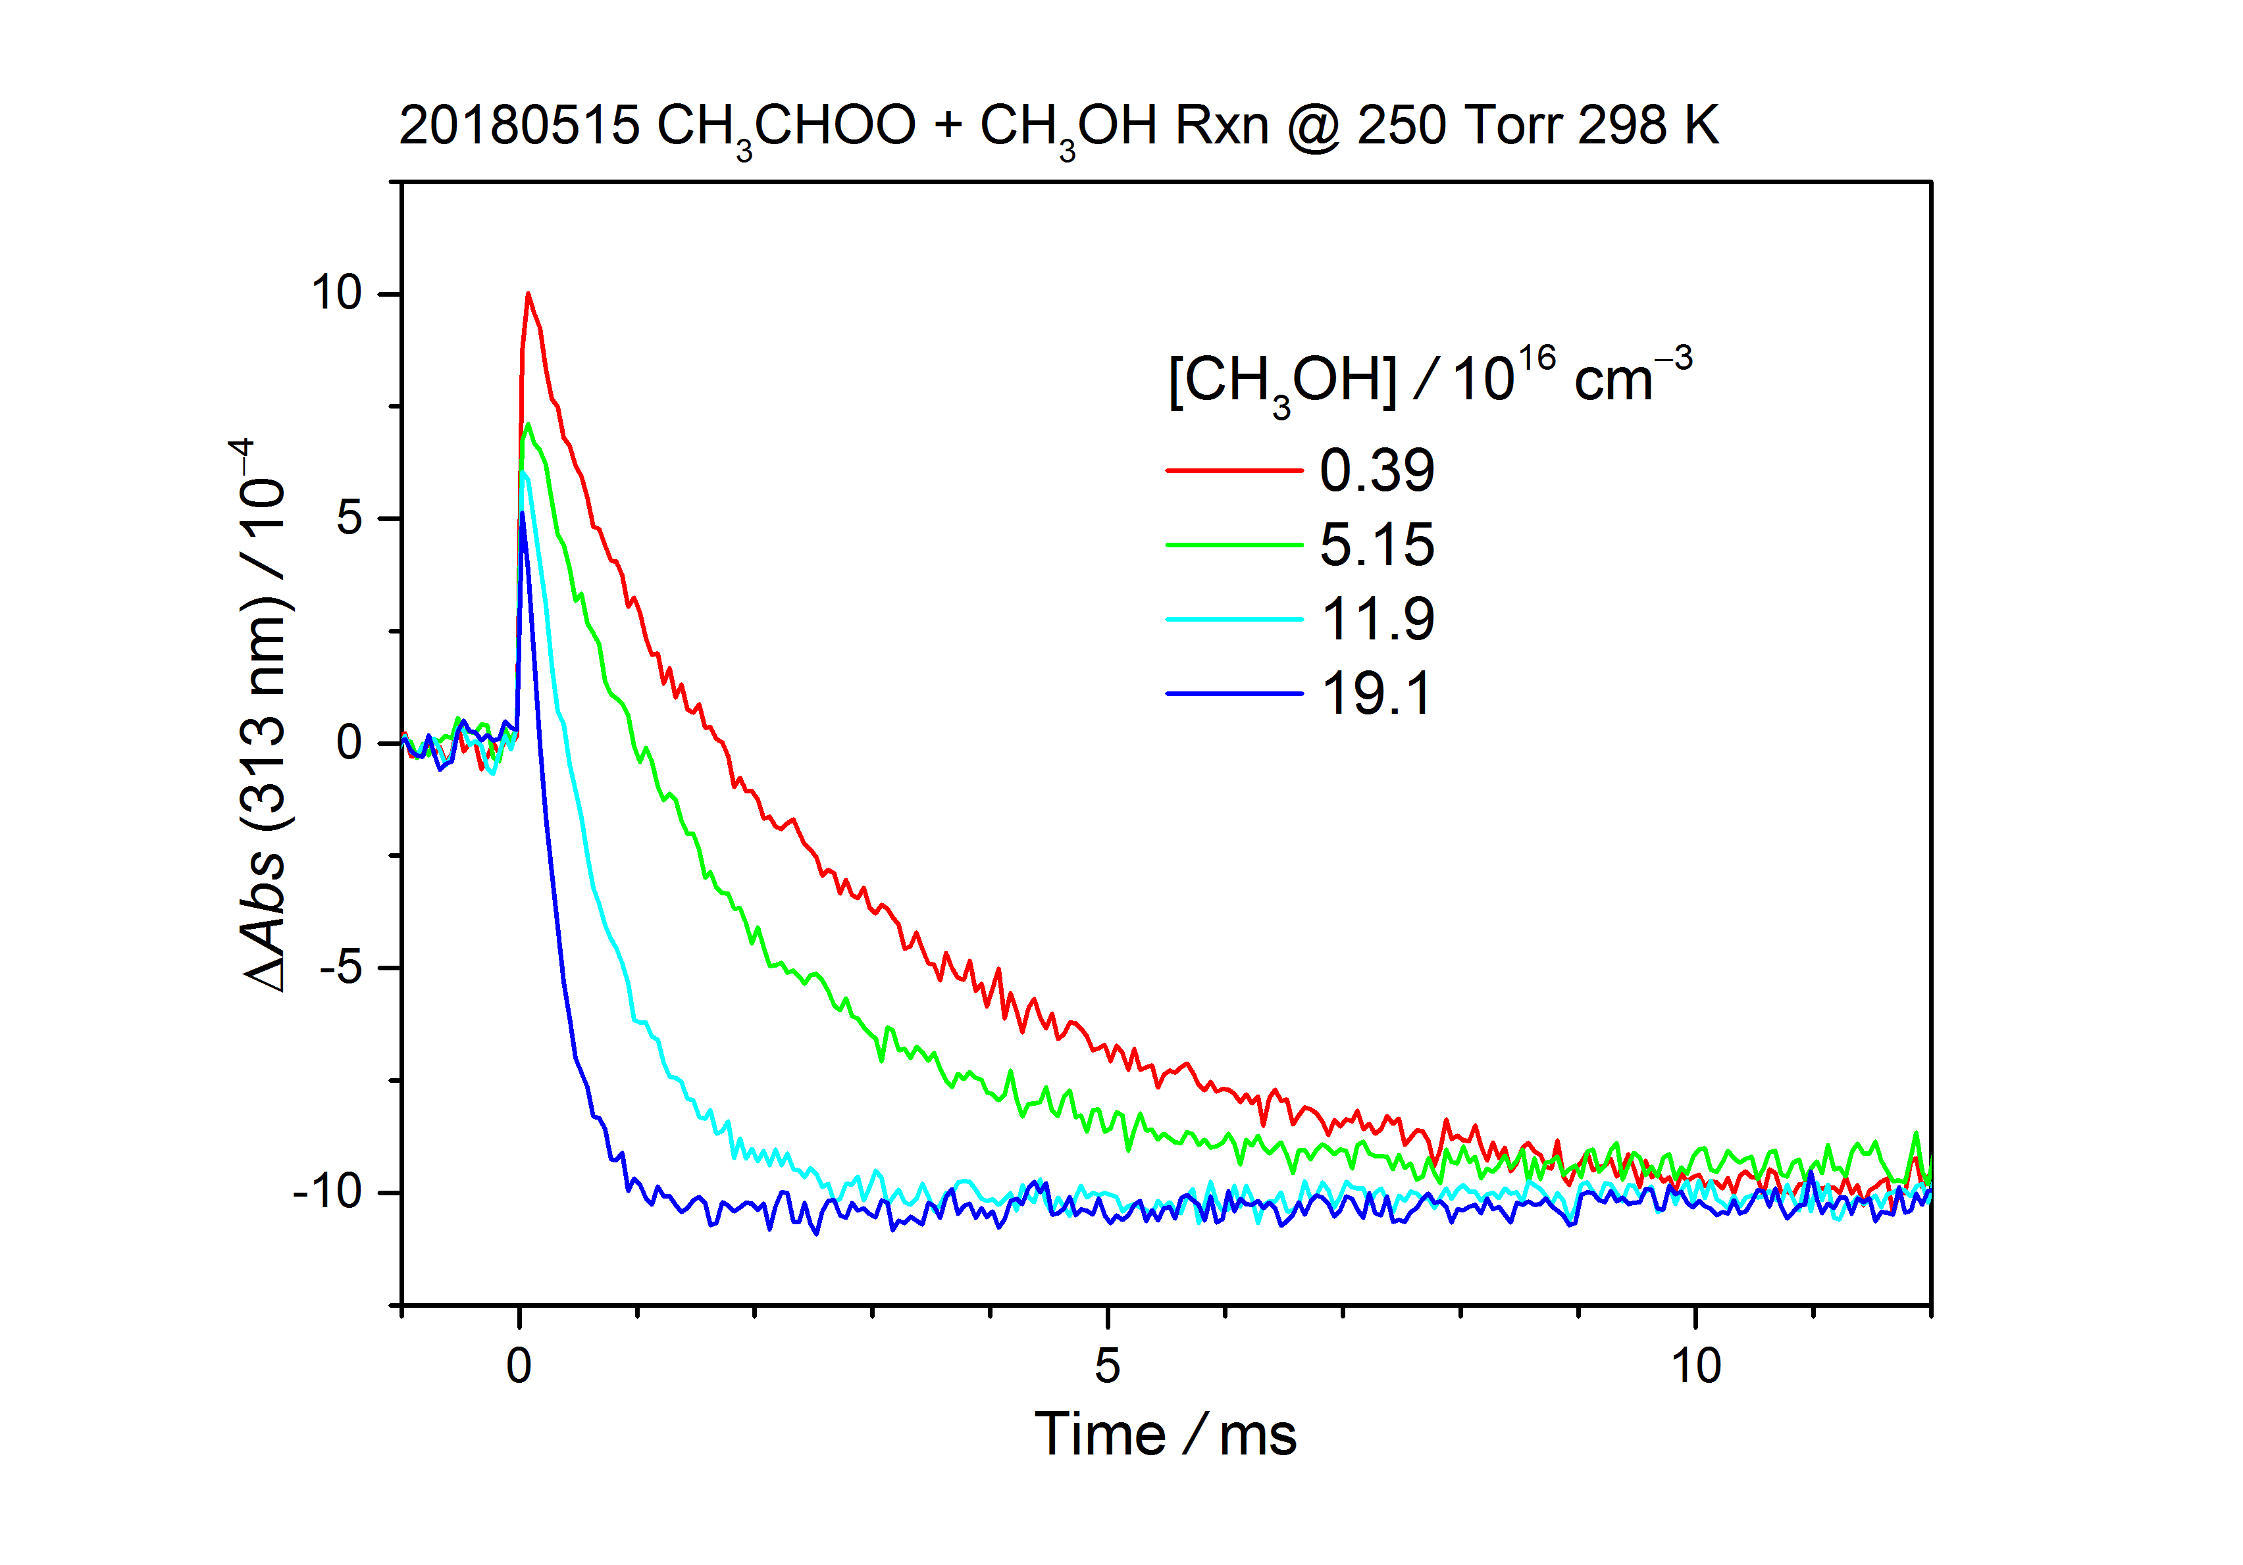
Syn-CH₃CHOO + CH₃OH 250 Torr _{@xxxx}

Slide 38
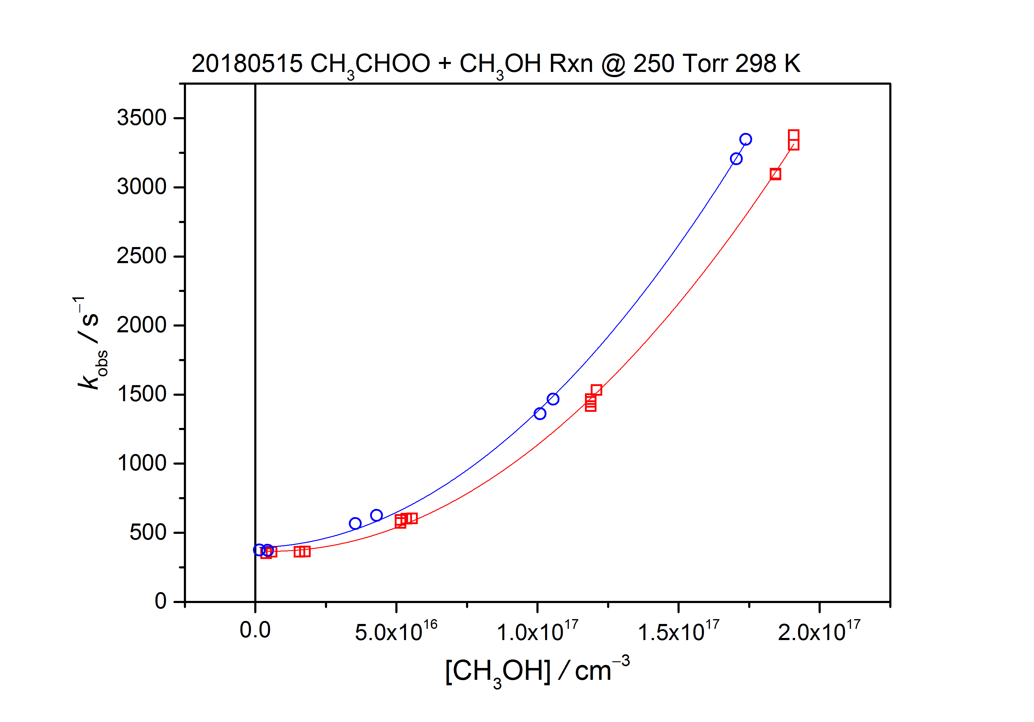
Syn-CH₃CHOO + CH₃OH 250 Torr _{@xxxx}

Slide 39
Syn-CH₃CHOO
+ CH₃OH Monomer and Dimer

Slide 40
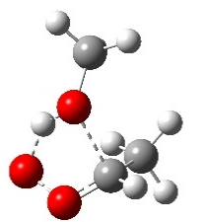
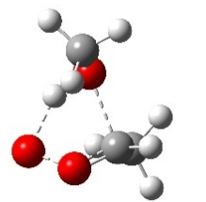
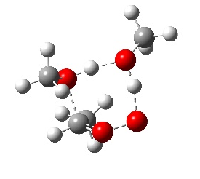
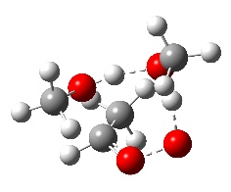
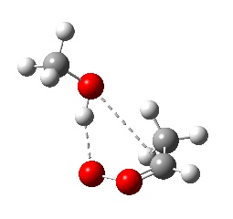
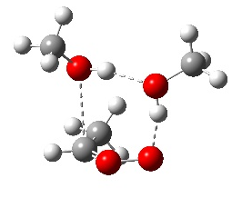
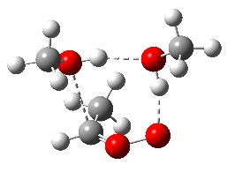
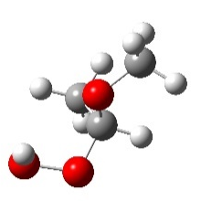
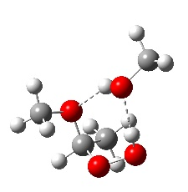
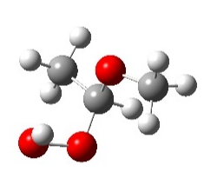
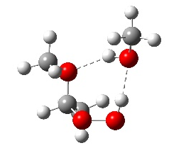
Syn-CH₃CHOO meets CH₃OH
B3LYP/6-311+G(2d,2p)

Slide 41
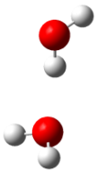
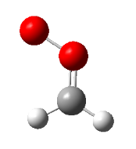
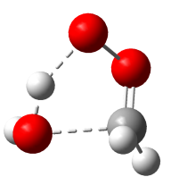

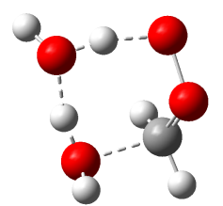
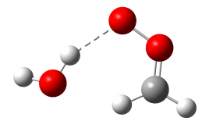
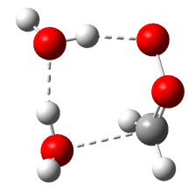
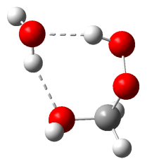
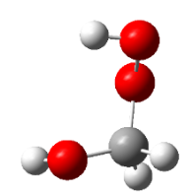


CH₂OO meets water
CH₂OO+H₂O
$$≈$$
CH₂OO+(H₂O)₂
2 paths
$$≈$$
4 paths
Infinitely separated reactants=0
QCISD(T)/CBS//B3LYP/6-311+G(2d,2p)

Slide 42
?
Upper limit
JPC Lett, 9, 184 (2018)
Lin & Chao, Chem. Soc. Rev., 46, 7483-7497 (2017)

Slide 43
The 3rd Example of H-bonded-cluster-assisted Reactions was observed.

Slide 44
Coauthors:
林妍秀、林維鴻、李鈺琳、高橋開人
Acknowledgements：
許家詮、張元賓
科技部、中央研究院

