Slide 1
Glow discharge & mean free path
氣體是絕緣體；
A glow discharge is a plasma (導電).
例：日光燈、省電燈泡、氖氣燈(demo)…
Wiki: The mean free path is the average distance traveled by a moving particle between successive impacts (collisions).

Slide 2
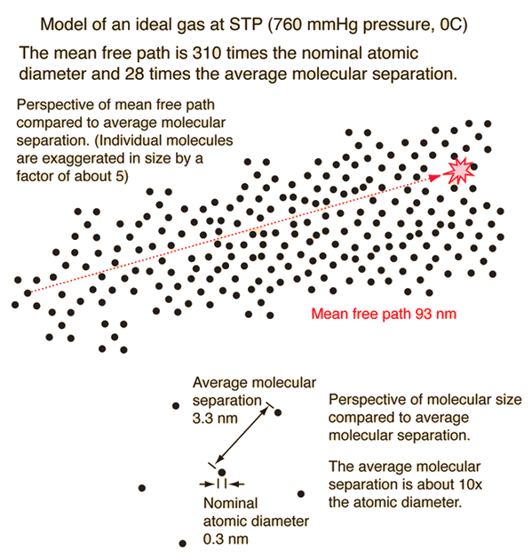
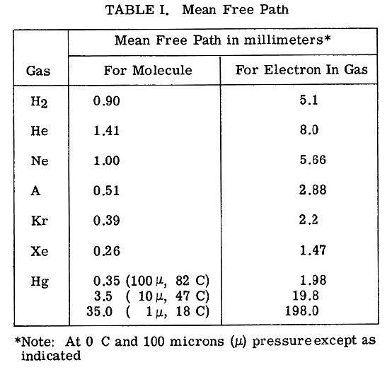
100 μ = 0.1 Torr
λ ∝ 1/P
H H Wittenberg
Electron Tube Design, RCA Electron Tube Division, 1962, pages 792 - 817.
http://hyperphysics.phy-astr.gsu.edu/hbase/Kinetic/menfre.html

Slide 3
Potential energy change (ΔU) of a charged particle (q) between two collisions (mean free path = λ) in electric field (E)
下樓梯
small λ
跳樓
big λ
λ ∝ 1/P
Using ΔU, a molecule (M) can be excited (M*) or ionized (M⁺).
Photon may be emitted from M*.
M + e⁻ + (~16 eV) → M⁺ + 2 e⁻ : charged particles: 1 => 3
M + e⁻ + (~9 eV) → M* + e⁻ ; M* → M + hν

Slide 4
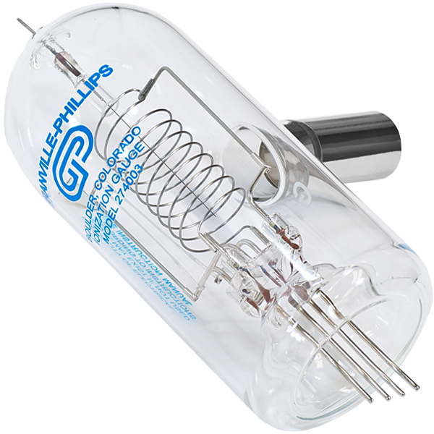
For the cylindrical electrodes,
E is higher at smaller radius (R), thus
ΔU = E λ is larger at smaller R.
E(R) ∝ R^{−n} , n = ? 1? or 2?
For exciting M to M*,
ΔU must be larger than a threshold value (ΔU_{min}),
ΔU = E(R) λ > ΔU_{min}; R has a limit value R_{lim}.
R_{lim} is smaller at smaller λ (higher P)
λ ∝ 1/P

Slide 6
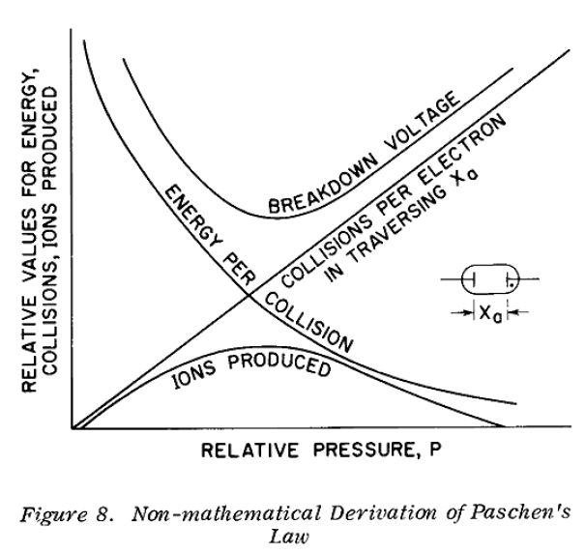
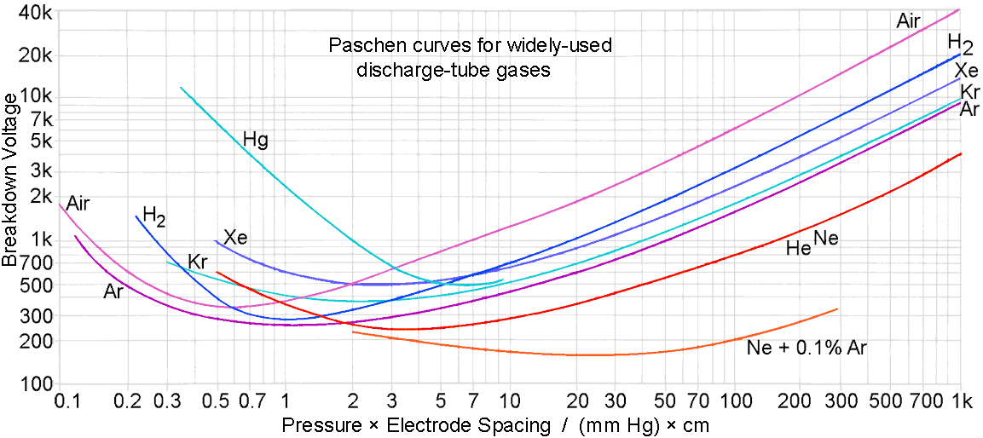
H H Wittenberg
Electron Tube Design, RCA Electron Tube Division, 1962, pages 792 - 817.
http://g3ynh.info/disch_tube/intro.html

