Slide 1
從玩中成長、自我學習、
到解決問題
林志民

Slide 2
個人年表
1985-1988: Hsinchu high school
1988-1992: Undergraduate Study
1992-1994: Master student
1994-1998: PhD student
1998-2001: Postdoc
2001- now: Research Fellow
1992.6-9: UC, Berkeley
(3 months)
1995.1-4: UC, Berkeley
(3 months)

Slide 3
1985−1988: Hsinchu high school
200 m x 5, 7, 9, ...
200 m x 30 = 6 km
250th/3000
攝影社：光學 暗房
曾以考試為樂
科展：數學
考大學?
數學 → 化學 → 物理化學

Slide 4
1988-1992: 化學系 清大 台大
English Text Book
Reading problem
NTHU to NTU
Laser spectroscopy
(~30 seminars)
1992. 6-9: UC Berkeley
Speaking problem

Slide 5
1992-1994: 化學碩士班 台大
高解析度光電子光譜儀 DIY
模仿
想像、(創造)
紮實的基本工夫
(3 months)

Slide 6
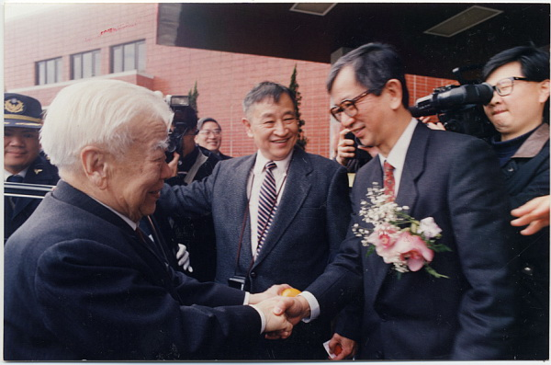
1994-1998: 化學博士班 台大

Slide 7
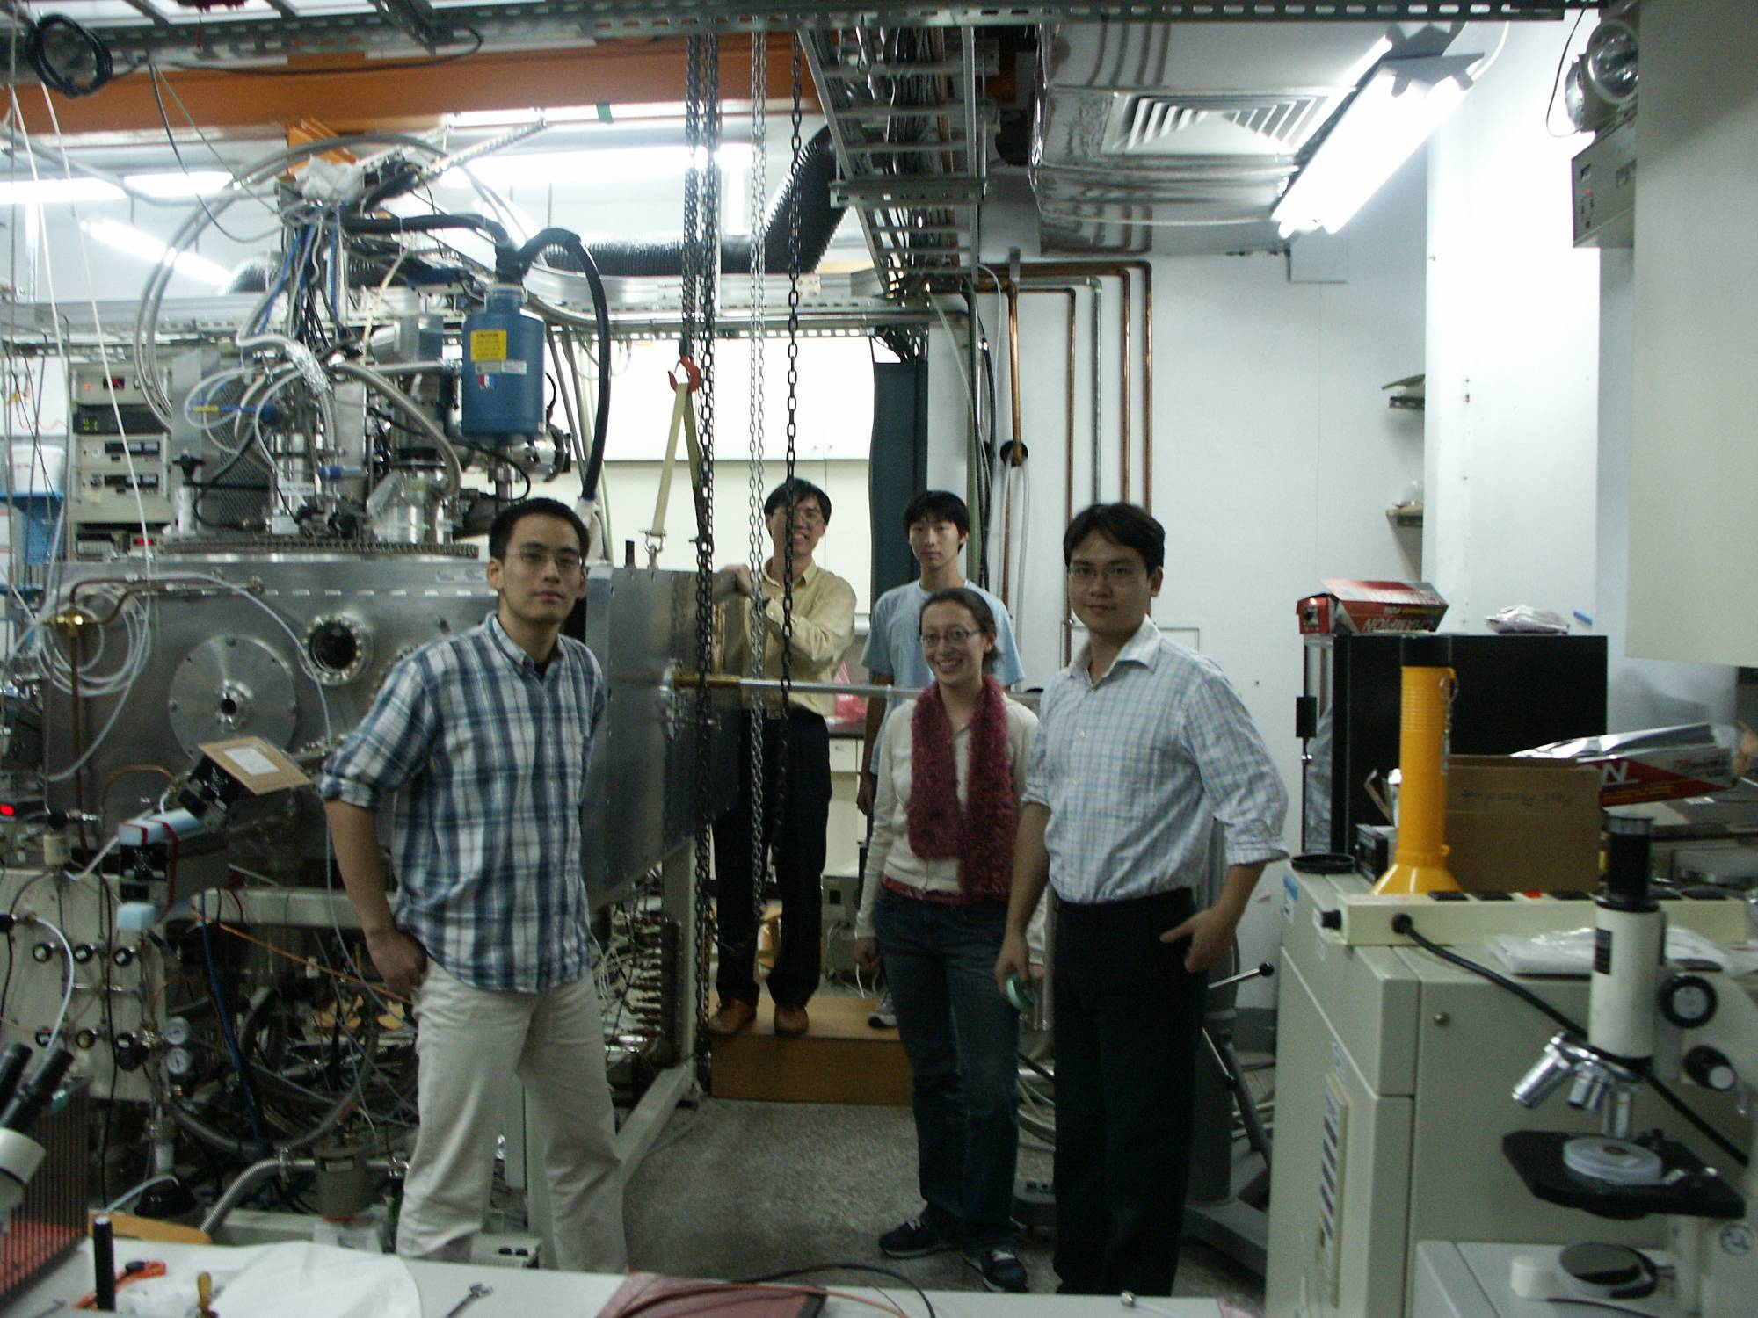

Slide 8
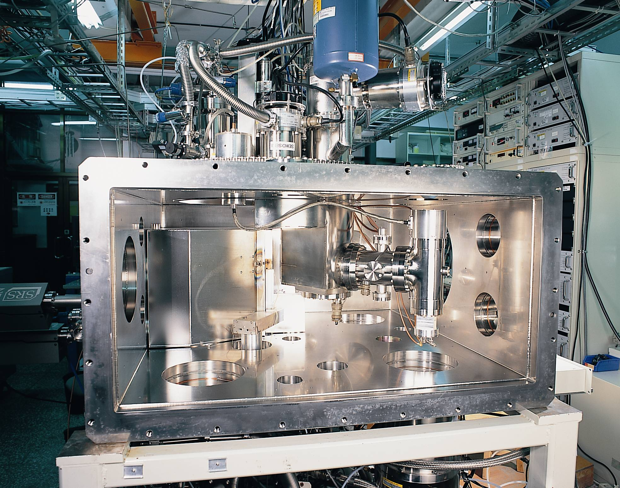

Slide 9
科學家的玩具
Most Latest!
Most Sophisticated!
You earn it by well playing with it.
latest = newest
sophisticated = clever in a complicated way
Making your own toys.

Slide 10
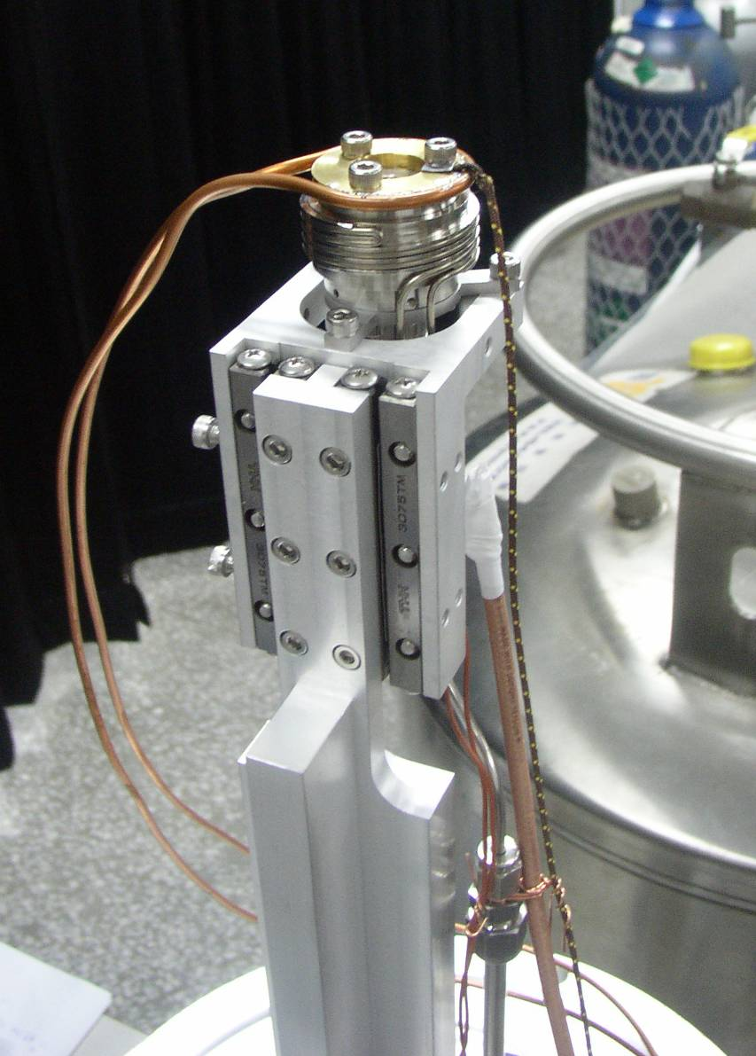
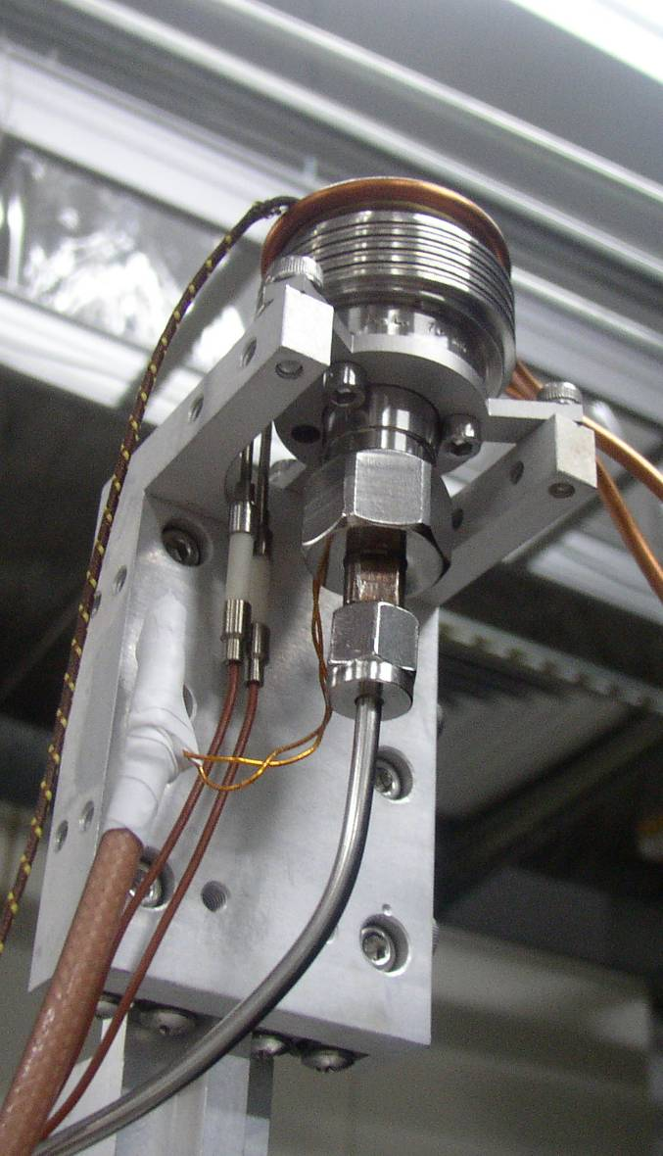
玩具
Picture of a pulsed valve

Slide 11
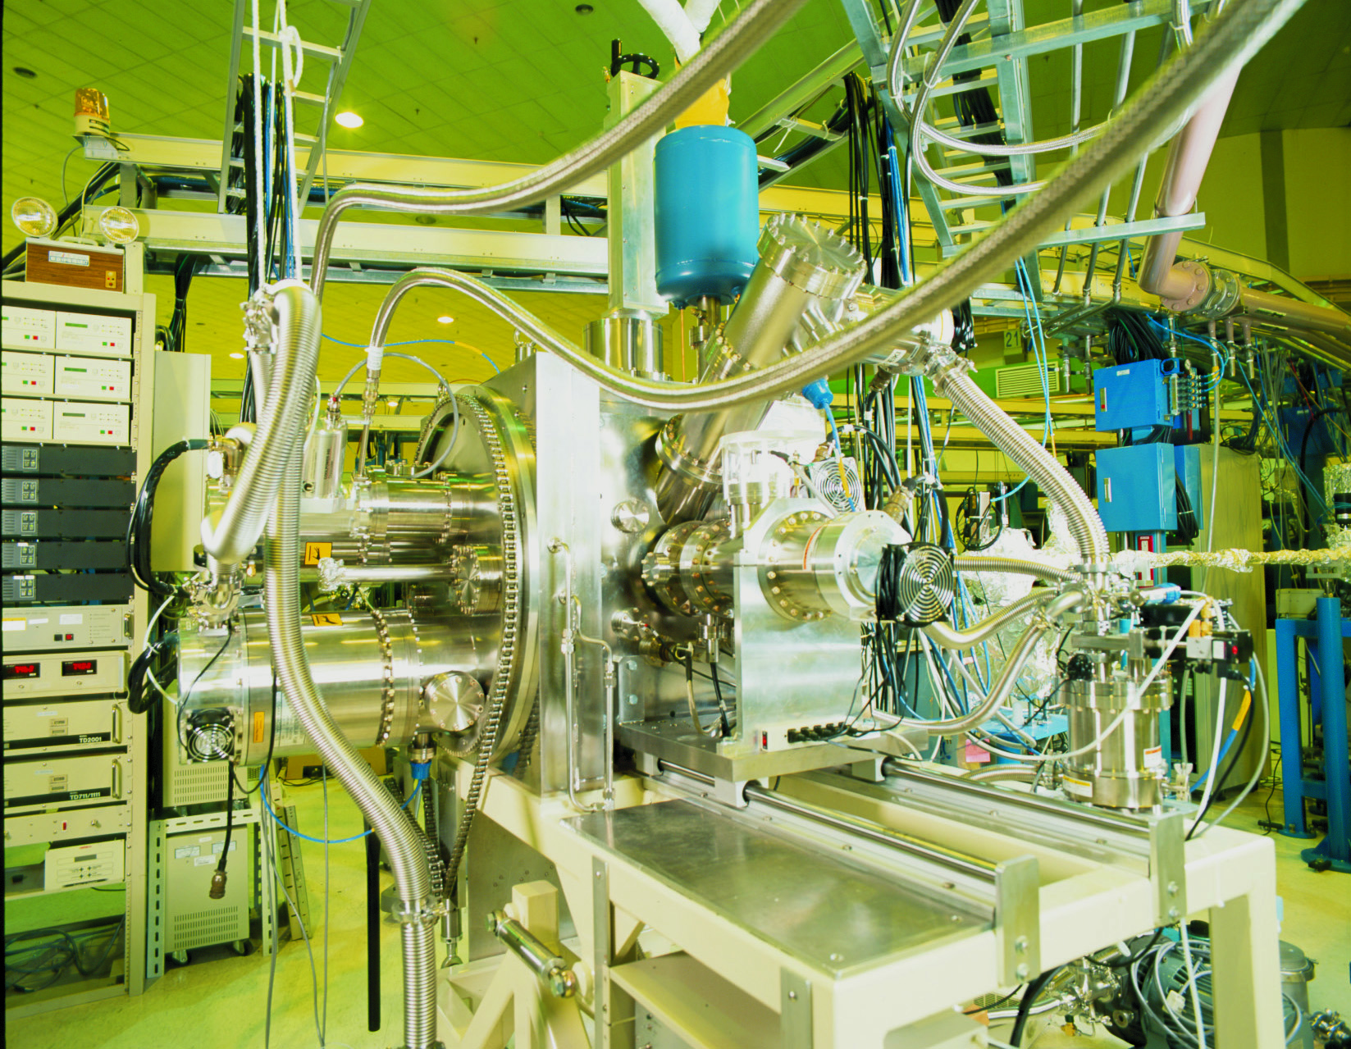
1998-2001: 博士後
不是愈大愈好

Slide 12
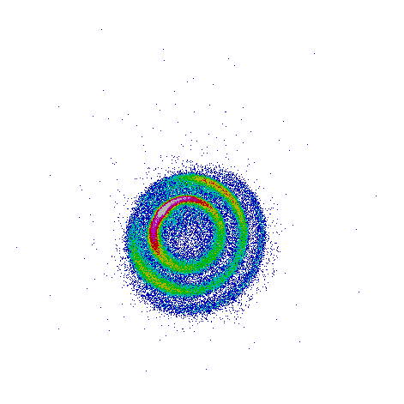
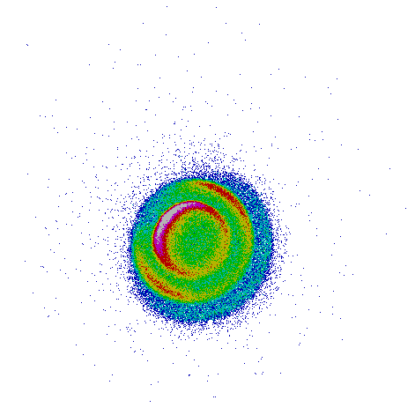
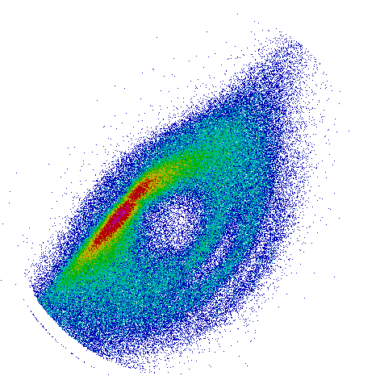
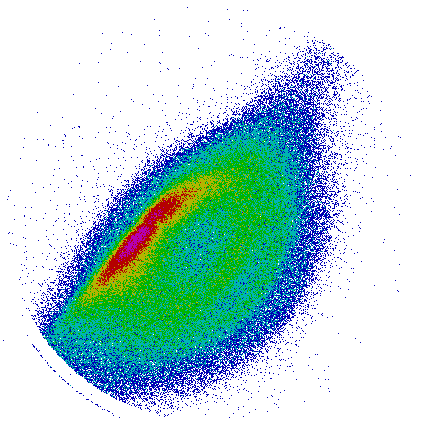
2001-2004: 助研究員

Slide 13
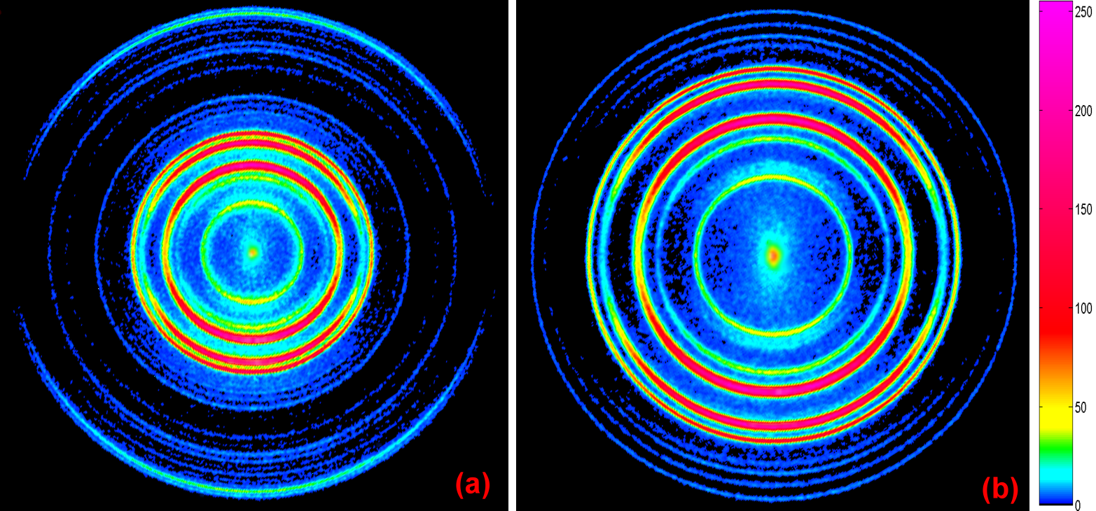
O₂ + 4hv (224.999 nm) O⁺ + O + e⁻
1.682X ion-optical zoom

Slide 14
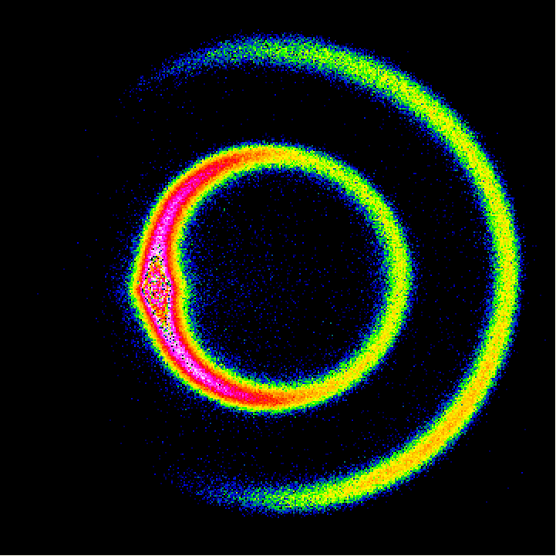
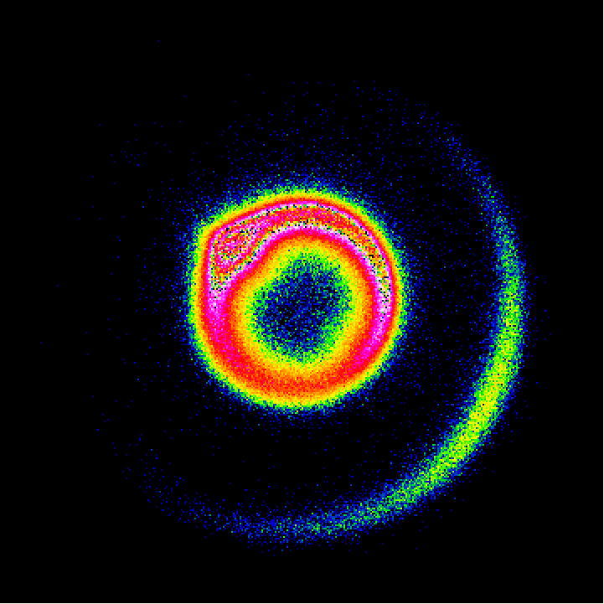
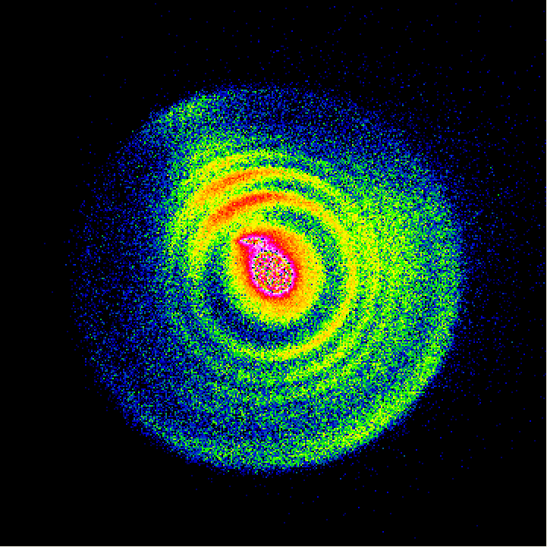
向自然學習
(分子密碼)
Dynamical Resonance in F + CH₄ → HF(v’, j’) + CH₃ (v = 0)
E_{C}=5.3 kcal/mol
2.7 kcal/mol
0.5 kcal/mol

Slide 15
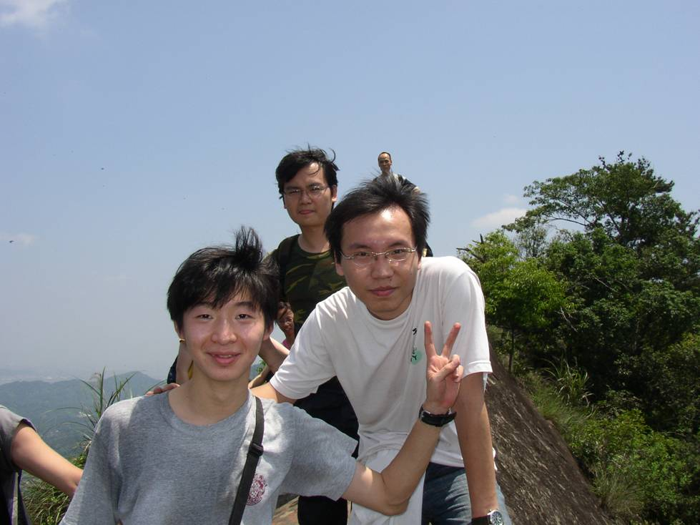
科學家的朋友
2004−2009: 副研究員
棋逢對手
無獨孤求敗之憾

Slide 16
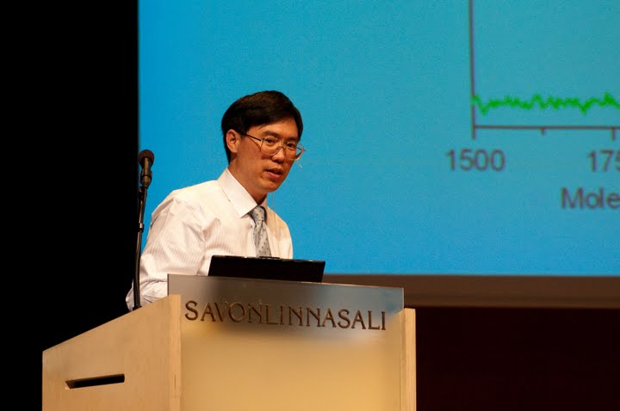
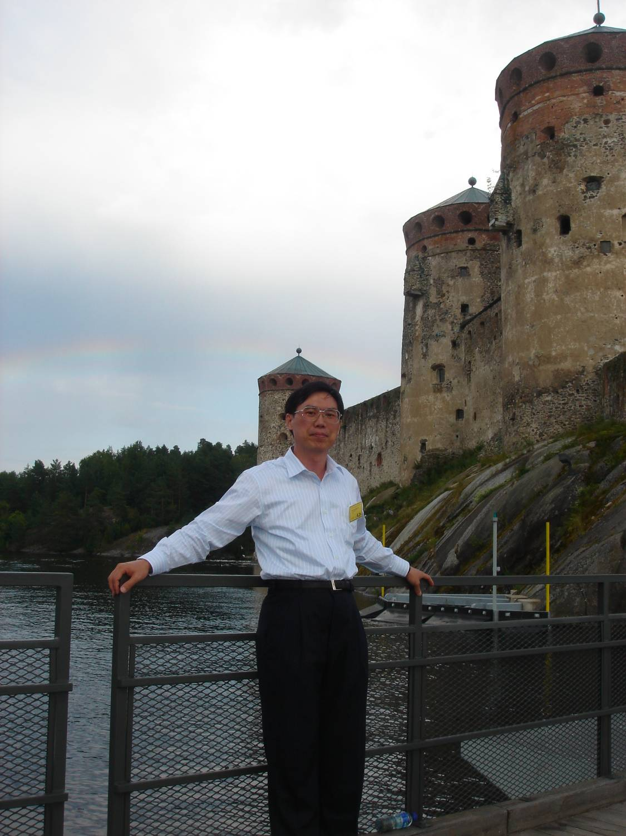
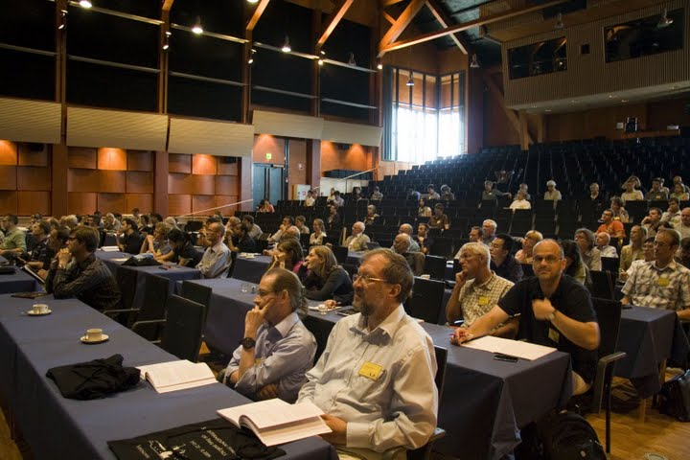
高手過招

Slide 17
研究科學的麻煩
與好玩
@台北市西湖國小

Slide 18
從事專業研究的麻煩
門檻高：
與聰明且努力的人競爭
需證明自己值得投資(納稅人出錢)
還好
很多聰明的科學家喜歡幫助別人

Slide 19
從事專業研究的麻煩
時間長：
每天12-14小時 每週6-7天 每年50-52週
每年超過 12 x 6 x 50 = 3600小時
如果
不覺得好玩的話，最好不要來
要學的東西又深又廣

Slide 20
從事專業研究的好玩
時間長： 整天都在玩
與聰明且努力的人一起玩
納稅人出錢買玩具
門檻高： 有成就感
難度無止境：不會無聊

Slide 21
從玩中成長、自我學習
成功和你想的不一樣
競爭和你想的不一樣

Slide 22
A fact that you need to know:
It is true that an old dog can’t learn new tricks.
It may be different for Homo sapiens.
You are here.
I am here.
Ability of learning new things
Age

Slide 23
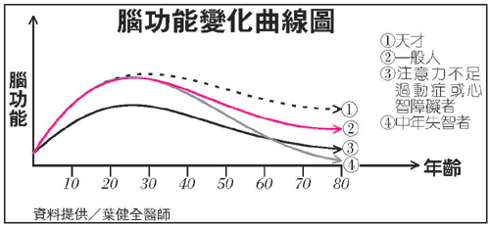

Slide 24

一本書上說，
至少投入10,000小時才能成功。

Slide 25
一萬小時定律
**只算真正認真的時間**

Slide 26
以一般人眼中的成功而言
American Thinking: $$$ = Success
若以一萬小時的無聊換成功，我寧可不要！
我會每天多努力幾小時，來換一萬小時的趣味。
⎯ Jim J. Lin
我的定義︰
成功是做有成就感的事
且得到社會的支持。

Slide 27
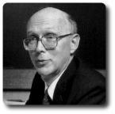
成功和你想的不一樣
It is about Competition.
You need some
unfair advantages.
競爭和你想的不一樣

Slide 28
除了豺狼的利齒外
還有什麼能磨出羚羊的健肢
除了恐懼 還有什麼能使鳥長翅
除了飢餓 還有什麼能賦予蒼鷹以利眼
世界之寶 來自暴行
Robinson Jeffers 美國詩人
It is about Competition. 競爭

Slide 29
But, 人類社會不一樣
about the Unfair Advantages of Myself
or of Yourself
.
.
.
.
.
.

Slide 30
Fun & Time
Love Science & Scientific Thinking
Focus (Do one thing in a period of time)
Good Advisers
Suitable Environment
Not trapped in what I can’t do well
Confident
Smart, but not very smart
Support from family
Importance

Slide 31
The cure for boredom is curiosity.
There is no cure for curiosity.
⎯ Dorothy Parker

Slide 32

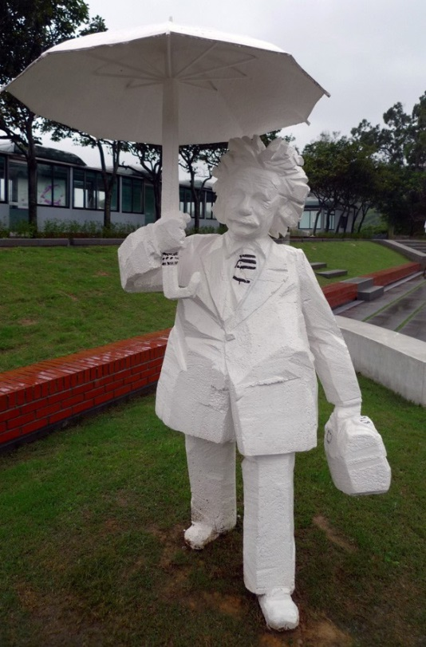
< 1%
Job market concerns
Fun
Parents’ influences
Information
Different life style
Achievements
Higher risk?
Brain power
Longer life?
子非魚焉知魚之樂

Slide 33
To survive, live, and have fun in a scientific JUNGLE.
在科學叢林中生存、生活、及生趣
Jungle Vs. Civilization
A high school student said:
做實驗時，會與不會的差別太明顯了，
一點也無法掩飾!
Jungle Rule:
弱肉強食 適者生存

Slide 34
基礎研究之出路與退路
Don’t isolate yourself, unless you are Einstein.
interests, abilities, visions
專注 ≠ 狹隘
吾少也賤，故多能鄙事
某師曰：其生僅不能二事 …

Slide 36
Learning Barriers
Fun
Difficulty
成功攀岩:
找著力點

Slide 37
Barriers that I have encountered:
Undergraduate: 1st barrier: Text books are in English.
2ed: Seminars are not understandable.
3rd: Instruments are complicated.
Exchange Student: English is harder when listening.
Master: Building instruments
PhD: Building a lab
Research Fellow: to Find a topic (interesting & doable)
to Teach students
(learning but not scaring)

Slide 38
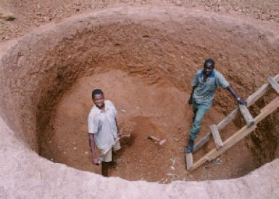
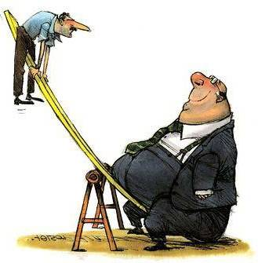
Tricks to survive:
Learn fast, steady.
Don’t give up too fast.
自發學習
Tricks to live:
Broad interests
Focused efforts
為了要深入而廣博
Tricks to have fun:
Interest, Ability, Communicate

Slide 39

憂國憂民或思考科學
不傷胃
憂慮自己又不運動
會得胃潰瘍
Don’t Worry,
Be !
running

Slide 40
During my career:
What I enjoy most:
解決問題 problem solving
明白事物的道理(自然律是不變的且有跡可循)
見識 vision
What I did not enjoy:
(Personally)
寫作、講英文
Typing, computer programming

Slide 41
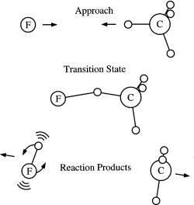

Slide 42

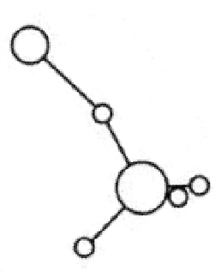
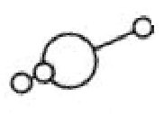
Time delay of the short-lived collision complex
Forward peaking product

Slide 43
North pole
South pole
from Manney et al, Nature 2011

Slide 44
Ozone mass: (3.0−3.3) ×10¹² kg
Air mass: 5.1×10¹⁸ kg
World population: 7×10⁹ person

Slide 45
Simulations under conditions of Polar Stratosphere
Frieler et al. Geophys. Res. Lett., 33, L10812 (2006).
ClO + ClO cycle
(blue)
ClO + O cycle
(red)
HOCl cycle (orange)
BrO + ClO cycle
(gray)
(20~22 km)
Notes:
Most important but large error bar

Slide 46
Catalytic Cycles of Ozone Depletion
ppb of ClO_{x} can destroy ppm of O₃
ClOOCl cycle
50-70%
ClO-BrO cycle

Slide 47
Horizontal Cut View of the Crossed Beam Chamber at R410, IAMS
C₂H₄
F₂

Slide 48

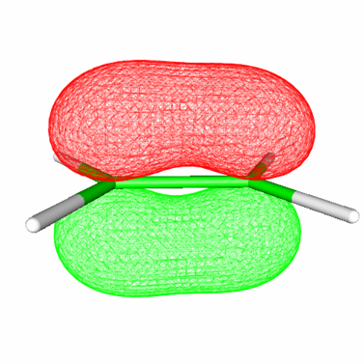
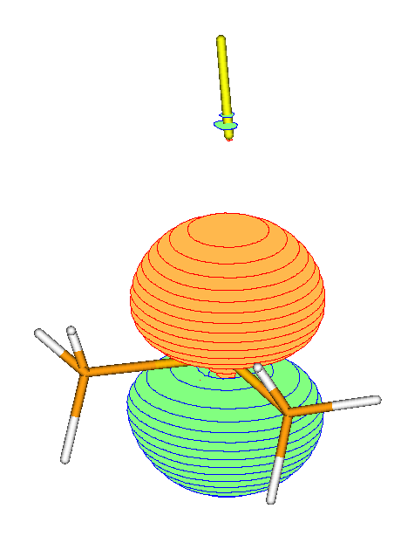
Two types of M-M Reactions investigated:
F₂ + C₂H₄
F₂ + (CH₃)₂S
J. Chem. Phys. 128, 184302 (2008).
J. Chem. Phys. 127, 101101 (2007)
J. Chem. Phys. 128, 104317 (2008)
F₂ + C₃H₆
F₂ + CH₃SSCH₃
J. Phys. Chem. A, 113, 4381 (2009).
J. Chem. Phys. 130, 014301 (2009)

Slide 49
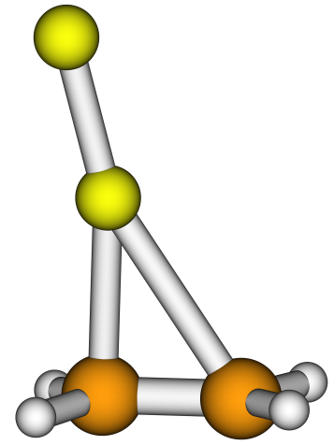
F₂ + C₂H₄
→ F + C₂H₄F
F₂ + C₃H₆
→ F + C₃H₆F
5.5±0.5 kcal/mol
2.4 ± 0.3 kcal/mol

Slide 50
F₂ + C₂H₄ → F + C₂H₄F

Slide 51

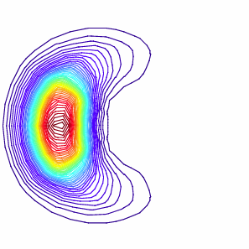
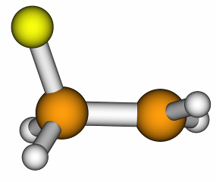
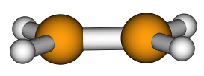
F +
F₂ +
backward
+

Slide 52
F₂ + (CH₃)₂S → Products
Negative activation energy; Negative temperature dependence
fast
slow
attractive region

Slide 53
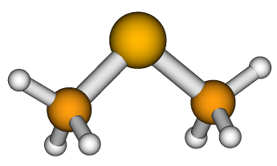
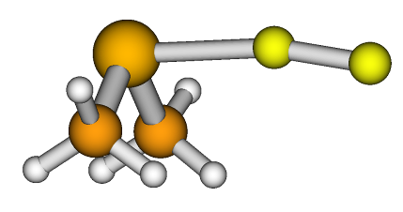
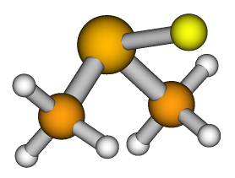
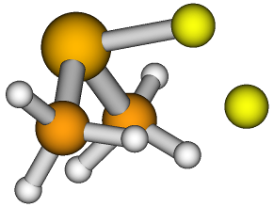
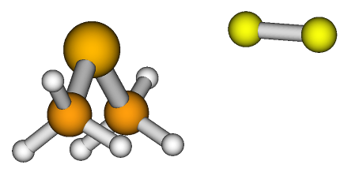
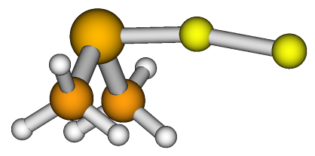
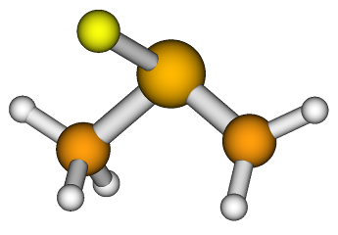
Relative Energy in kcal/mol
3.4 kcal/mol
+ F
F₂+
0.0
TS1 ≲ -2.5
TS2
VDW
INT (-12)
+ HF
-80.1
Geometry: CAS-PT2 /cc-pVDZ (C,H); cc-pV(T+d)Z (S); aug-cc-pVTZ (F)
CCSD(T) & CAS-PT2 / Complete Basis Set Extrapolation for S, F.

Slide 54
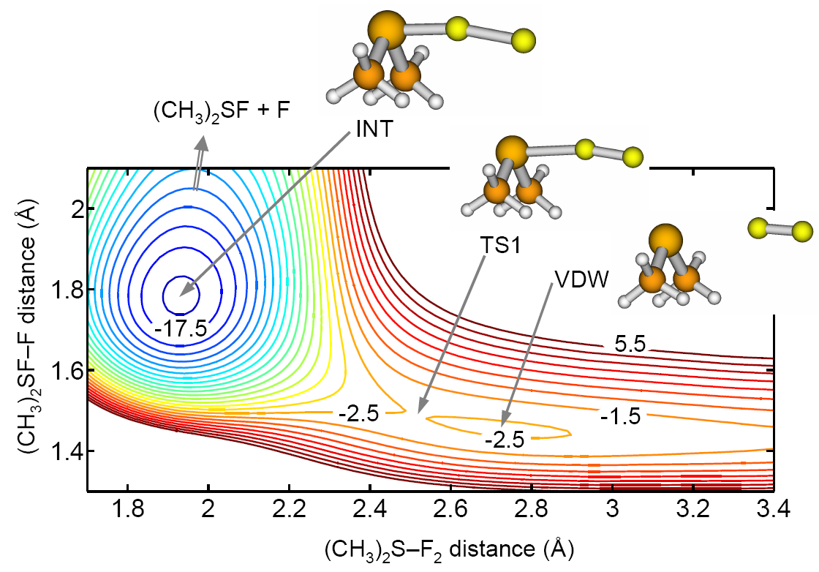
2-D PES

Slide 55
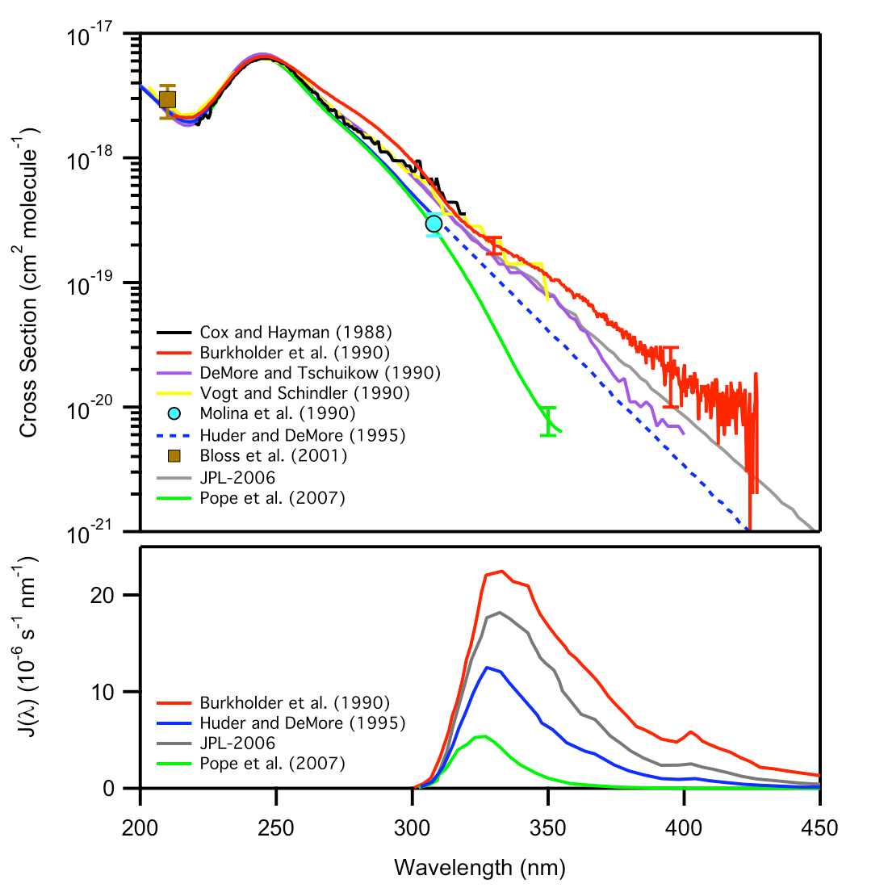
10 X
2007
1990
Only the highest two can explain the observed ozone loss!
J(λ) = I(λ) σ(λ) φ(λ)
Evaluated
1995
2007

Slide 56
Cross Section at 330 nm
Bing Jin, et al.
J. Phys. Chem. A (Articles ASAP January 19, 2010
DOI: 10.1021/jp909374k).

Slide 58
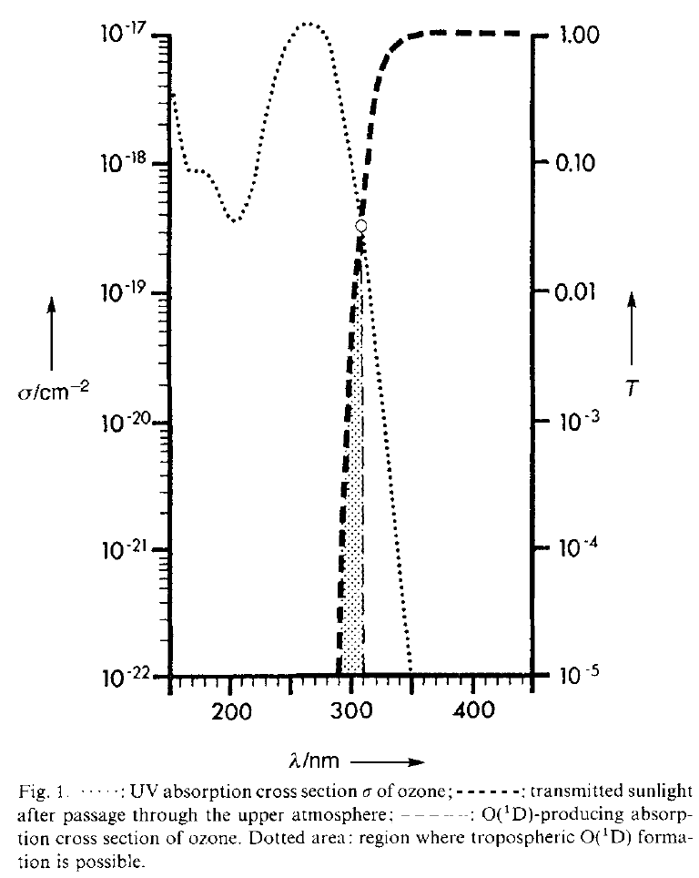
VUV
UV-B
Ozone is Important in Protecting the Biosphere, e.g.,
UV is important in
Vitamin D synthesis
DNA damage, …
Sunlight
Transmission
O₃
Abs
Figure is from
Notes:
O2 abs; Biological impacts

