Slide 1
解決臭氧洞形成
之爭議
林志民
中央研究院原子與分子科學研究所
國立台灣大學化學系(合聘)

Slide 2
中央研究院
原子與分子科學研究所
Institute of Atomic and Molecular Sciences
I A M S

Slide 3
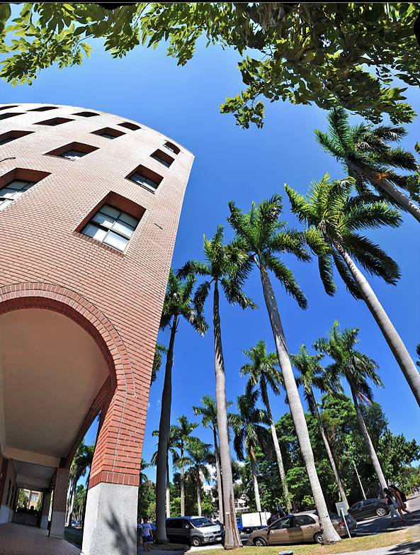
IAMS
I AM Smart.
台北市羅斯福路四段一號

Slide 4
E= hv
= hc/λ
UV is important in Vitamin D synthesis, DNA damage, …
光子能量
化學鍵強度
kcal/mol
UV-B
UV-C
UV-A
波長, nm

Slide 5
Cross Section
A physical quantity in terms of area to describe the average Strength of Interaction between the particles of interest.

Slide 6
光被分子吸收的機率
(截面積) (濃度) (光徑長度)

Slide 7
Demo (Fluorescent Dye)
100%*0.99=99%
99%*0.99=98.01%
98.01%*0.99=97.03%
97.03%*0.99=96.06%
0.99^10=90.4%
0.99^20=81.8%
0.99^40=66.9%
0.99^80=44.8%
0.99^160=20.0%

Slide 8
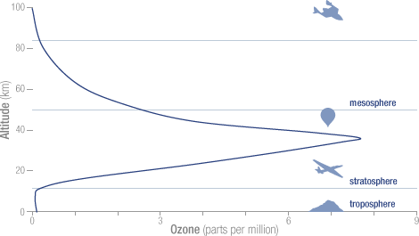
高度
臭氧濃度

Slide 9
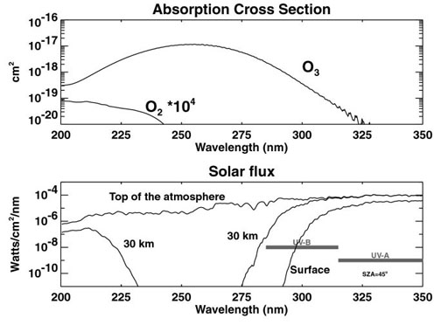
臭氧吸收
陽光強度
UV-B
UV-A

Slide 10
臭氧層吸收了陽光中波長在300奈米以下的紫外光
如果臭氧層變稀薄
陽光中UV-B (290−320奈米) 波段增強
破壞生物圈 (DNA 破壞, …)

Slide 11
陽光強度
臭氧吸收

Slide 12
SPF : block UV-B (sun burn)
PA : block UV-A (darkening, aging)

Slide 13
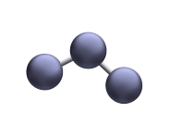
O + O₂ → O₃
O₃ + hv → O + O₂
Net: hv → heat
光
熱

Slide 14
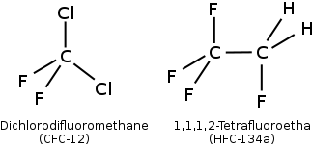
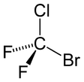
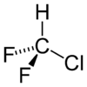
CFC
=Chloro Fluoro Carbon
Lifetime (τ) in atmosphere
τ = 100 yr
氟 氯 碳 化合物
τ = 10 yr
海龍
Halon 1211
HCFC-22,

Slide 15
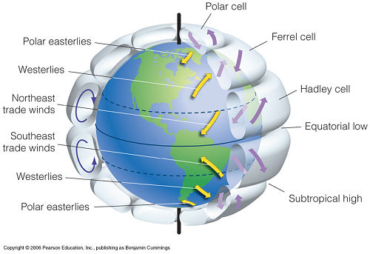
CFC 穩定、無毒、不燃、長壽
廣泛用於冷媒、發泡劑、推進劑、溶劑等
到處飄
飄的又高又遠!

Slide 16
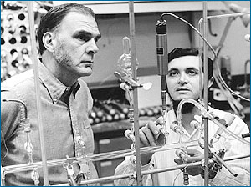
CCl_{x}F_{y} + hν → Cl
Cl + O₃ → ClO + O₂
Nature 249, 810 - 812 (28 June 1974)
Mario J. Molina & F. S. Rowland
Chlorofluoromethanes are being added to the environment in steadily increasing amounts.
These compounds are chemically inert and may remain in the atmosphere for 40−150 years,
and concentrations can be expected to reach 10 to 30 times present levels. Photodissociation of the Chlorofluoromethanes in the stratosphere produces significant amounts of chlorine atoms, and leads to the destruction of atmospheric ozone.

Slide 17
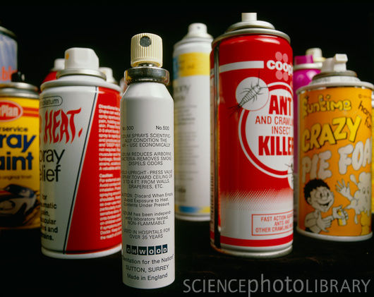

6×10⁹ cans/year @1974
35 cans/US house
CFC
inside

Slide 18

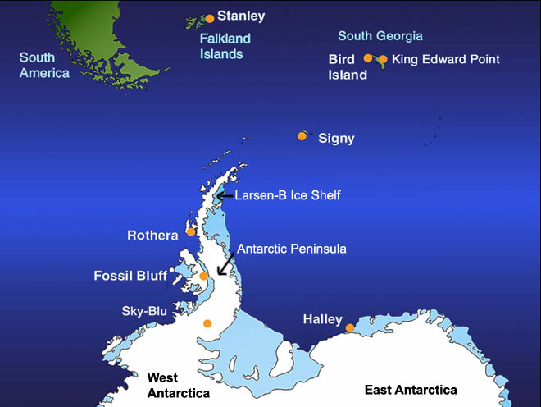
1985 Farman et al.
臭氧濃度
CFC
濃度
CF₂Cl₂
CFCl₃

Slide 19
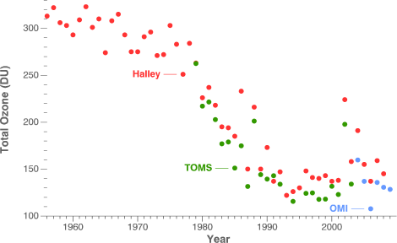

1985 Farman et al.
140,000 readings per day
http://ozonewatch.gsfc.nasa.gov/facts/history.html

Slide 20
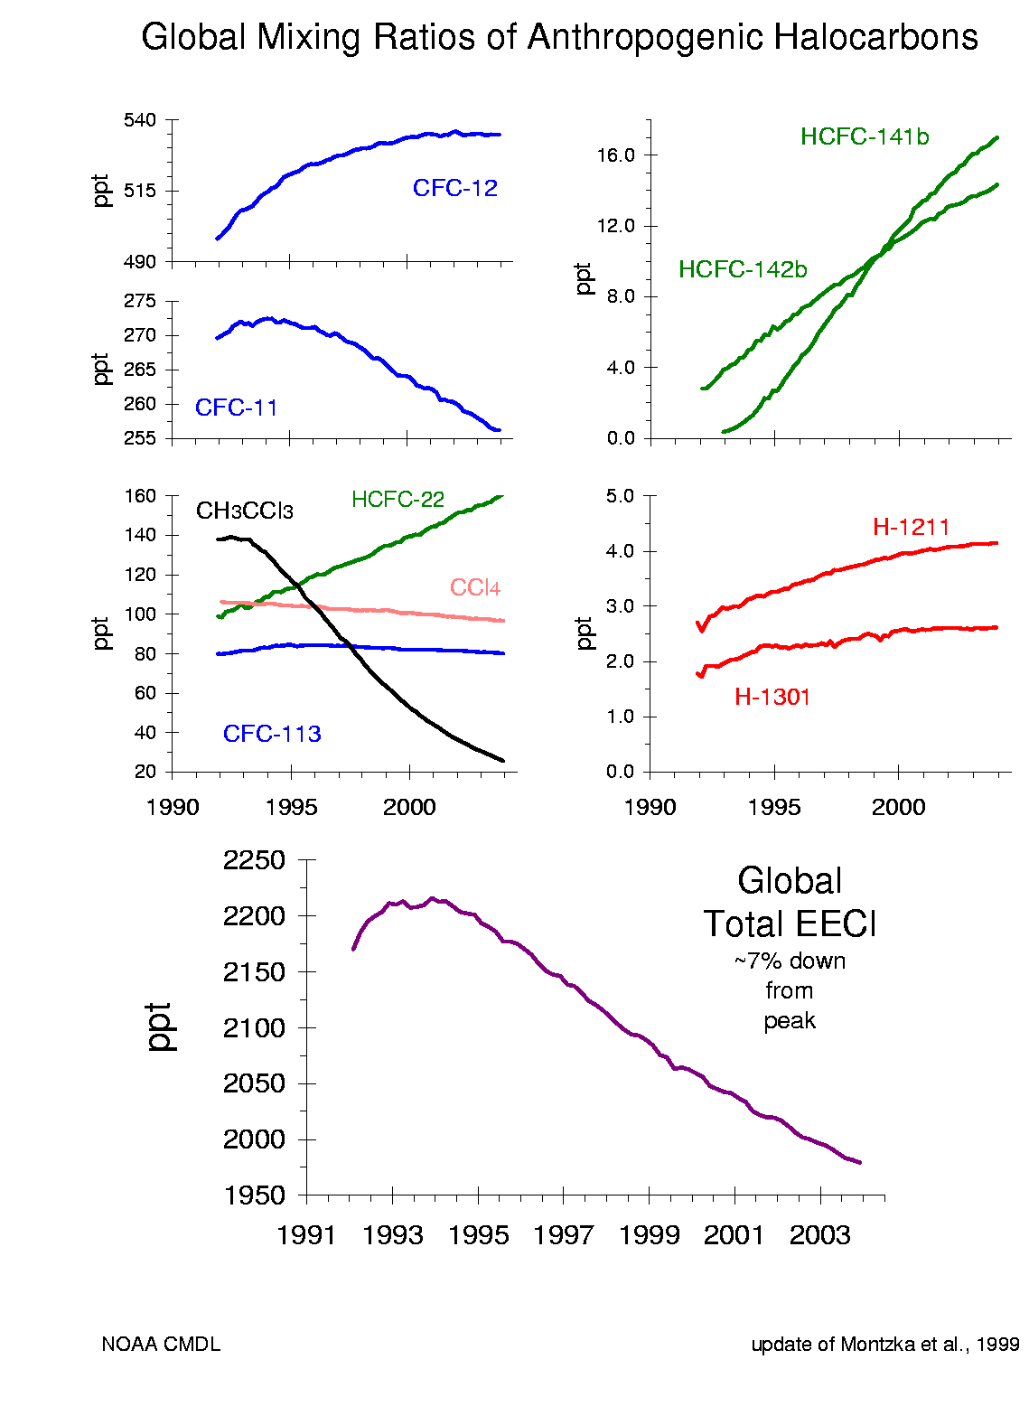
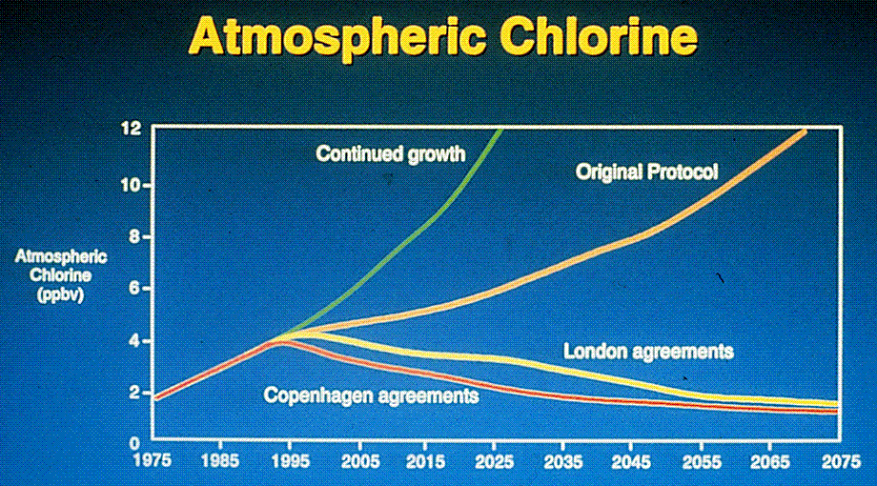
Montreal Protocol (1987- )
蒙特婁公約
⎯史上大規模環保問題最重要的例子之一，其重要性僅次於全球暖化。
Measured
Cl + O₃ → ClO + O₂
10%
Wiki

Slide 21
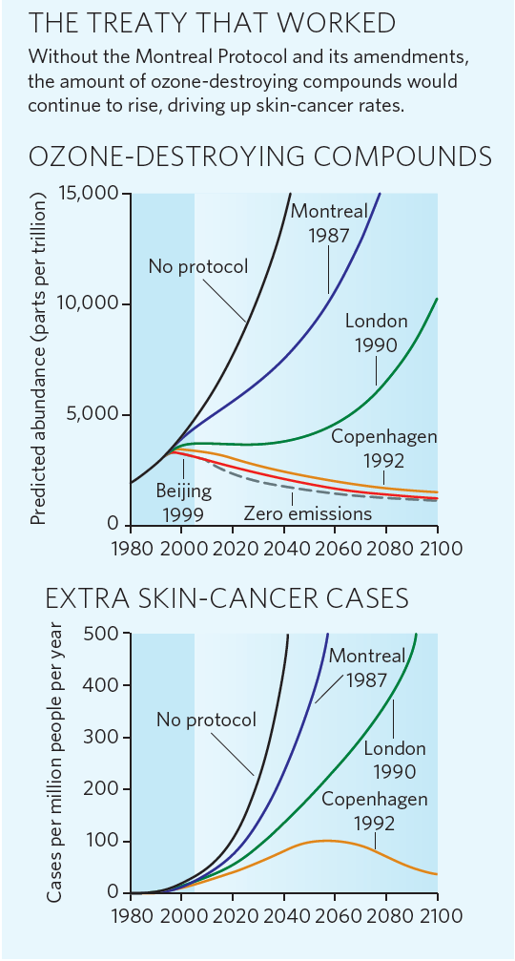
聯合國世界氣候組織資料
World Meteorological Organization (WMO) and United Nations Environment Programme, Adapted from Nature 460, 792-795 (2009)

Slide 22
τ = 10年
HCFC-22,
τ = 100年
海龍
Halon 1211

Slide 23
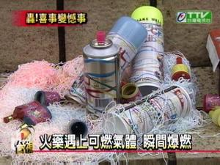
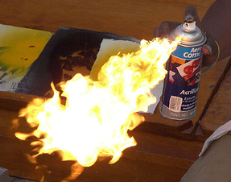
CFC 穩定、無毒、不燃、長壽
CFC 禁用後遺症
C₃H₈ C₄H₁₀

Slide 24
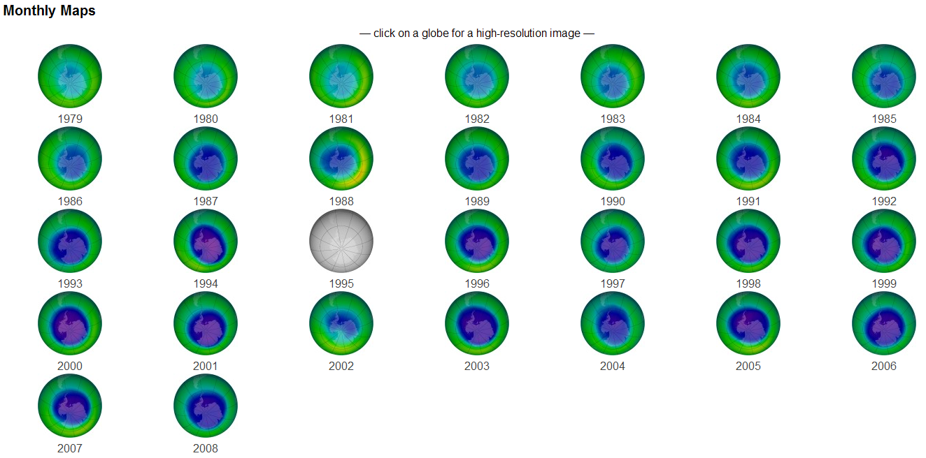

Septembers
NASA/Ozone Hole Watch

Slide 25
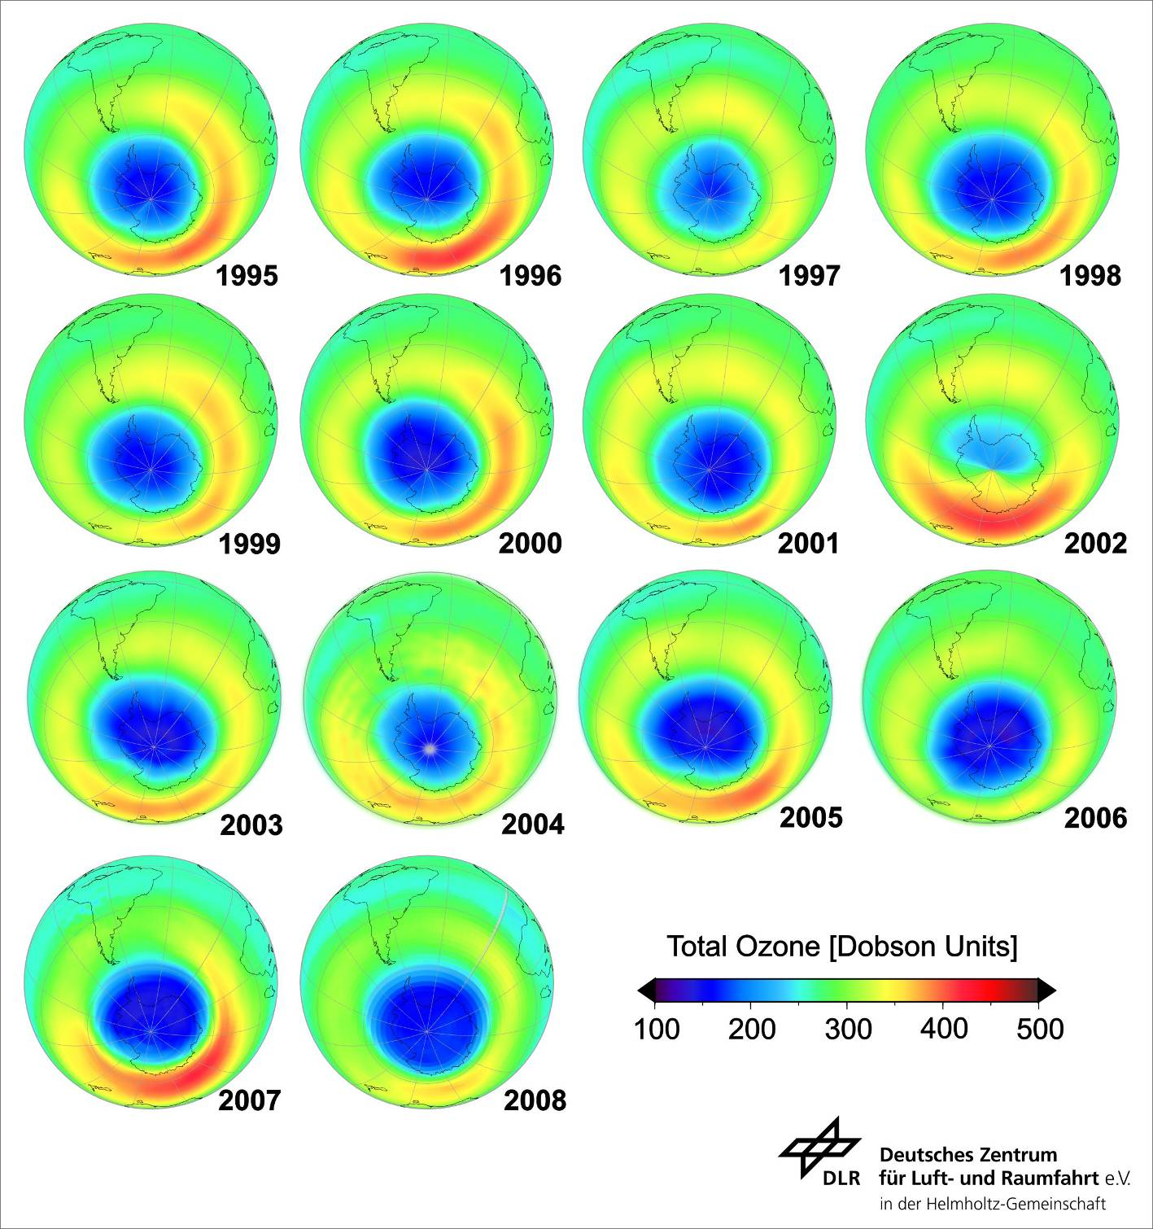

Slide 26
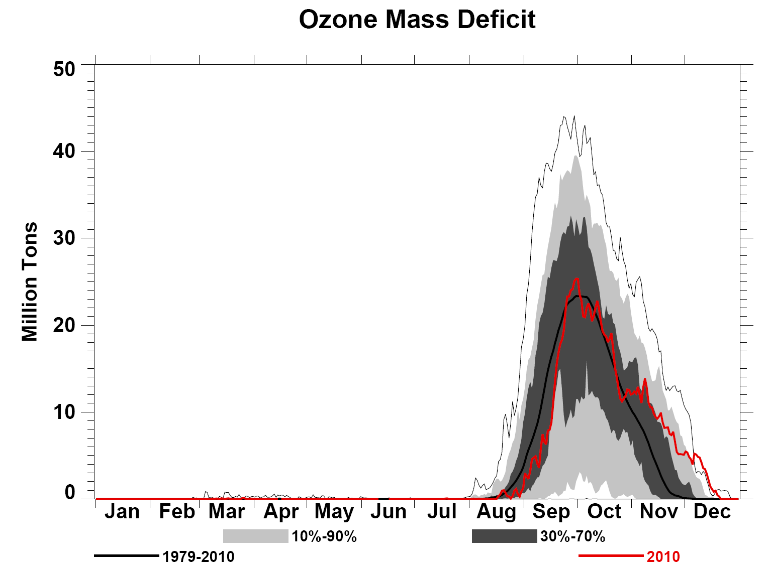
額外損失的臭氧
春
Summer
秋
夏
冬
(totally dark)
NASA

Slide 28
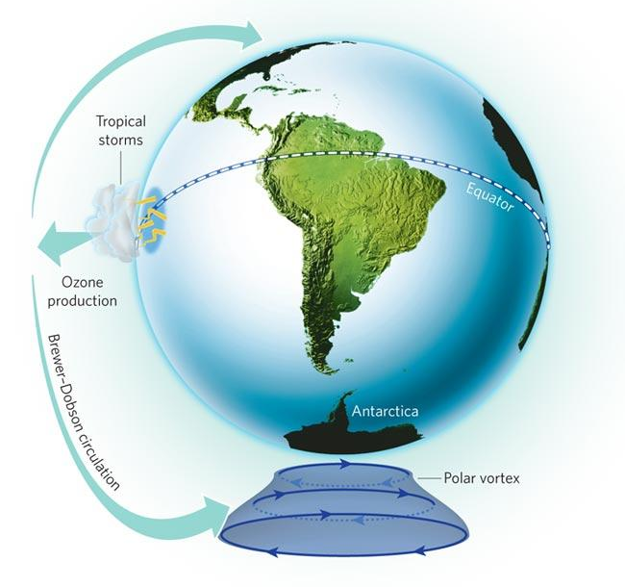
極區氣旋
Nature 460, 792-795

Slide 29
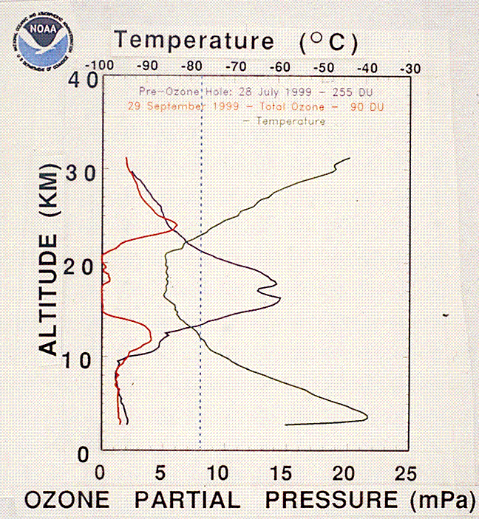
溫度
正常
Balloon-measured ozone over South Pole, Jul. 28 and Sep. 29, 1999. (Source: NCSE)

Slide 30
Why above 南極洲?
極區氣旋
低溫
半年長的白天、黑夜
…

Slide 31
Cl + O₃ → ClO + O₂
~ ppb
~ ppm
1 : 1000

Slide 32
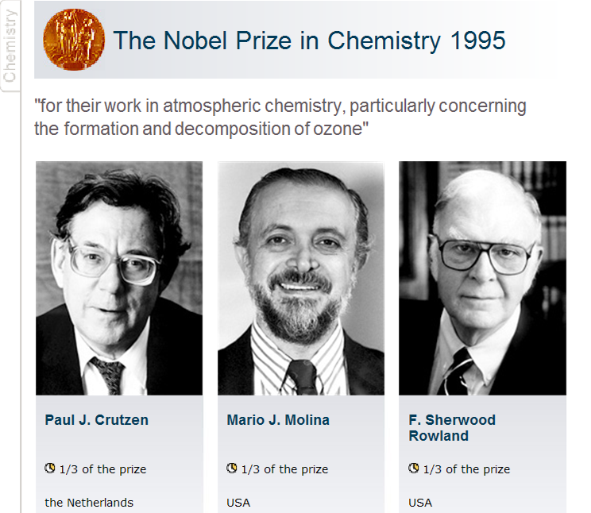

Slide 33
根據WMO (聯合國世界氣候組織 World Meteorological Organization, United Nation) 2006年的報告，科學家對臭氧洞的成因已有相當程度的瞭解。
科學家認為過氧化氯循環，是臭氧洞形成的主要貢獻
O₂
hν (陽光)
CF_{x}Cl_{y}
hν (陽光)
2 Cl
ClOOCl
2 O₃
低溫
高溫
2 O₂
2 ClO

Slide 34
但是過氧化氯光分解速率之誤差高達 2 倍!
O₂
hν (陽光)
2 Cl
ClOOCl

Slide 35
ClOOCl吸收
陽光強度

Slide 36
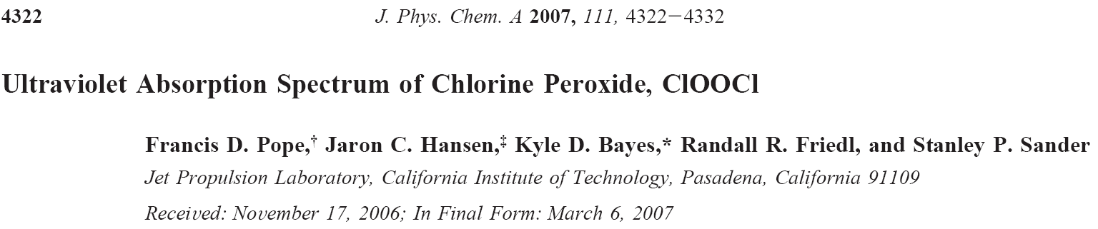
2007
J. Phys. Chem. A 2007, 111, 4322
2007年五月
美國噴射推進實驗室 波普博士
(Dr. F. D. Pope)等人所發表的
過氧化氯分子吸收陽光的截面積，比先前學界接受的值小了近十倍
ClOOCl + hv → 2Cl + O₂
光分解變慢甚多
無法解釋臭氧洞的形成

Slide 37
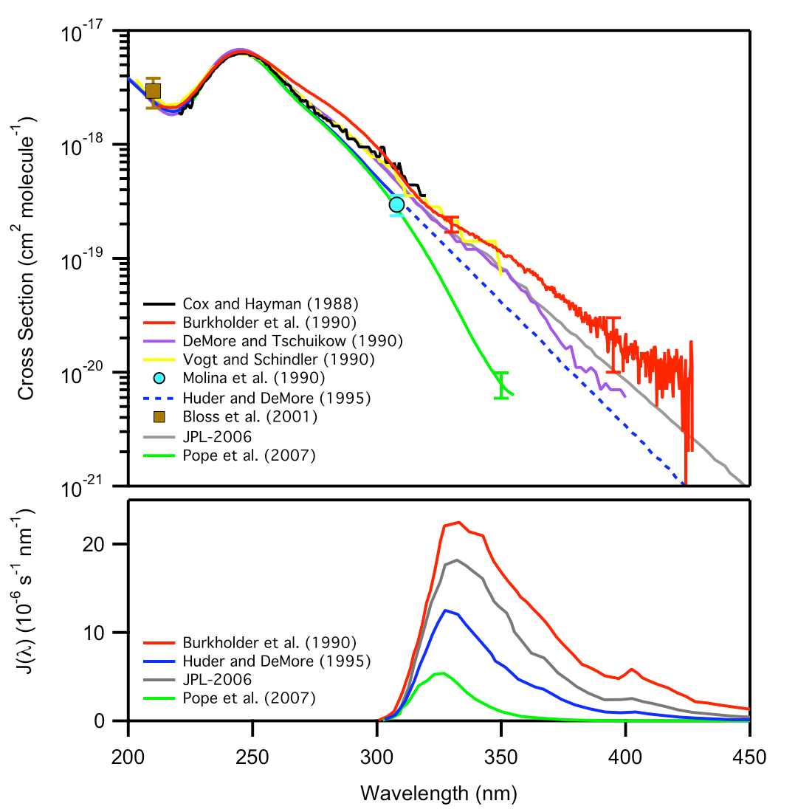
10 X
2007
1990
Only the highest two can explain the observed ozone loss!
J(λ) = I(λ) σ(λ) φ(λ)
Evaluated
1995
2007

Slide 38
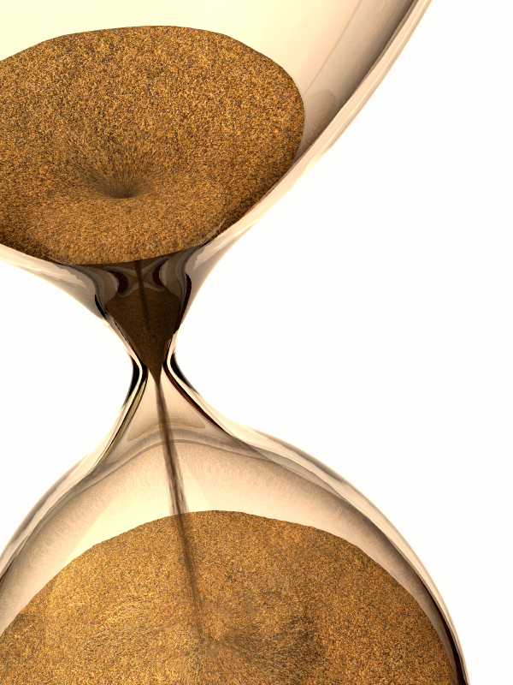
O₂
hν
2 Cl
ClOOCl
2 O₃
2 O₂
2 ClO

Slide 39
Nature, 449, 382 (Sep. 2007)
(Pope et al. J Phys Chem A, May 2007)
(Mechanisms of Ozone Hole formation)

Slide 40
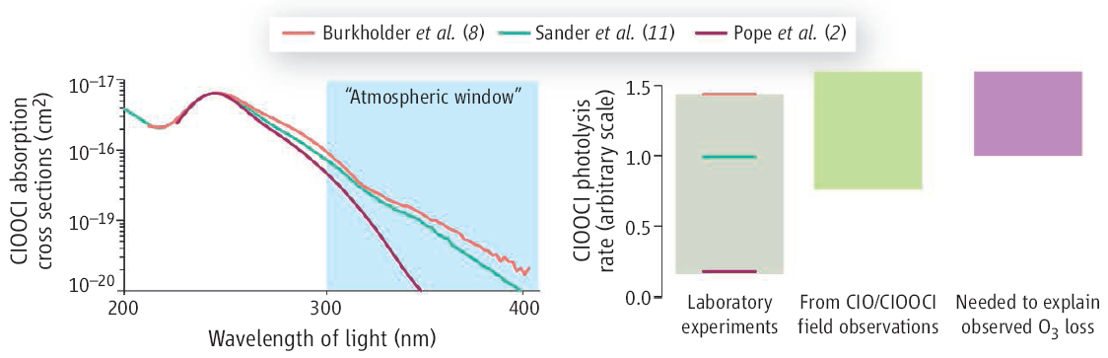
Science, 318, 1878 (Dec. 2007)
New laboratory data (Pope et al. J Phys Chem A, 2007) imply unknown mechanisms in the formation of the ozone hole, but it is too soon to …
1990
(2006)
2007

Slide 41
Experimental Groups working on this issue:
NOAA Earth System Research Laboratory in Boulder, Colorado, USA
Research Center, Juelich and University of Wuppertal, Germany
Harvard University, USA
University of Cambridge, UK
IAMS, Taiwan 中央研究院原分所

Slide 42
純的ClOOCl 無法製備
hv
I₀
Absorption cell
hv
I
[ClOOCl], [Cl₂], [O₂], [Cl₂O], …
ClOOCl + hv → 2Cl + O₂
Cl₂ + hv → 2Cl
Cl₂O + hv → Cl + ClO

Slide 43
Why so large discrepancies?
But c₁, c₂, … cannot be accurately known.

Slide 44
But c₁, c₂, … cannot be accurately known.
σ(Cl₂)
Pope et al. 2007

Slide 45
怎麼辦?
我們能做什麼?

Slide 46
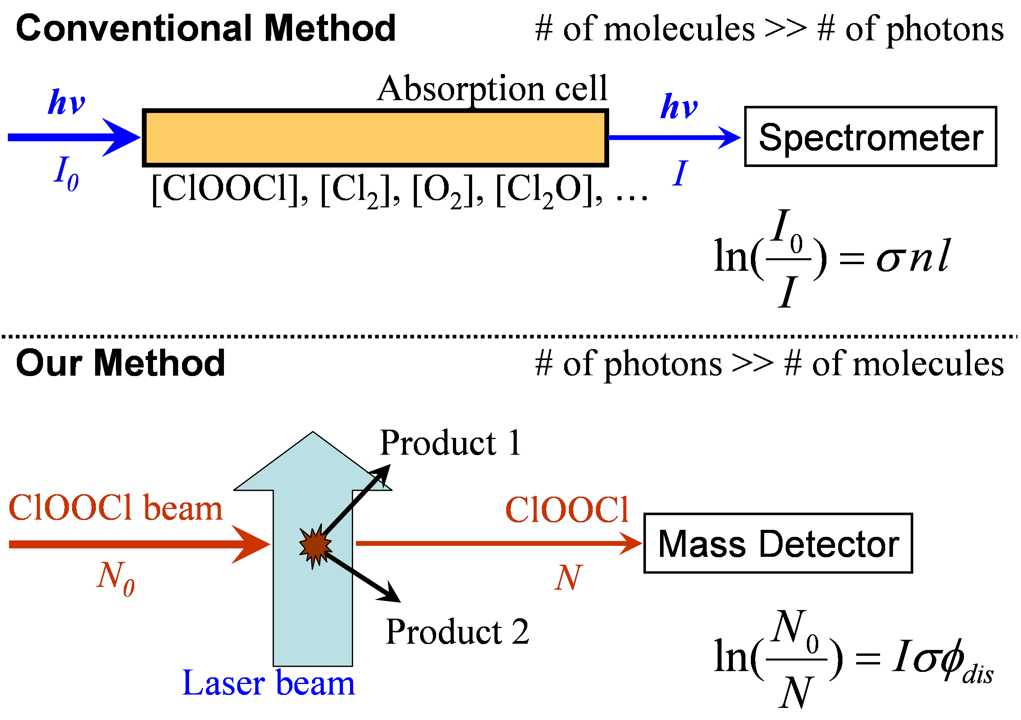

Slide 47
Mass spectrum of our sample
質量

Slide 48
Cl₂ + hν → 2 Cl Cl + O₃ → ClO + O₂
ClO + ClO ↔ ClOOCl
ClOOCl_{(g)} ↔ ClOOCl_{(s)}

Slide 49
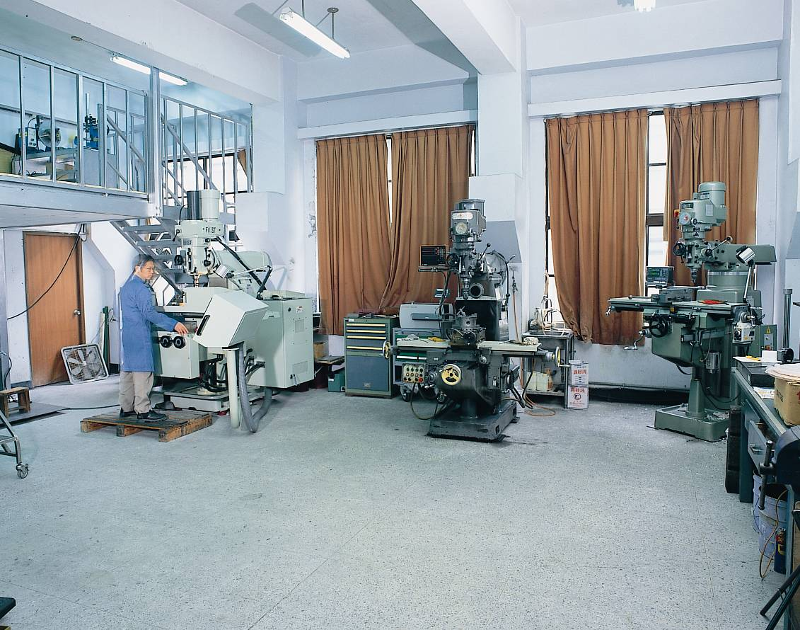
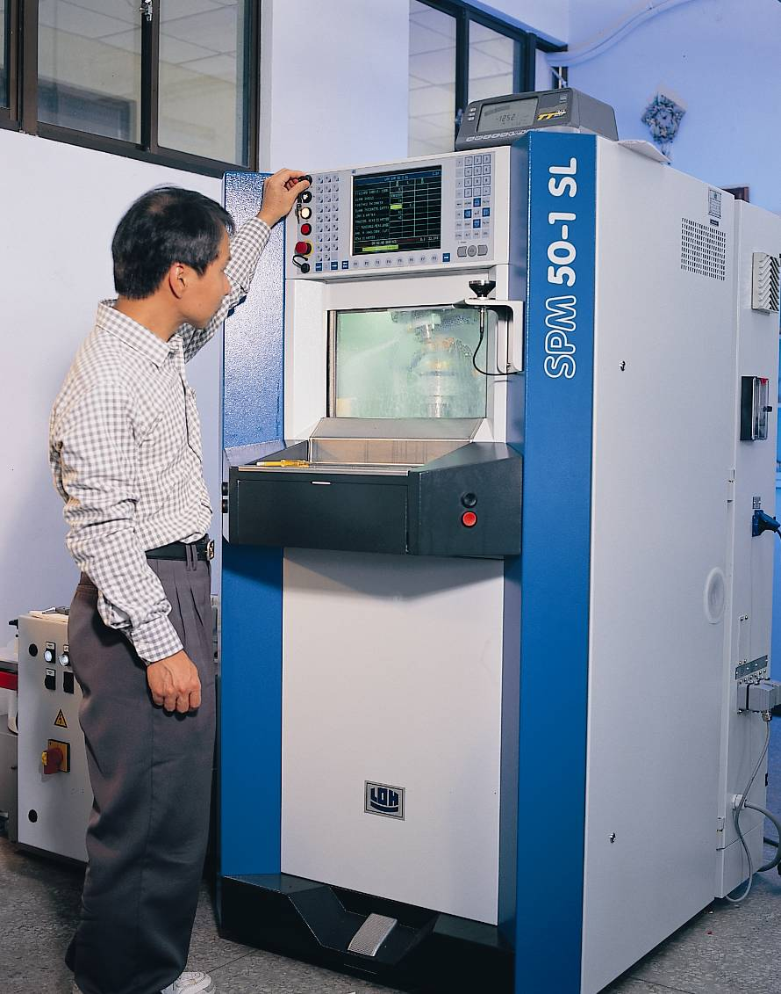

Slide 50
質譜儀
beam source
Mass Detector
σ = cross section in cm²
I = laser fluence in photons/cm²
Laser

Slide 51
Effusive beam source of ClOOCl
35 cm
25 cm
Notes:
Arrival time depends on the velocity.

Slide 53
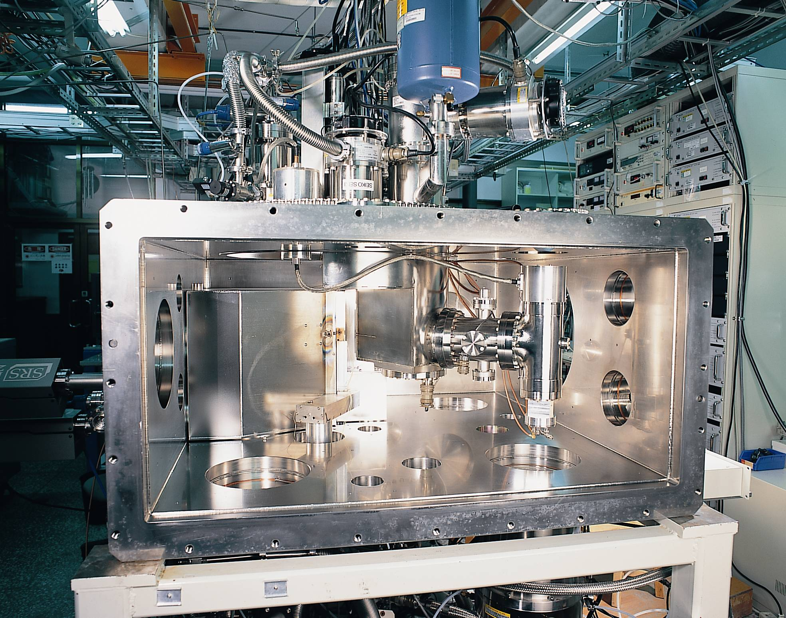

Slide 54
Laser off
Laser on
Time

Slide 55
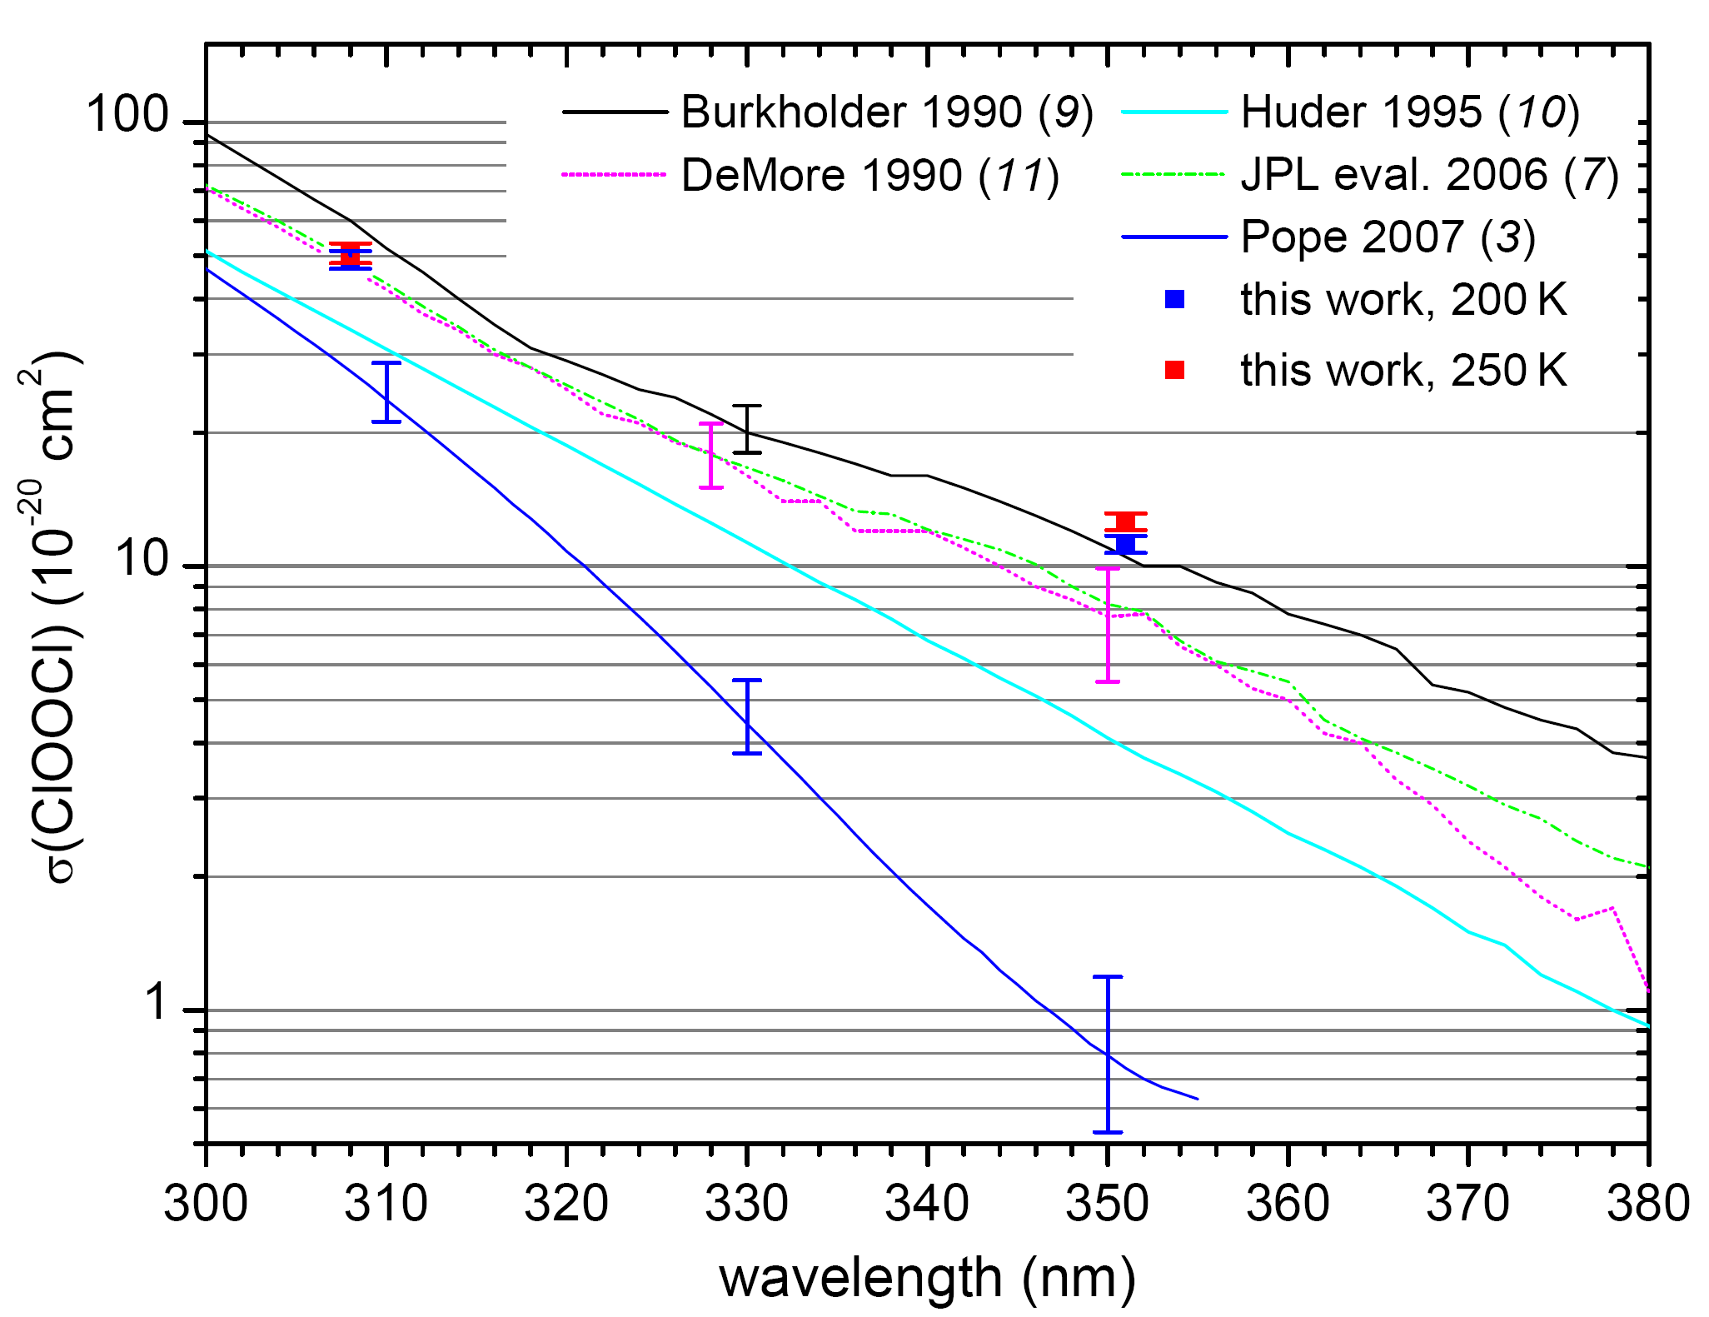
2007
Hsueh-Ying Chen, Chien-Yu Lien, Wei-Yen Lin, Yuan T. Lee, Jim J. Lin,*
Science 324, 781 (2009)

Slide 56
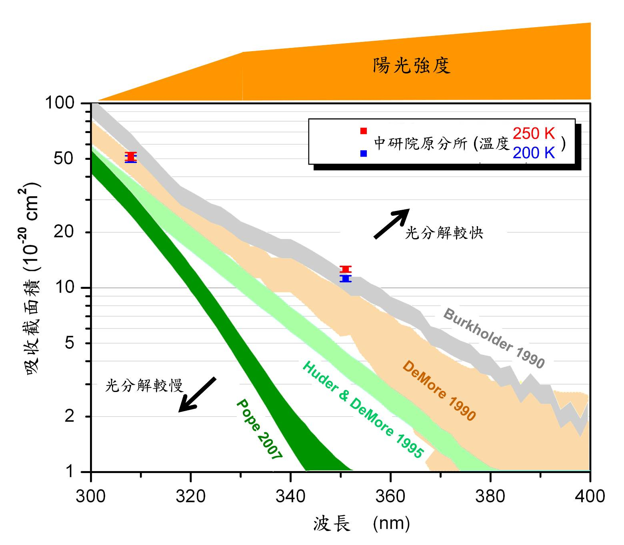
陽光強度示意

Slide 57
It seems that the Pope et al. results turn out to be wrong. Our data provide a definitive answer.
This work
1990
2006
2007

Slide 58
結論：
過氧化氯分子的吸收截面積不僅遠大於2007年波普博士等人的結果，且較學界在2006年的評估認定值為大。
將我們的數據代入現有的大氣化學模型中，就可以妥善解釋臭氧洞的形成以及大氣中各相關物質如氧化氯與過氧化氯實測的濃度。
證實人類活動所排放的氟氯碳化合物為臭氧層破壞的主因，而且過氧化氯分子破壞臭氧的效率較以往認知的更快。

Slide 59
• Recent laboratory measurements of the chlorine monoxide dimer (ClOOCl) dissociation cross section and analyses of observations from aircraft and satellites have reaffirmed the fundamental understanding that polar springtime ozone depletion is caused primarily by the ClO + ClO catalytic ozone destruction cycle, with significant contributions from the BrO + ClO cycle.

Slide 60
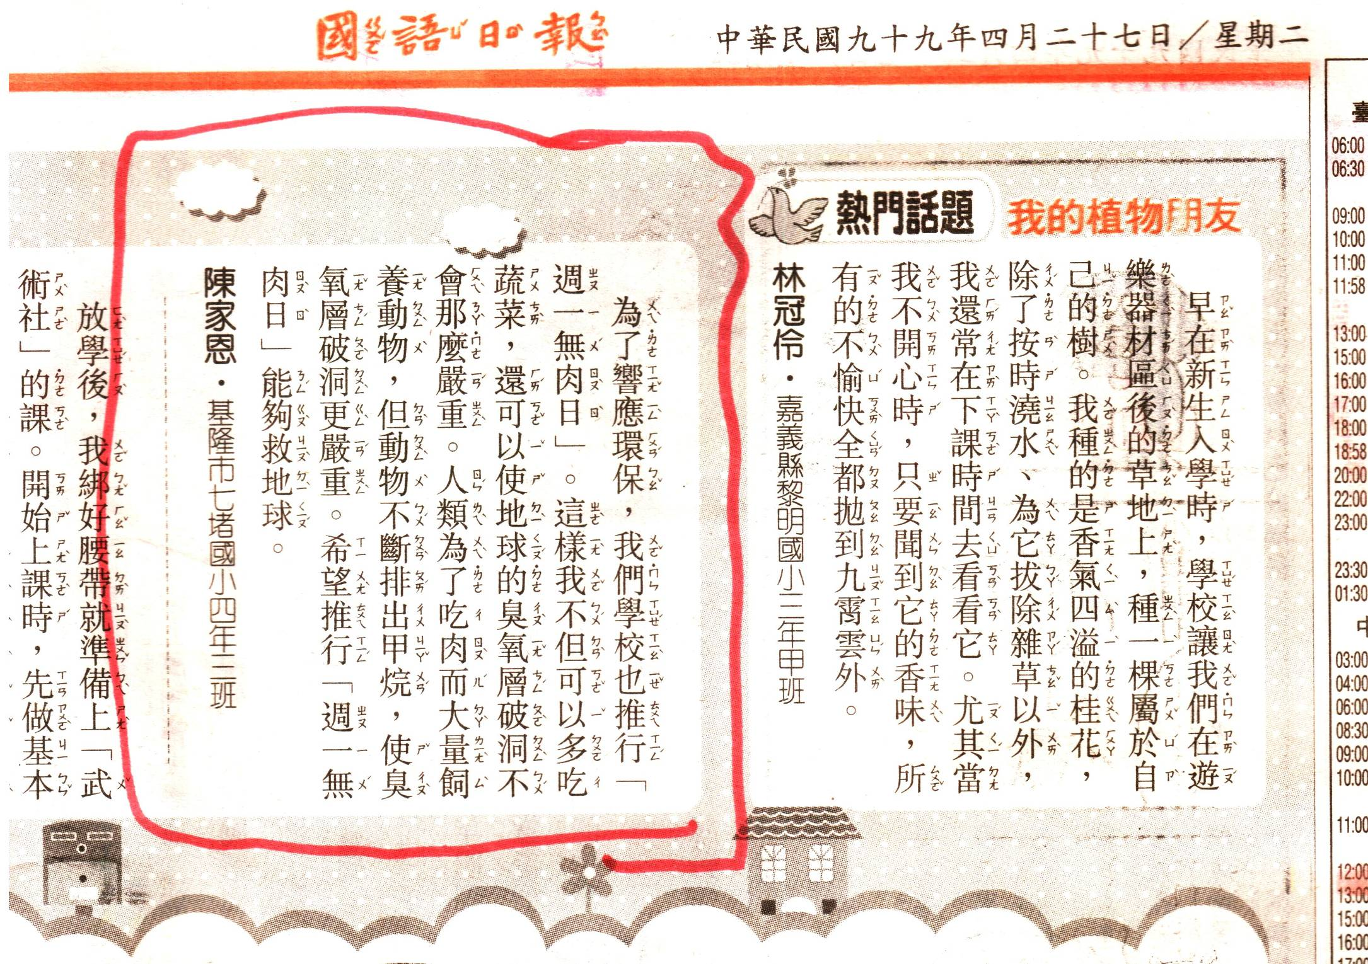

Slide 61
對進行未知的實驗，以下幾點會是重要的關鍵：
1. 正確估算情勢以挑戰未知；
(Scientifically, technically, competitively)
2. 紮實的基本工夫與想像力、創造力同樣重要；
3. 在失敗中學習，即時修正；
總之，「機會是留給準備好的人的」，如此才能及時解決重要的問題。

Slide 62
Acknowledgements
Hsueh-Ying Chen, Chien-Yu Lien, Wei-Yen Lin, Yuan T. Lee,
Wen-Tsung Huang, I-Cheng Chen, Andrew F Chen, Chen-Hsun Tsai
Dr. Mao-Chang Liang 梁茂昌
(Research Center for Environmental Changes,
Academia Sinica)
$$$: Academia Sinica, NSC

Slide 63
人類當初因無知及圖自身方便，大量地使用CFC
（氟氯碳化合物），致造成臭氧層的破壞。
臭氧多的是
地球這麼大
不用怎知道
ClOOCl催化循環很有效
地球這麼大
CFC百年才壞，糟了!

Slide 64
南極的臭氧洞是大氣層已經生病的警告，
就算立刻停止污染，地球仍要花50年以上的時間，臭氧層才能復元。
還好！人們重視這個警告 …
可是， … .

Slide 65
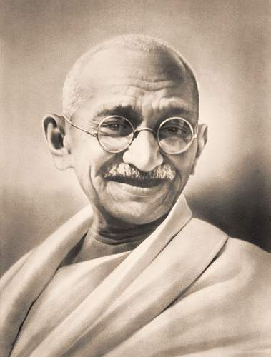
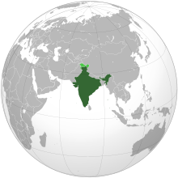
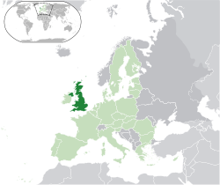
How many planets would India require ...
“It took Britain half the resources of the planet to achieve this prosperity. How many planets will a country like India require?

Slide 66
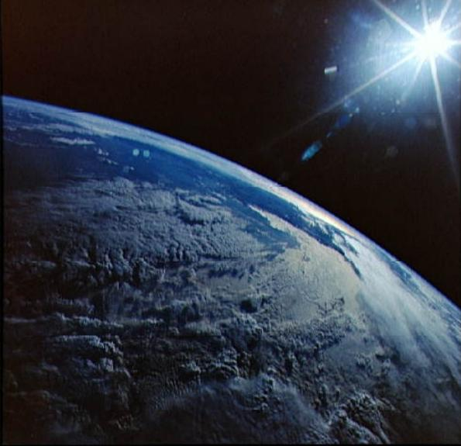
甘地: How many planets would India require ...
英 : ½ 地球 = 印度 : 10 地球
But, …

Slide 67
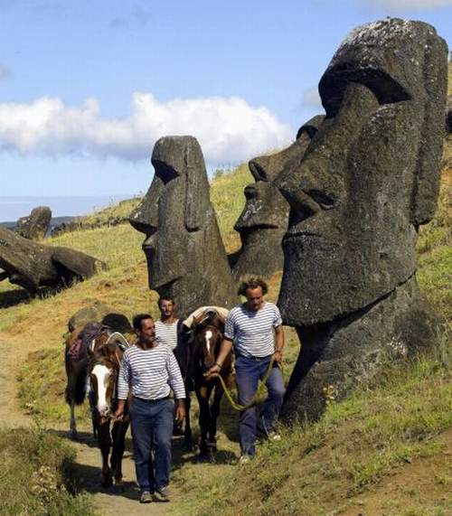
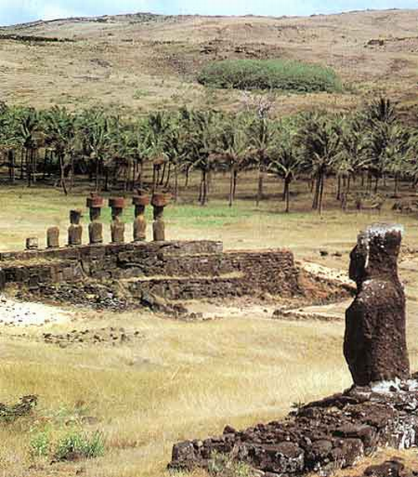
只有一個復活節島

Slide 68

How many planets would India require ...
聖嚴法師108自在語
1.需要的不多，想要的太多

Slide 69
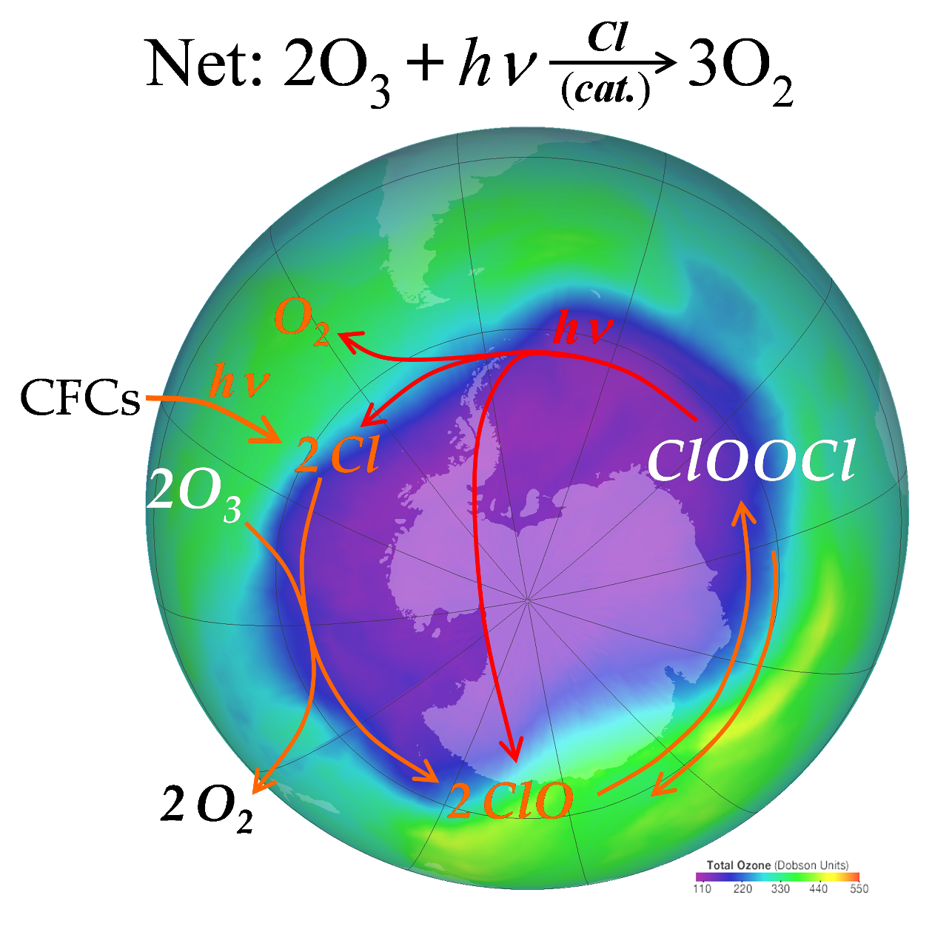
Thank You for Your Attention

Slide 70
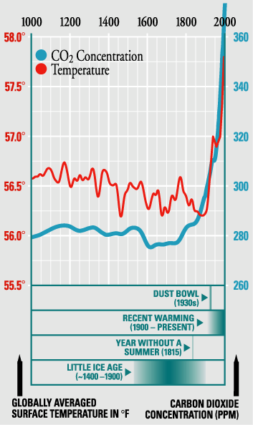
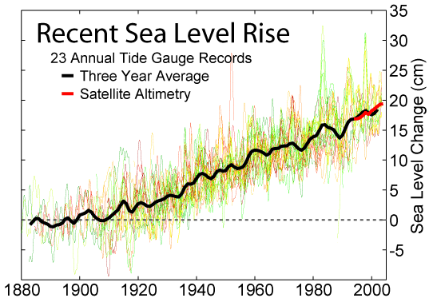
Global Temperature
Sea Level
from Wikimedia
from National Academy of Sciences

Slide 71
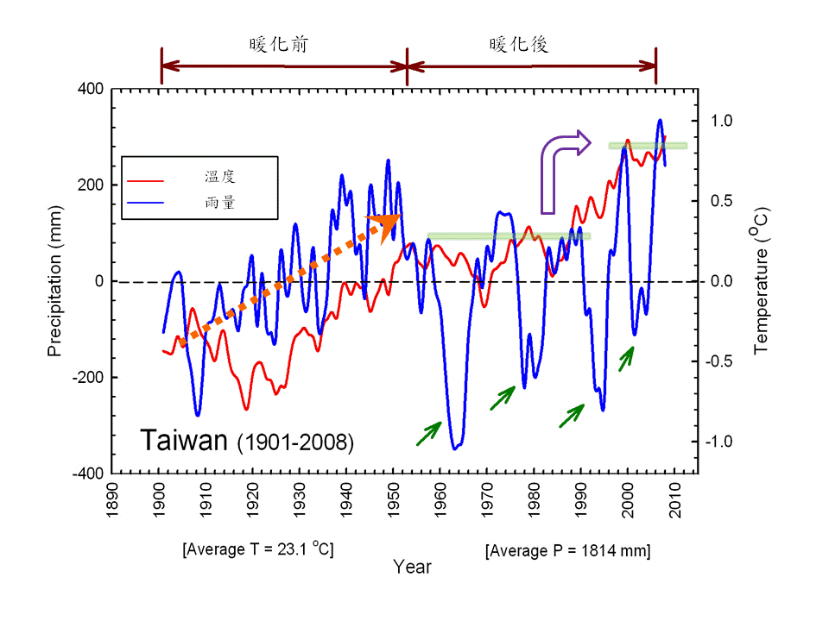
中央氣象局有百年記錄的8 個氣象站（彭佳嶼、臺北、臺中、澎湖、臺南、恆春、花蓮、臺東）所繪
製的年均溫及年雨量變化圖，並做了5 年的滑動平均消除高頻信號，以表現台灣一個世紀來溫度與雨量的長期變化特性。圖中的溫度（紅色曲線）及雨量（藍色曲線）都以百年平均值為基準（年限為1901-2008；溫度平均值是23.1 度，雨量是1814 mm.
汪中和研究員（中央研究院地球科學研究所）中央研究院週報 第1246 期

Slide 72

Science 324, 781 (2009)

Slide 73
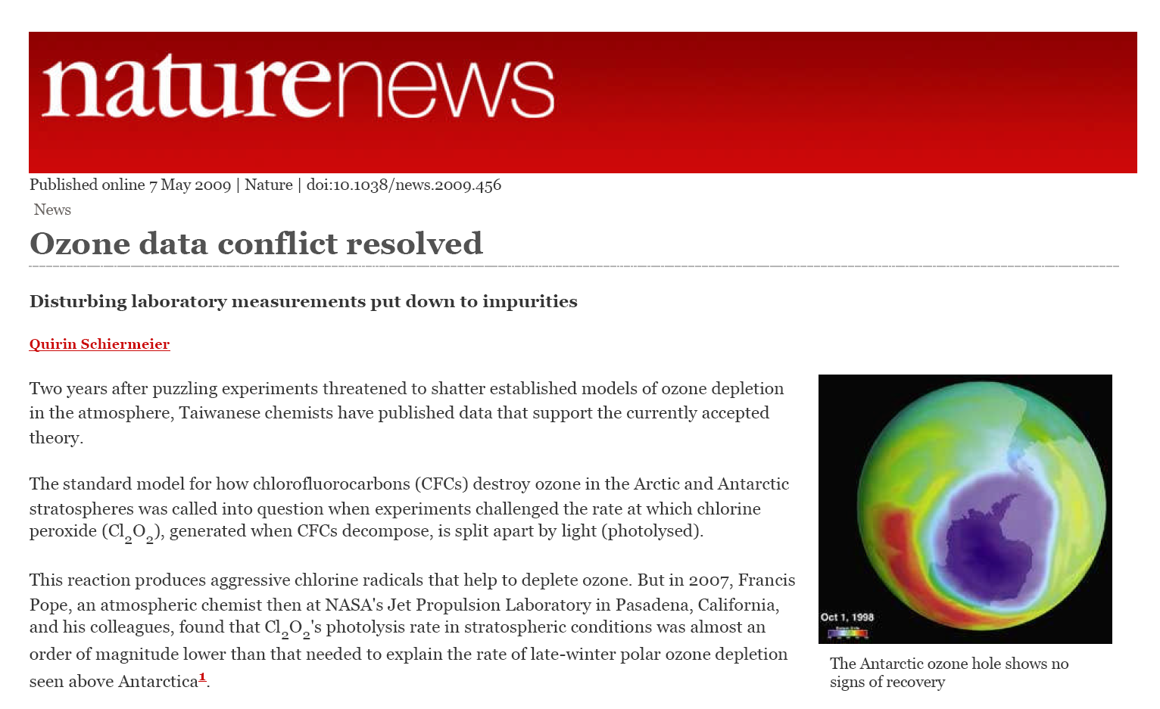

Slide 74
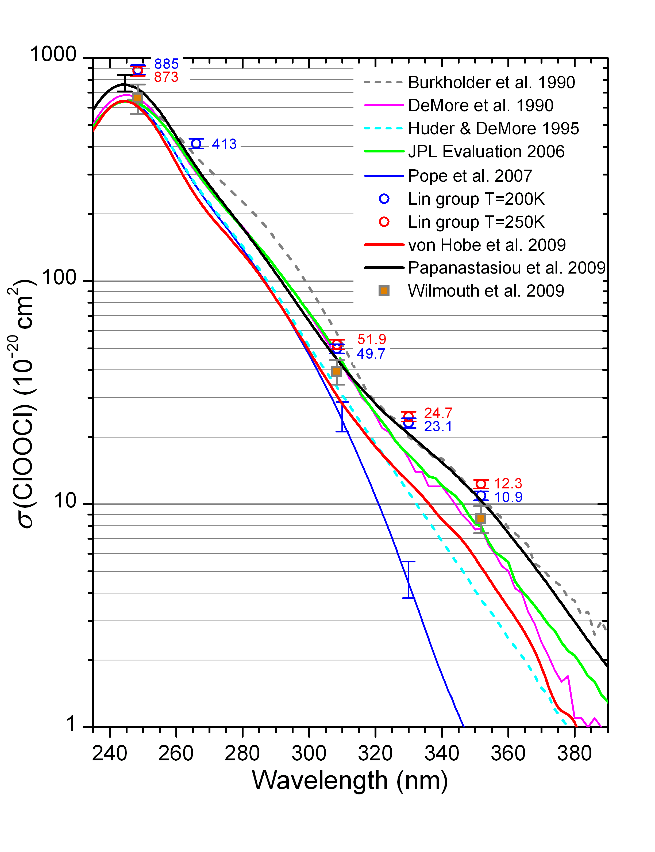

Slide 75
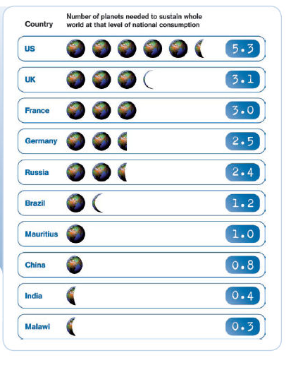
我們想要消費幾個地球?
美
英
巴西
中
印
2009 by Samuel Mann

Slide 76

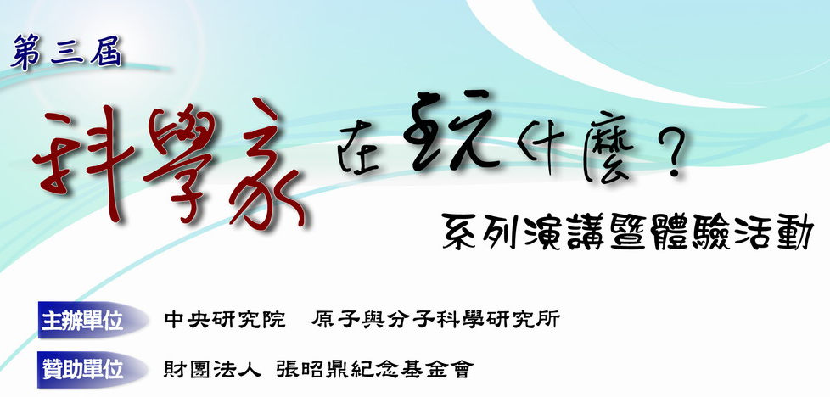
五

Slide 77
A fact that you need to know:
It is true that an old dog can’t learn new tricks.
It may be different for Homo sapiens.
You are here.
I am here.
Ability of learning new things
Age

Slide 78
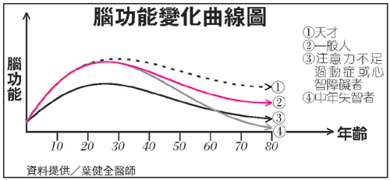

Slide 79
North pole
South pole
from Manney et al, Nature 2011

Slide 80
Ozone mass: (3.0−3.3) ×10¹² kg
Air mass: 5.1×10¹⁸ kg
World population: 7×10⁹ person

Slide 81
Simulations under conditions of Polar Stratosphere
Frieler et al. Geophys. Res. Lett., 33, L10812 (2006).
ClO + ClO cycle
(blue)
ClO + O cycle
(red)
HOCl cycle (orange)
BrO + ClO cycle
(gray)
(20~22 km)
Notes:
Most important but large error bar

Slide 82
Catalytic Cycles of Ozone Depletion
ppb of ClO_{x} can destroy ppm of O₃
ClOOCl cycle
50-70%
ClO-BrO cycle

Slide 83
Horizontal Cut View of the Crossed Beam Chamber at R410, IAMS
C₂H₄
F₂

Slide 84
10 X
2007
1990
Only the highest two can explain the observed ozone loss!
J(λ) = I(λ) σ(λ) φ(λ)
Evaluated
1995
2007

Slide 85
Cross Section at 330 nm
Bing Jin, et al.
J. Phys. Chem. A (Articles ASAP January 19, 2010
DOI: 10.1021/jp909374k).

Slide 87
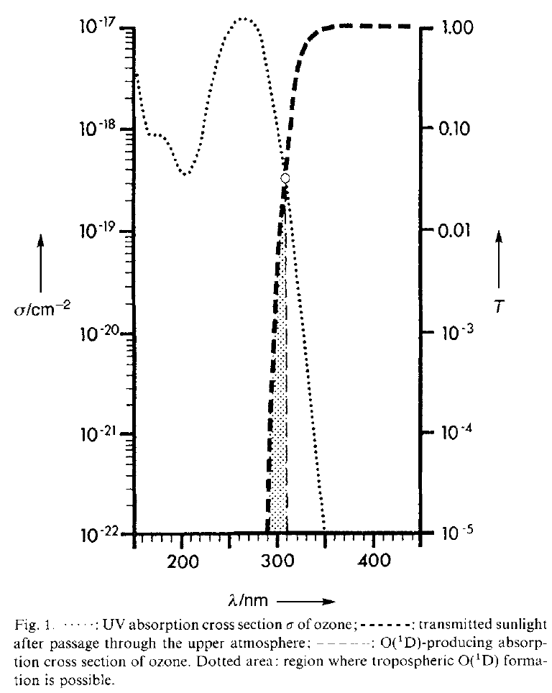
VUV
UV-B
Ozone is Important in Protecting the Biosphere, e.g.,
UV is important in
Vitamin D synthesis
DNA damage, …
Sunlight
Transmission
O₃
Abs
Figure is from
Notes:
O2 abs; Biological impacts

