Slide 1
Reactivity and Spectroscopy of
Simple Criegee Intermediates
&
Implications in Atmospheric Chemistry
林志民
中央研究院原分所
台大化學系

Slide 2
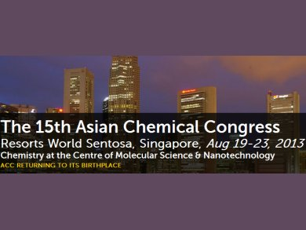

Slide 3
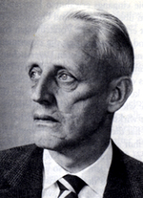
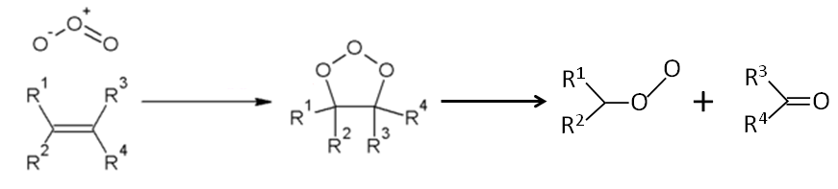
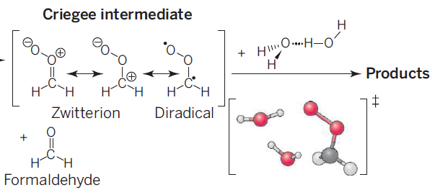
What are Criegee Intermediates?
Rudolf Criegee
1902 − 1975
Criegee
Intermediate
© Science 2015

Slide 4
乙烯ethene, 丙烯propene,
異戊二烯isoprene, 檸檬烯limonene, 松油烯pinene, ∙∙∙
臭氧
不飽和碳氫化合物
「克里奇中間體」 (Criegee Intermediates)
強氧化劑

Slide 5
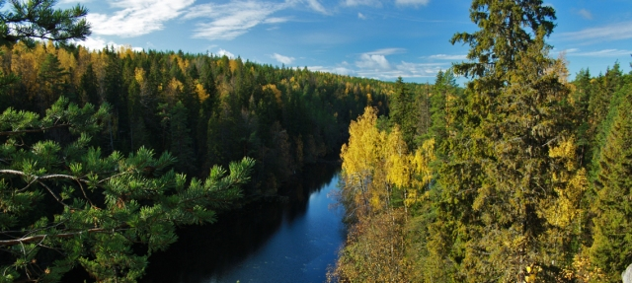
Why Criegee Intermediates are important?
HOSO₂
OH
O₂
SO₂
H₂O
H₂SO₄
Unknown Oxidant
SO₃
probably Criegee Intermediates
Aerosols
Mauldin III et al. Nature 488, 193 (2012)
[H₂SO₄]_{model} < [H₂SO₄]_{observed}

Slide 6
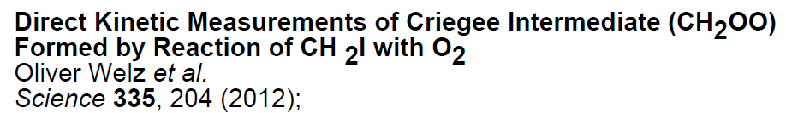
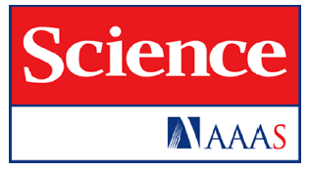
The Simplest Criegee Intermediate CH₂OO
CH₂I₂ + hν → CH₂I + I
CH₂I + O₂ → CH₂OO + I
CH₂OO + SO₂ → Products very fast
CH₂OO + NO₂ → Products very fast
Taatjes group
Time-resolved
PI-MS

Slide 7
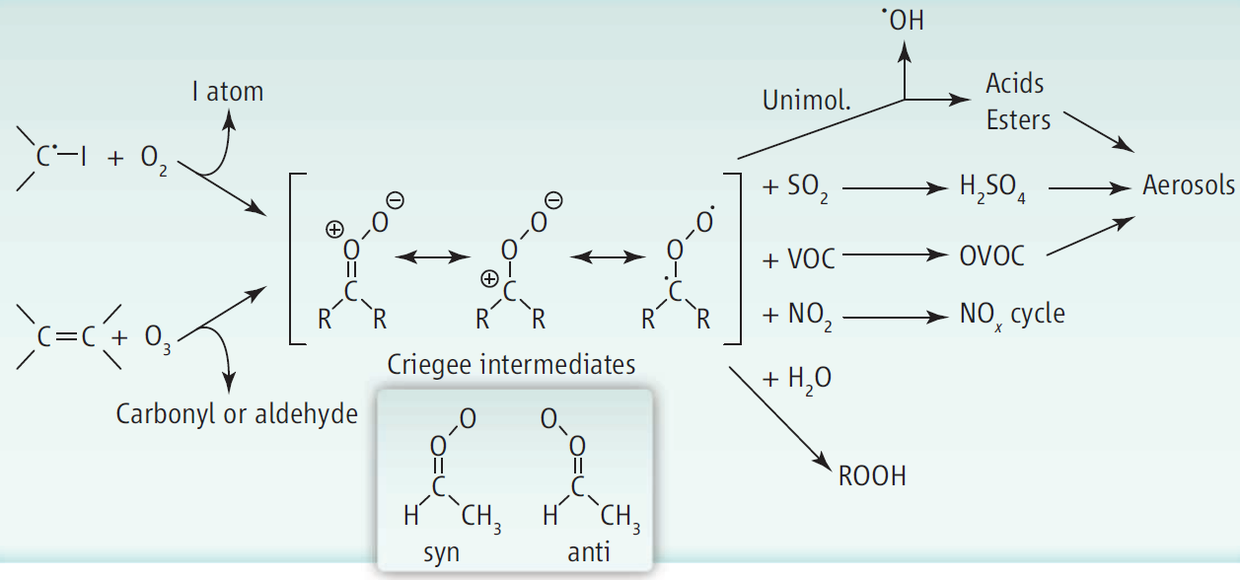
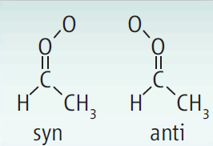
Criegee Intermediates are important.
© Science 2013

Slide 8
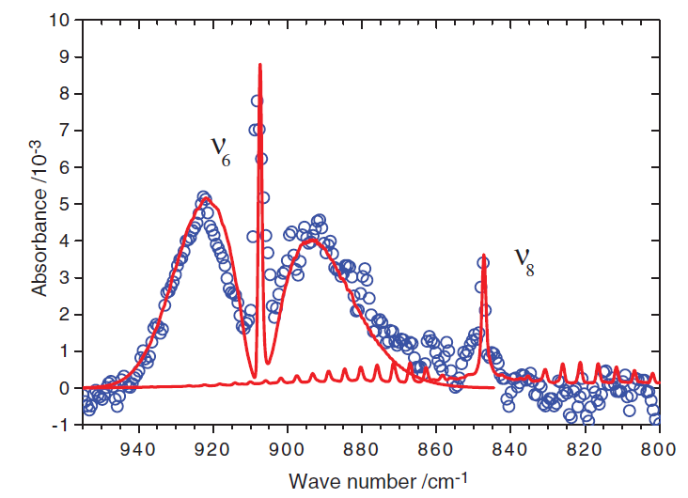
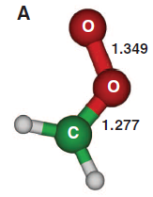
Science 340, 174 (2013)
O-O str.
CH₂ wag
YP Lee group
Time-resolved
FT-IR

Slide 9
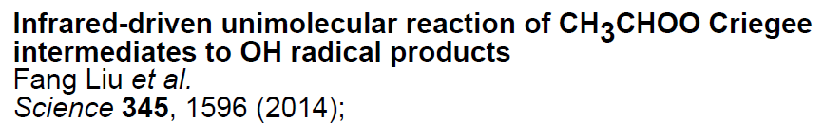
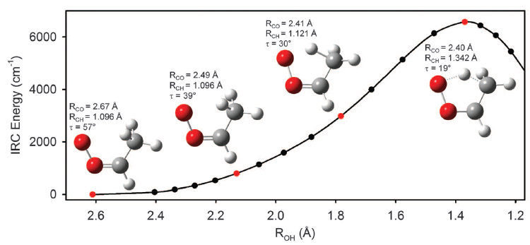
CH₃CHOO + hν → CH₃CHOO†
→ OH + CH₂CHO
< 16 kcal/mol
Lester group, IR pump, OH LIF probe

Slide 10
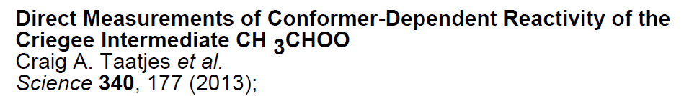
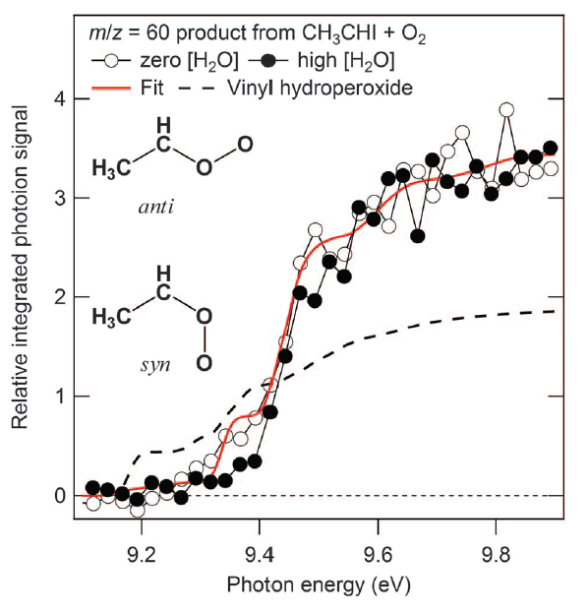
Taatjes group
Time-resolved
PI-MS

Slide 11
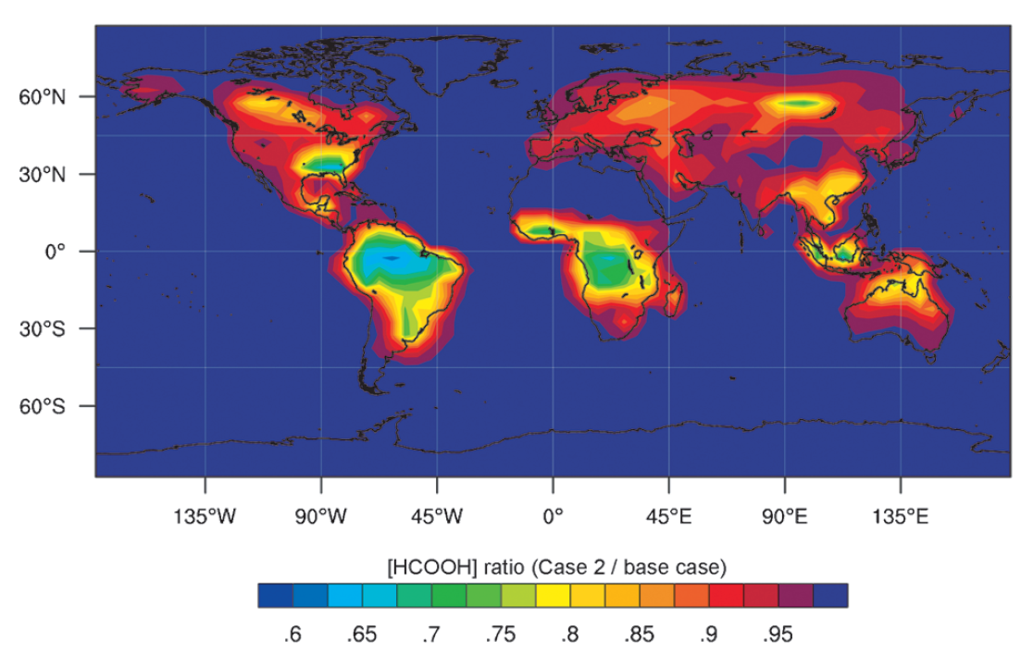
Effect of Criegee Intermediates on formic acid
Taatjes group
Time-resolved
PI-MS
Angew. Chem. 2014, 126, 1

Slide 12
But there are discrepancies in CH₂OO UV spectra
IAMS group
Time-resolved
UV-Abs
Ting et al. Phys. Chem. Chem. Phys., 16, 10438 (2014).

Slide 13
4 μs
196 μs

Slide 14
CH₂I₂ + hν → CH₂I + I (10 ns)
CH₂I + O₂ → CH₂OO + I (1~10 us)
CH₂I+O₂+M → ICH₂OO+M (high pressure)
CH₂OO + I → H₂CO + IO (~100 us)
2CH₂OO → O₂ + 2H₂CO (~100 us)
Ting, YP Lee, Lin, & coworkers, JCP, 141, 104308 (2014).

Slide 15
more
SO₂

Slide 16
99 curves
24 curves

Slide 17
How about reactions with water?
H₂O
SO₃
H₂SO₄
SO₂
Other molecules
CH₂OO
[H₂O] : [SO₂] ~ 10⁶ : 1 in troposphere
H₂O
peroxides
Reaction with water was not observed in 2012 with PI-MS!
H₂O

Slide 18
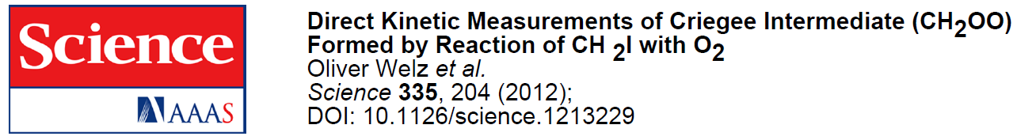
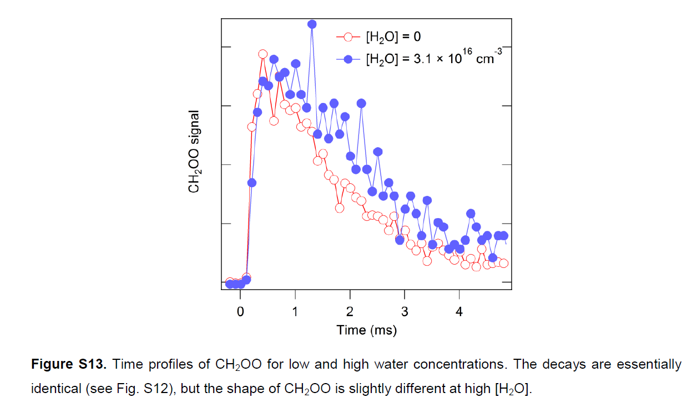
P(H₂O) ~ 1 Torr relative humidity ~ 4%

Slide 19
CH₂OO reaction with water was not observed in two other papers.
D. Stone, M. Blitz, L. Daubney, N. U. Howes, P. Seakins, Kinetics of CH₂OO reactions with SO₂, NO₂, NO, H₂O and CH₃CHO as a function of pressure. Phys. Chem. Chem. Phys. 16, 1139–1149 (2014). with P(H₂O) ≤ 5 Torr
B. Ouyang, M. W. McLeod, R. L. Jones, W. J. Bloss, NO₃ radical production from the reaction between the Criegee intermediate CH₂OO and NO₂. Phys. Chem. Chem. Phys. 15, 17070–17075 (2013). with P(H₂O) ≤ 21 Torr

Slide 20
IAMS group, Time-resolved UV-Abs
248 nm pulsed laser
cw UV probe light, λ > 280 nm
out (#6)
in (#1)
(#4)
探測光束
(#3)
(#2)
(#5)
稜鏡
球面鏡
反應槽

Slide 21
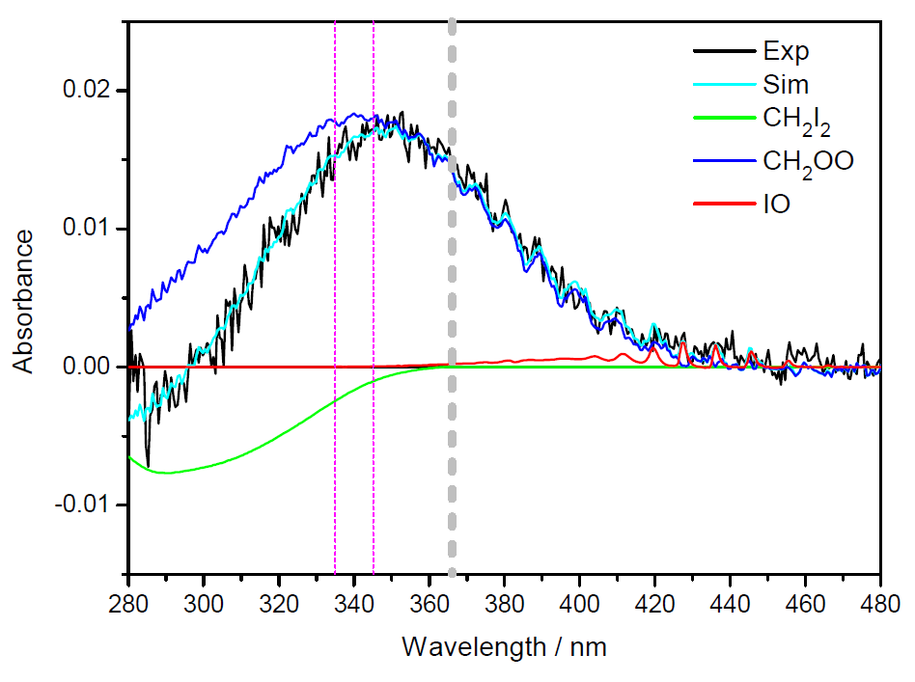
Probe CH₂OO with Time-resolved UV Absorption

Slide 22
Probe CH₂OO with Time-resolved UV Absorption
Advantages:
Selectivity:
σ (CH₂OO) ~ 1x10⁻¹⁷ cm² >> σ (non radicals) @ 340−380 nm
Moderate Sensitivity: Abs ~ 10⁻³, L ~ 4 m, [CH₂OO] ~ 2x10¹¹ cm⁻³
Can be performed at Near Atmospheric Conditions
(Humidity: 0−80% relative)
Disadvantages:
Little structure information (mass, conformer, …)
Competitions: Sandia, MIT, U Leeds UK, U Bristol UK, …

Slide 23
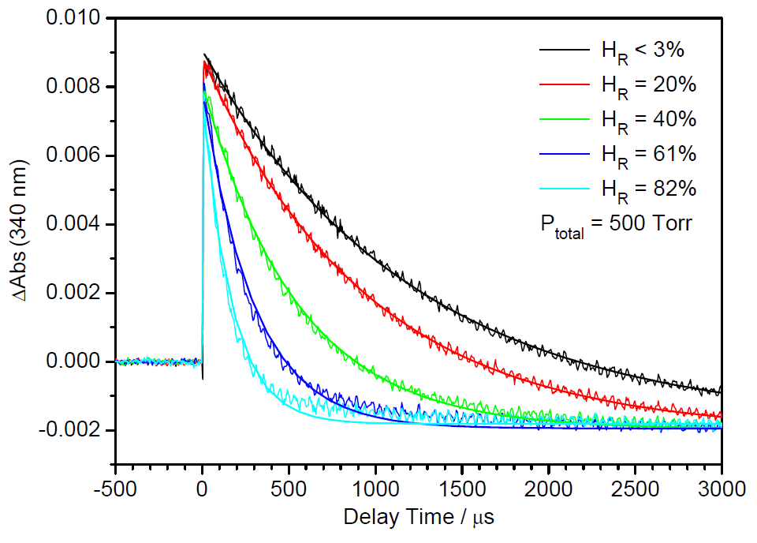
[CH₂OO] at various humidity
Relative Humidity
dry
wet
Science 347, 751 (2015)

Slide 24
Reaction with water dimer predominates for CH₂OO decay!
Relative Humidity
Science 347, 751 (2015)

Slide 25
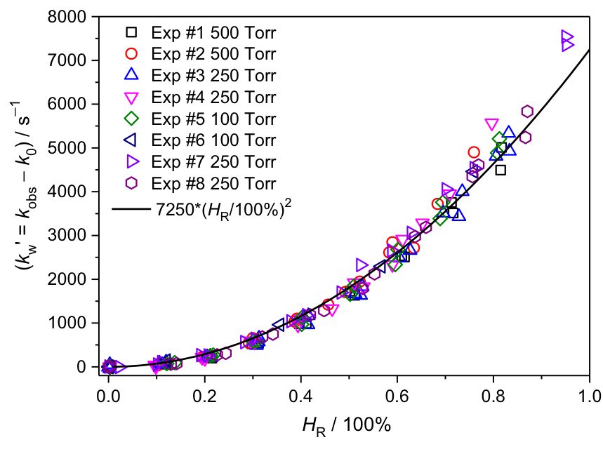
Relative Humidity
Science 347, 751 (2015)

Slide 26
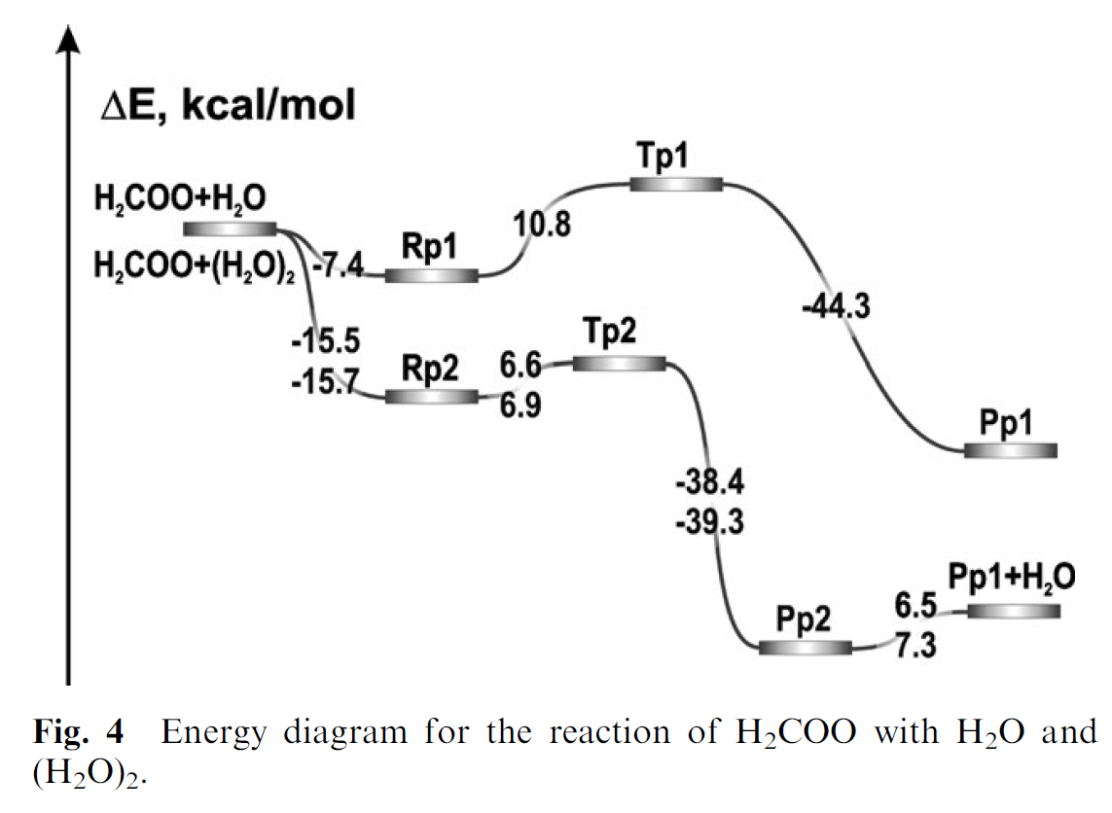
1 H₂O pathway
2 H₂O pathway
Ryzhkov and Ariya, Phys. Chem. Chem. Phys. 2004, 6, 5042

Slide 27
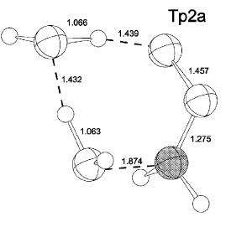
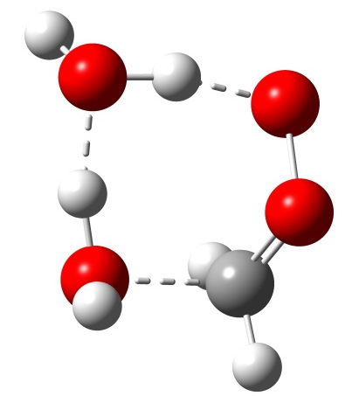
O
O
C
Ryzhkov and Ariya
Phys. Chem. Chem. Phys. , 2004, 6, 5042
Liang-Chun Lin & Kaito Takahashi
27

Slide 28
Co-reactant | k_{rxn} (cm³ sec⁻¹) | Assumed Concentration | Number density^{d} (cm⁻³) | k_{eff} (sec⁻¹)
(H₂O)₂ | (5.9x10⁻¹²)ª | H_{R} ≥ 38% | ≥ 1.8x10¹⁴ | ≥ 1000
SO₂ | (4x10⁻¹¹)^{b} | 50 ppb | 1.2x10¹² | 50
NO₂ | (7x10⁻¹²)^{b} | 50 ppb | 1.2x10¹² | 9
carboxylic acids | (1x10⁻¹⁰)^{c} | 5 ppb | 1.2x10¹¹ | 12
ª This work. ^{b} O. Welz et al. Science 335, 204–207 (2012).
^{c} O. Welz et al. Angew. Chem. Int. Ed. 53, 4547-4550 (2014).
Science 347, 751 (2015)

Slide 29
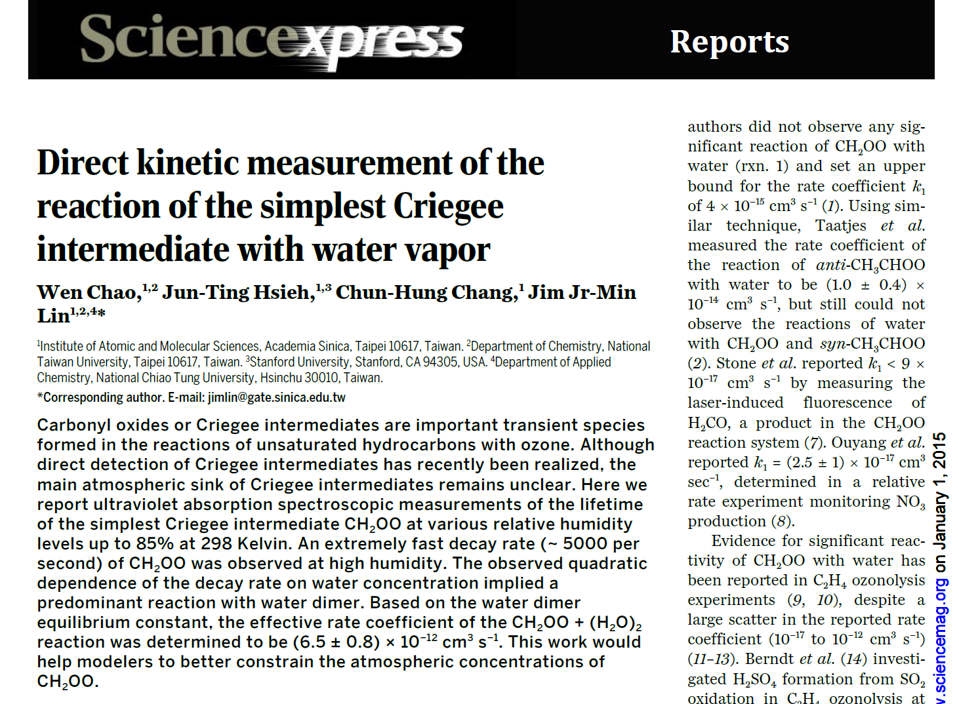

Slide 30
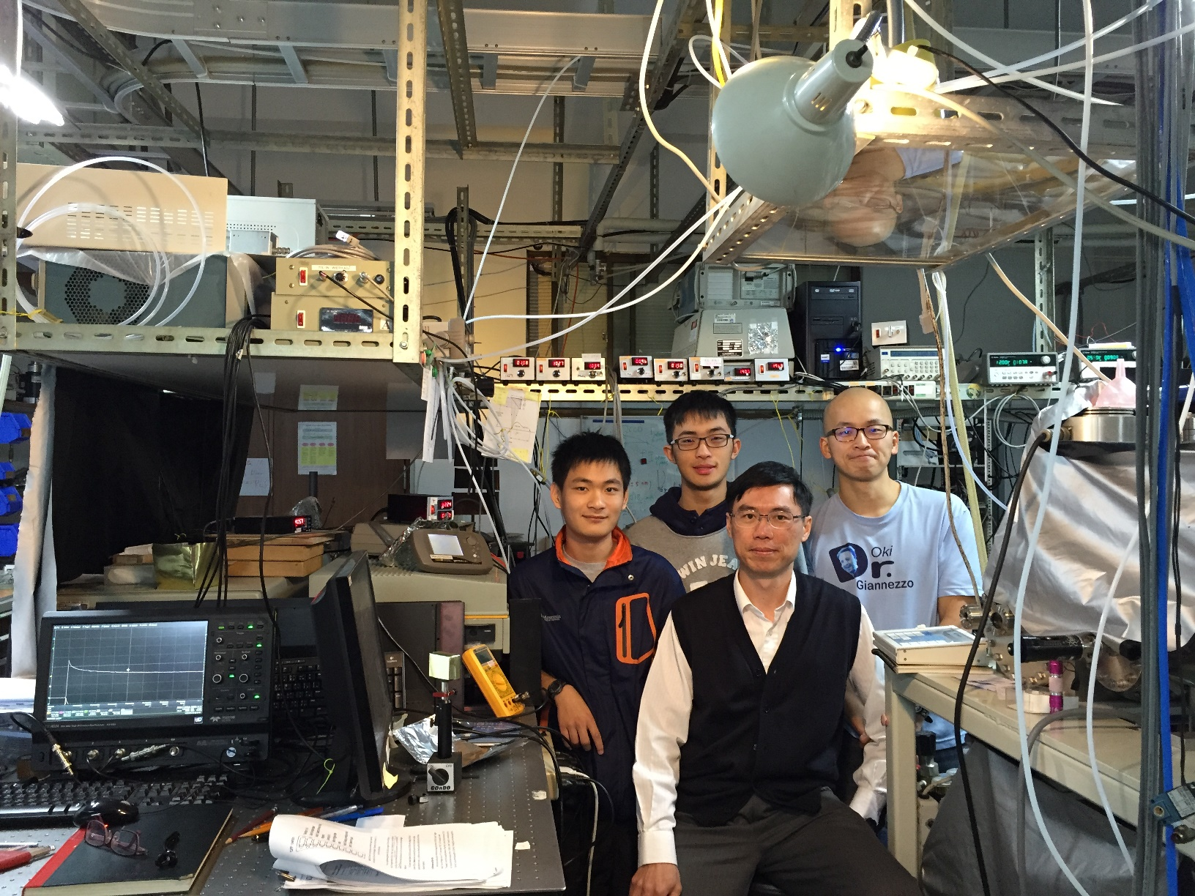

Slide 31
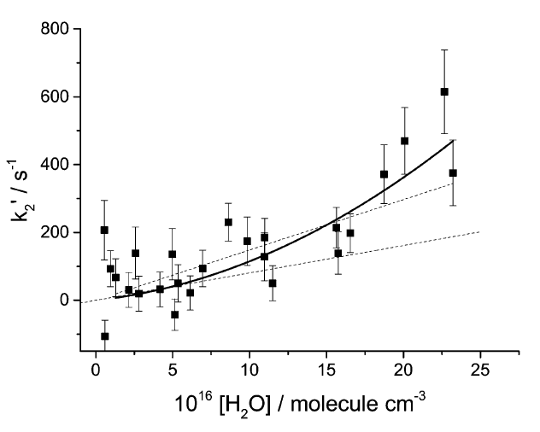
(≤ 30% RH)
Tom R. Lewis, Mark A. Blitz, Dwayne E. Heard and Paul W. Seakins
Phys. Chem. Chem. Phys., 2015,17, 4859-4863

Slide 32
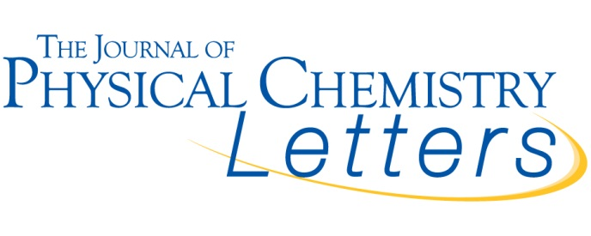
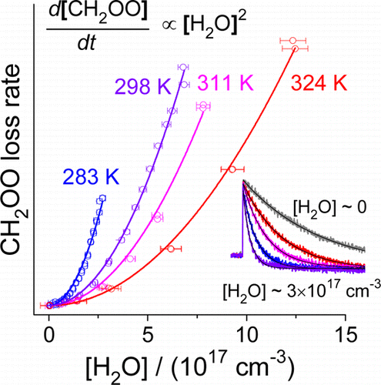
Strong Negative Temperature Dependence of the Simplest Criegee Intermediate CH₂OO Reaction with Water Dimer
Mica C. Smith†‡, Chun-Hung Chang‡, Wen Chao‡§, Liang-Chun Lin‡§, Kaito Takahashi‡, Kristie A. Boering†∥, Jim Jr-Min Lin*‡§
† Department of Chemistry, University of California, Berkeley, Berkeley, California 94720, United States
‡ Institute of Atomic and Molecular Sciences, Academia Sinica, Taipei 10617, Taiwan
§ Department of Chemistry, National Taiwan University, Taipei 10617, Taiwan
∥ Department of Earth and Planetary Science, University of California, Berkeley, Berkeley, California 94720,United States
DOI: 10.1021/acs.jpclett.5b01109

Slide 33
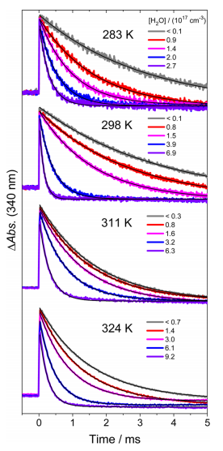

Slide 34






Slide 35
Arrhenius activation energy: E_{a} = −8.1 ± 0.6 kcal mol⁻¹
CH₂OO + (H₂O)₂ reaction rate: k(298 K) = (7.4±0.6)×10⁻¹² cm³ s⁻¹

Slide 36
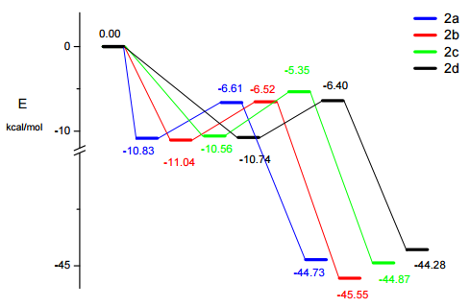

Slide 37
Very strong structure effect in the Criegee intermediate reactions with water vapor
Water dimer + anti conformers and CH₂OO
k⁽²⁾_{eff} ~ 10⁻¹¹ cm³ molecule⁻¹ s⁻¹
Water dimer + syn conformers and (CH₃)₂COO
k⁽²⁾_{eff} < 10⁻¹³ cm³ molecule⁻¹ s⁻¹
© Science 2013

Slide 38
Chun-Hung Chang, Wen Chao, Hao-Li Huang, Liang-Chun Lin and Jim Jr-Min Lin, submitted.

Slide 39
CH₃CHOO
dry
wet

Slide 40
anti-CH₃CHOO
770 Torr
100 Torr
Relative Humidity

Slide 41
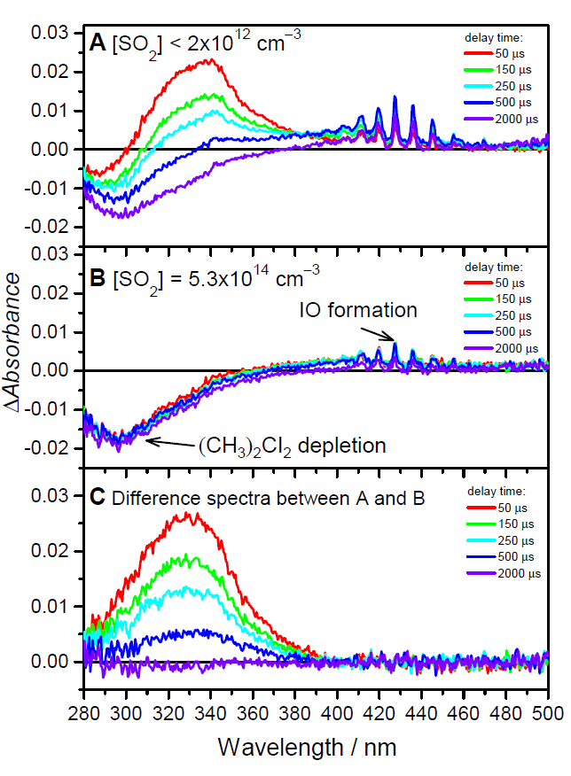
(CH₃)₂CI₂ + hν
→ (CH₃)₂CI + I
(CH₃)₂CI + O₂
→ (CH₃)₂COO + I
(CH₃)₂COO + SO₂
→ Products
doi: 10.1073/pnas.1513149112

Slide 42
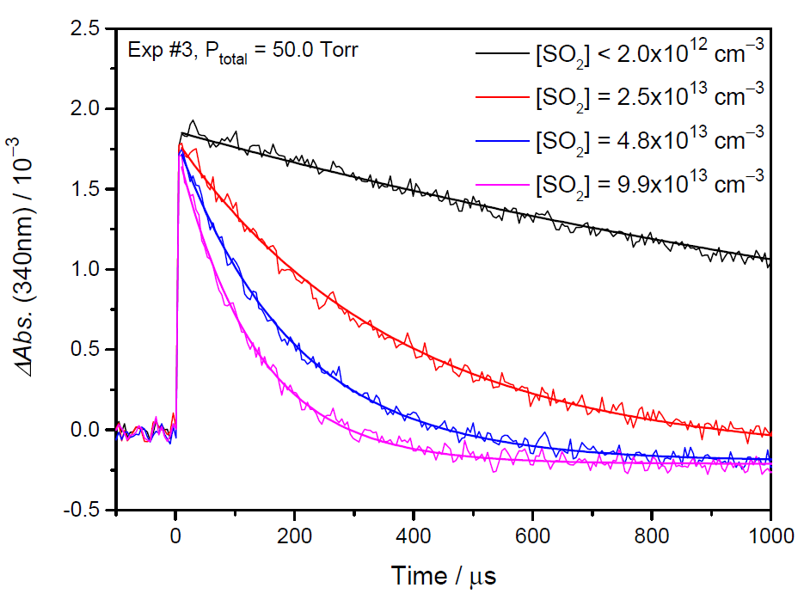
doi: 10.1073/pnas.1513149112

Slide 43
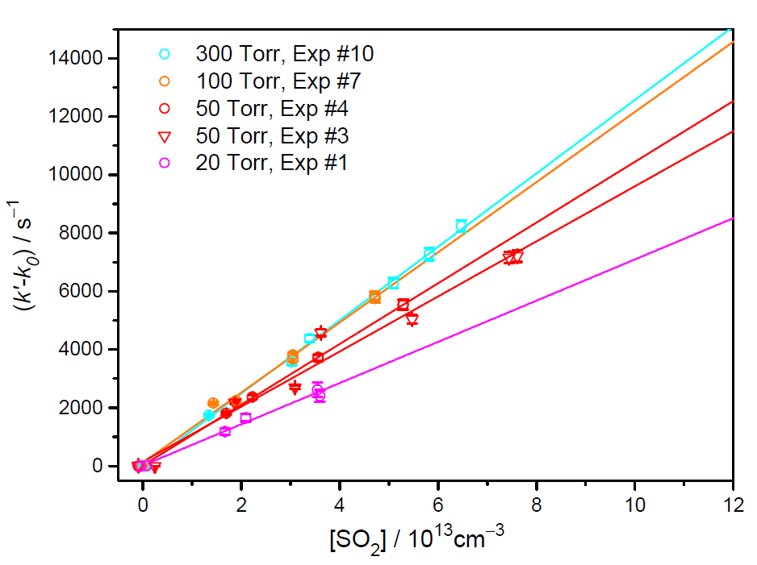
doi: 10.1073/pnas.1513149112

Slide 44
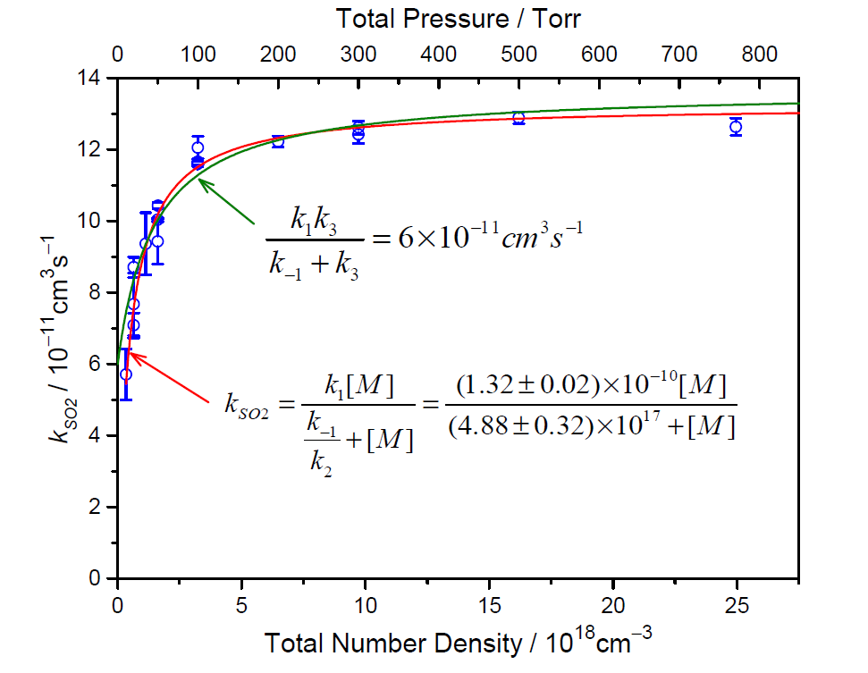
doi: 10.1073/pnas.1513149112

Slide 45
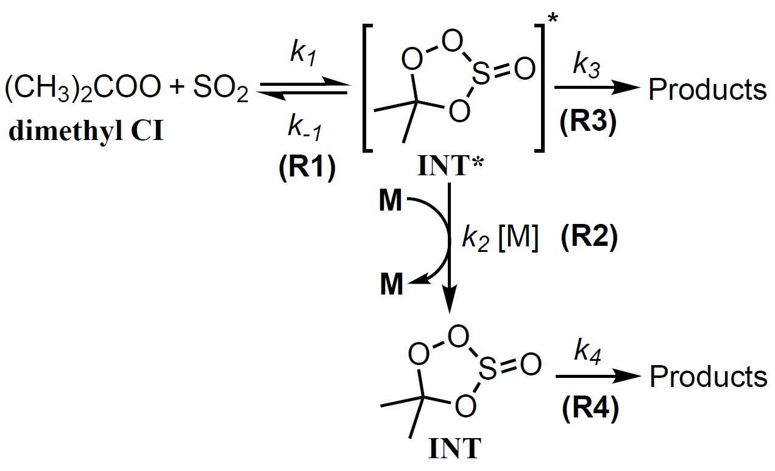
doi: 10.1073/pnas.1513149112

Slide 46
doi: 10.1073/pnas.1513149112

Slide 47
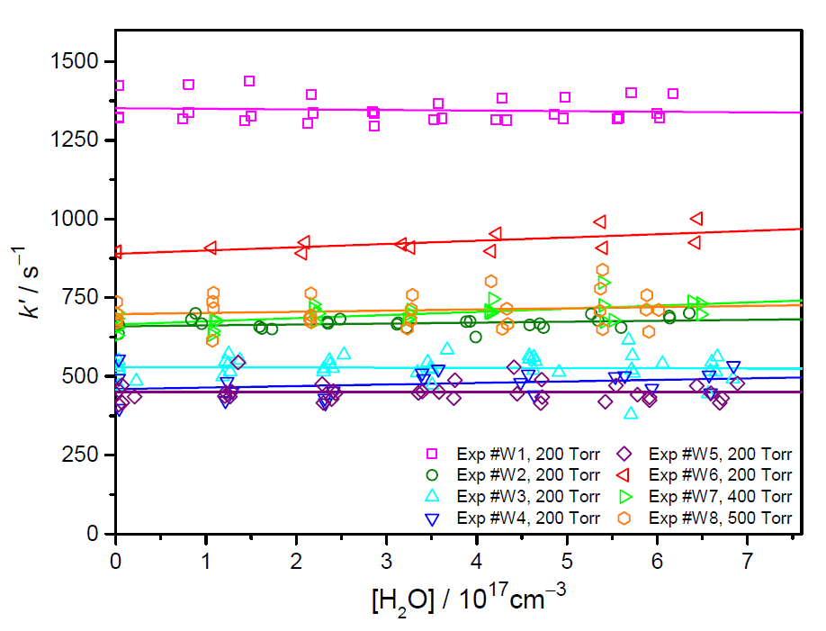
doi: 10.1073/pnas.1513149112

Slide 48
CI | Coreactant | [Coreactant] /cm⁻³ | k / cm³s⁻¹ | k_{eff} / s⁻¹ | ref.
CH₂OO | H₂O | 5.4×10¹⁷ | < 1.5×10⁻¹⁵ | < 810 | (22)
 | (H₂O)₂ | 6.0×10¹⁴ | 6.5×10⁻¹² | 3900 | (22)
 | SO₂ | 1.2×10¹² | 3.9×10⁻¹¹ | 47 | (2)
anti- CH₃CHOO | H₂O | 5.4×10¹⁷ | 1.0×10⁻¹⁴ | 5400 | (3)
 |  |  | 2.4×10⁻¹⁴ | 13000 | (24)
 | SO₂ | 1.2×10¹² | 6.7×10⁻¹¹ | 80 | (3)
 |  |  | 2.2×10⁻¹⁰ | 260 | (24)
syn- CH₃CHOO | H₂O | 5.4×10¹⁷ | < 4×10⁻¹⁵ | < 2200 | (3)
 |  |  | < 2×10⁻¹⁶ | < 110 | (24)
 | SO₂ | 1.2×10¹² | 2.4×10⁻¹¹ | 29 | (3)
 |  |  | 2.9×10⁻¹¹ | 35 | (24)
(CH₃)₂COO | H₂O | 5.4×10¹⁷ | < 1.5×10⁻¹⁶* | < 81* | This work
 | (H₂O)₂ | 6.0×10¹⁴ | < 1.3×10⁻¹³* | < 78* | This work
 | SO₂ | 1.2×10¹² | 1.3×10⁻¹⁰ | 160 | This work
doi: 10.1073/pnas.1513149112

Slide 49
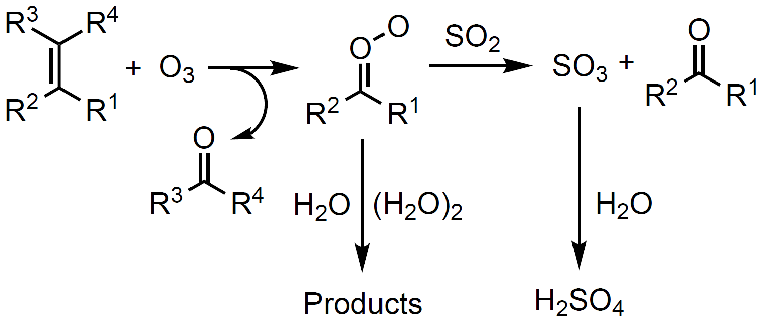
fast, if R¹ = H
slow, if R¹ ≠ H
www.pnas.org/cgi/doi/10.1073/pnas.1513149112

Slide 50
Summary
Reactivity of Criegee intermediates towards water (dimer) depends strongly on their structures.
Anti forms react with water (dimer) much faster than the syn forms.
k_{decay}
= k_{therm} + k_{H2O}[H₂O] + k_{w2}[(H₂O)₂] + k_{SO2}[SO₂]
+ k_{NO2}[NO₂] + ···

Slide 51
$$$: Academia Sinica, MOST
Coworkers: Su, Ting, Chen, Smith, Chao, Hsieh, Chang, Huang, Lin,
Collaborators: YP Lee, K Takahashi, YT Lee
Thank You for Your Attention
out (#6)
in (#1)
(#4)
探測光束
(#3)
(#2)
(#5)
稜鏡
球面鏡
反應槽

Slide 52
Comparison of reported rate coefficients in cm³s⁻¹ for anti- and syn-CH₃CHOO reactions.
5. Science, 2013, 340, 177-180.
20. Phys. Chem. Chem. Phys., 2014,16, 26701-26706.

Slide 53
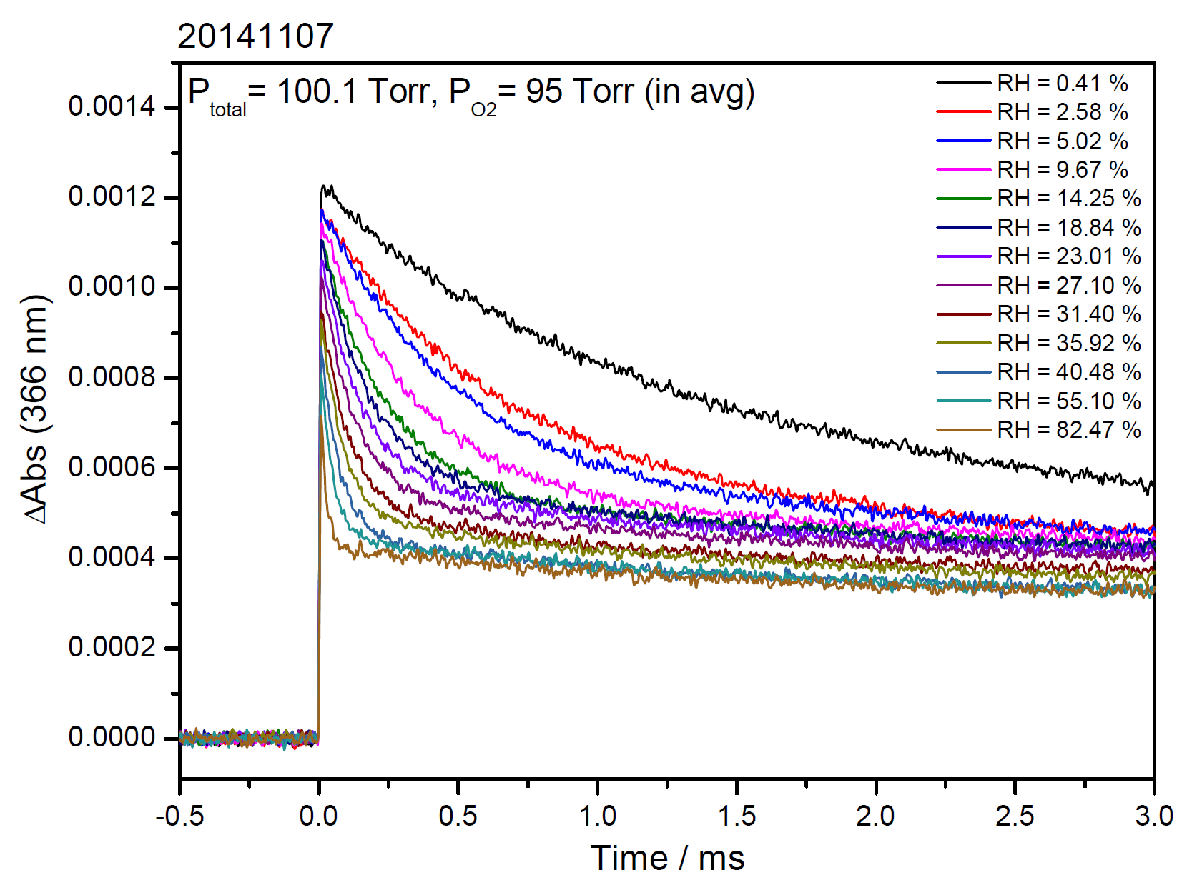
C₂H₅CHOO
dry
wet

Slide 54
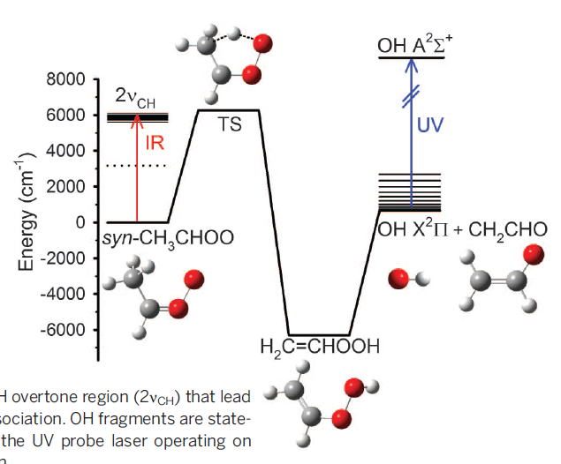
Science 345, 1596 (2014)

Slide 55
Okumura, Perspective in Science 347, 718-719 (2015)

