Slide 1
用實測教導模型歸納與分析
—以訊號之反射實驗為例
林志民
中央研究院原子與分子科學研究所
國立臺灣大學化學系
國立交通大學應用化學系
E-mail：jimlin@gate.sinica.edu.tw

Slide 2
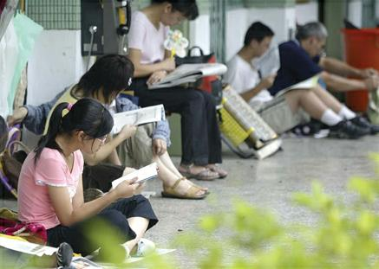
如果小的時候只會考試，我怕
老了連試都考不好

Slide 3
相當多的研究是無法預知結果的，而是從現有的實驗結果，做分析與歸納，找出規律，進而建立物理模型，再而能預測類似實驗的結果或做出新穎的設計。
個人發現，學生普遍欠缺此類經驗。學生的物理模型，多由書本或教師告知而來；學生研究工作中的預測或設計，常由老師代勞。畢竟，此類工作極依賴經驗(沒有人生下來就有經驗)，大部分的學生無法立即進行上述完整的研究流程。
為此，本人設計了一套題目，要求學生在一週內，由自己的實驗結果建立模型，並互相驗證，優者可試著做出新設計。有趣的是，在此練習中，愈年輕的學生反應愈好。

Slide 4
My Goal is
To Simulate a Research Process
with Real Experiments.
There is no substitution for experiments.

Slide 5
A Research Process:
To measure something new
To describe and explain the measurements
(科學家 or 記者)
To build a model
To test the model by more experiments
To predict new things with the model

Slide 6
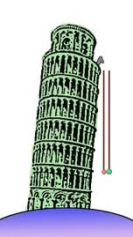

Slide 7
Why Simulation?
Faster
Lower cost
More exact
< 1 week
< 10,000 NTD
< 10% error

Slide 8
Why 訊號之反射實驗 ?
When I was young, ...
It is not easy to find the answer on Web.
Difficult enough ...
yet easy enough ...
It happens everyday.

Slide 9
只給實驗目標、不給步驟
要求學生自行決定測量範圍
逐日檢查實驗結果：
1) 避免錯得太遠 (小錯是好的)
2) 確定達到該有的精確度
3) 協助養成良好的實驗習慣

Slide 10
For example: (after a simple demo experiment)
Mission 1:
(1a) Measure the speed of an electric pulse propagating in a coaxial cable.
(1b) Measure the voltage reflection coefficient of a 50Ω coaxial cable which is terminated with: (i) resistive loads; (ii) capacitive loads; (iii) inductive loads.
You should choose a suitable range of resistors, capacitors and inductors and a suitable frequency range (pulse width) to make the measurements meaningful.
(1c) Make a R+C load that matches a 50Ω coaxial cable for fast pulses (width <=100 ns) but has almost zero current for dc voltage (>= 1 us). Also check pulses of very large widths.
(1d) Make a short pulse generator, of which the pulse width is controlled by the cable length. A fast high voltage switch is provided. [Do (1d) after all other training missions].

Slide 11
(Long) Coaxial Cable (Z₀ = 50 Ω)
A
B
load
A’
B’
To Monitor: Waveforms at A/A’ and B/B’

Slide 12

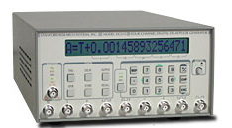
訊號產生器
示波器
ch1
ch2
負載
input signal
同軸電纜#1
T 接頭
同軸電纜#2
Voltage
time

Slide 13
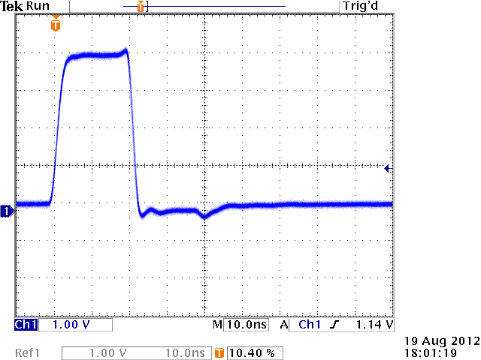
Only cable #1

Slide 14
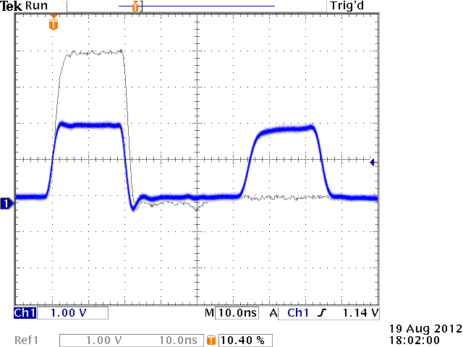
cable #1 and cable #2
Not only surprise. We require the student to perform analysis

Slide 15
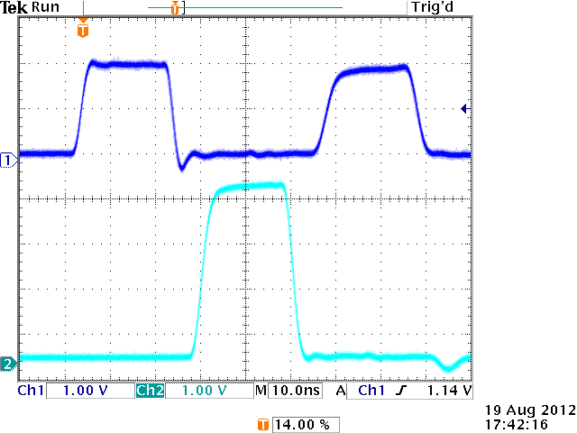
Load = open (∞ Ω)
A
B
Load
A’
B’
A/A’
B/B’

Slide 16
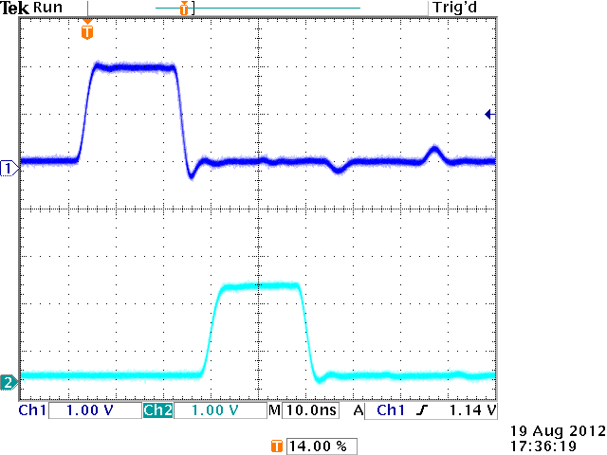
Load = 50 Ω (impedance matched)
Delay is due to the length of the cable

Slide 17
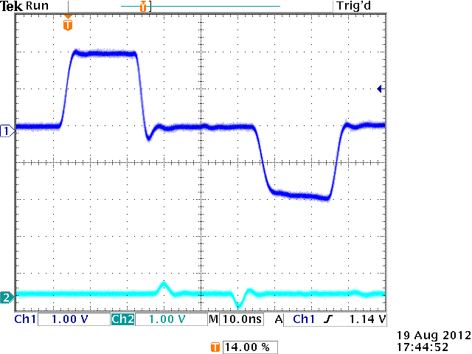
Load = short (0 Ω)

Slide 18
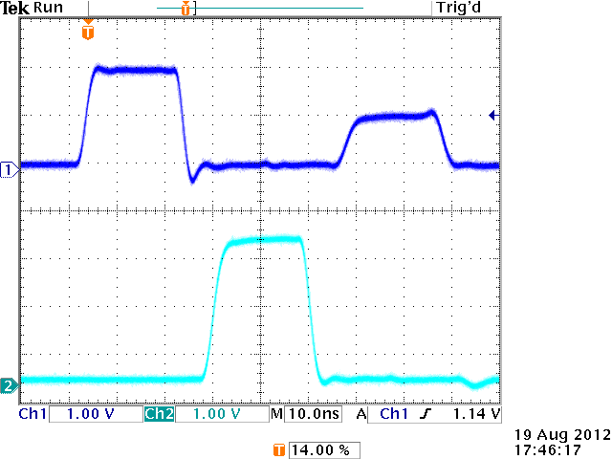
Load = 172 Ω

Slide 19
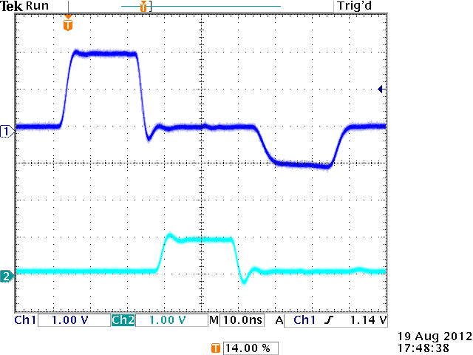
Load = 15 Ω

Slide 20
Essential Concepts:
Length matters at short time scales.
  Length of a coaxial cable causes time delay.
  For non-coaxial cable, using very short wires to approximate the ideal case.

Slide 21
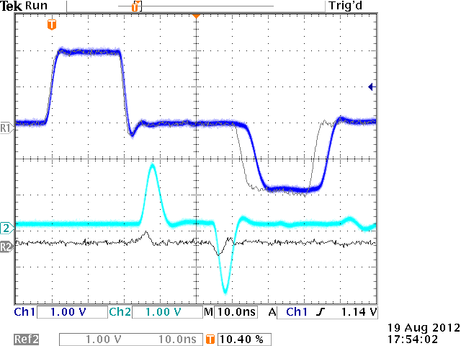
Load = copper wires 15 cm Vs. 1 cm

Slide 22
Essential Concepts:
2. What happens before the signal reaching the cable end?

Slide 23
Clues:
A
B
Load
(ch1)
A’
(ch2)
B’
Signal propagation speed can be measured.
2. The reflected signal can be monitored at A/A’ if the coaxial cable is long enough.
3. The load voltage can be measured at B/B’.
4. The impedance concept of a coaxial cable can be verified by using a matched termination.

Slide 24
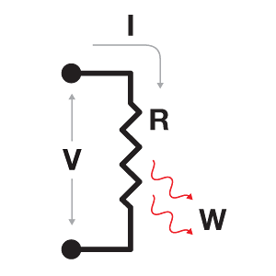
Essential Concepts:
Length matters at short time scales.
2. What happens before the signal reaching the cable end?
3. Apply the Ohm’s Law carefully.
Voltage Drop ΔV = i R
Not V

Slide 25
i_{in} = i_{L} + i_{R}
i_{in}
B
i_{R}
i_{L}
R_{L}
V_{B’} = 0
B’
inside cable
outside cable
V_{B} = i_{in} Z₀ + i_{R} Z₀
V_{B} = i_{L} R_{L}
not V_{B} = i_{in} Z₀ − i_{R} Z₀ , why?

Slide 26
i_{in}
i_{in} = i_{L} + i_{R}
i_{R}
i_{L}
R_{L}
V_{B} = i_{in} Z₀ + i_{R} Z₀
i_{in} Z₀
i_{R} Z₀
V_{B}

Slide 27
Load = short (0 Ω)
V_{B} = i_{in} Z₀ + i_{R} Z₀ = 0
i_{R} = − i_{in}
i_{in} Z₀
i_{R} Z₀
i_{L} = i_{in} – i_{R} = 2 i_{in}
General solution:
V_{B}

Slide 28
Doing this Simulated Research:
To measure something new (at least for the students)
To describe and explain the measurements
(記者 → 科學家)
To build a model (think, analysis, be creative)
To confirm every assumption of the model by experiments (be careful)
To predict new things with the model (knowledge becomes useful)

Slide 29
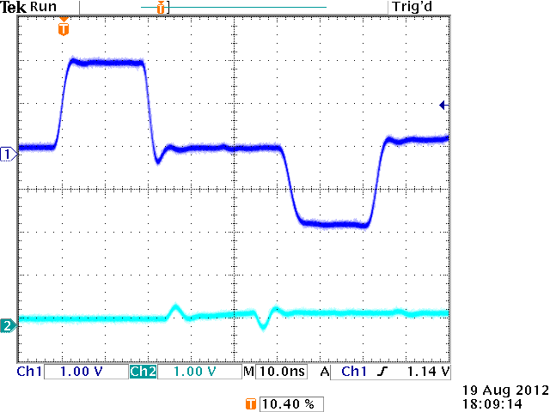
Load = 10 nF (capacitor)

Slide 30
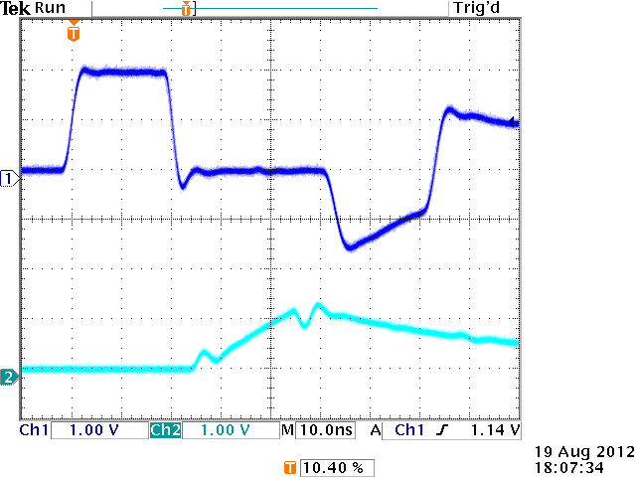
Load = 1 nF (capacitor)

Slide 31
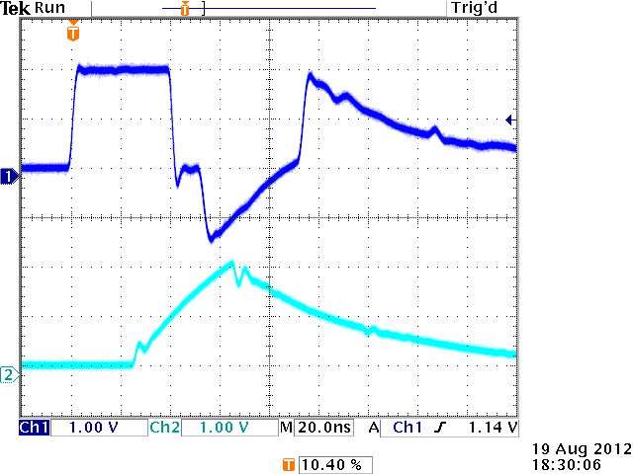
Load = 1 nF (capacitor)
At longer pulse width and time scale

Slide 32
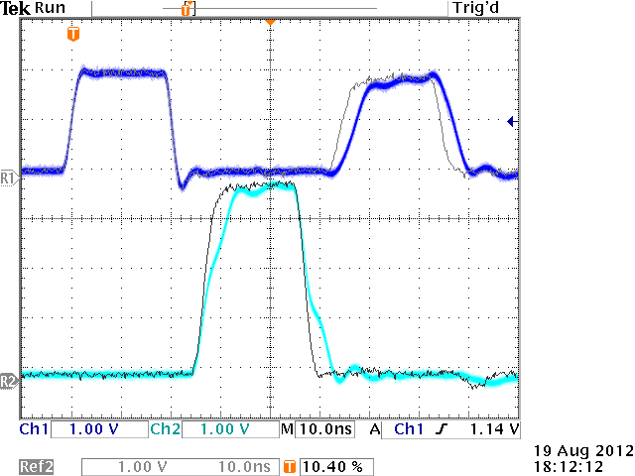
Load = an iron-core Coil (inductor)

Slide 33
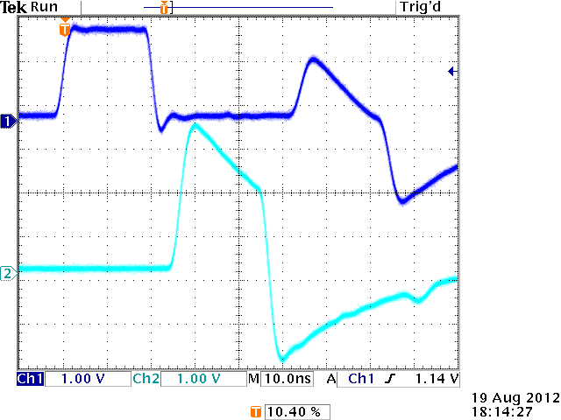
Load = an air-core Coil (inductor)

Slide 34
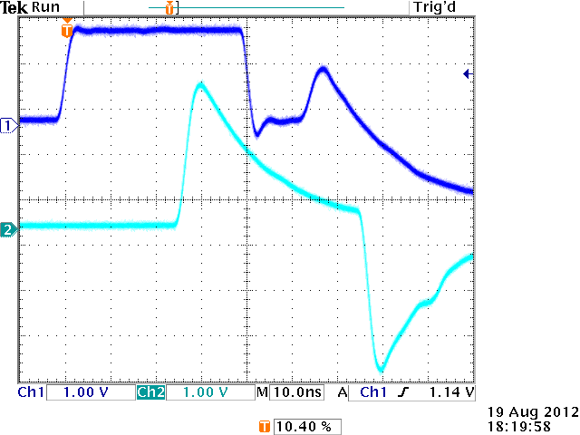
Load = a Shorter air-core Coil & Longer pulse width

Slide 35
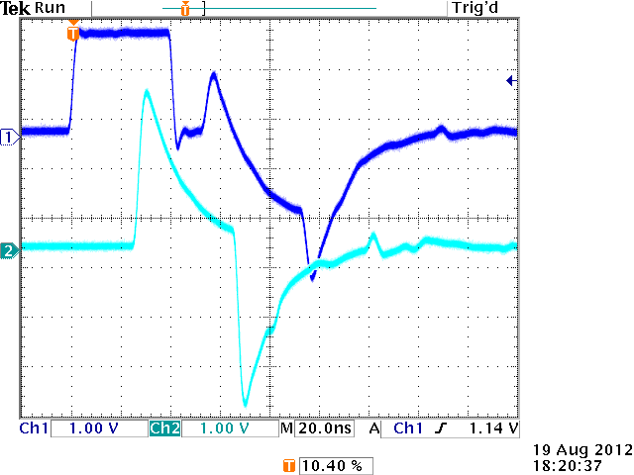
Load = a Shorter air-core Coil & Longer pulse width
Shown at a longer time scale

Slide 36

More Physical Concepts:
For a capacitor, its Voltage is a continuous function of time because Q is a continuous function of time.

Slide 37
More Physical Concepts:
2. For an Inductor, its Current i is a continuous function of time because V is finite.

Slide 38
More surprises in the experiments.

Slide 39
Interesting Observation #1:
For ≦ 100 students, from high school to postdoc,
Performance does not depend on previous level of education; Knowing calculus helps a bit but is not enough.
Persistence to think is important.
In average, the older, the worse.

Slide 40
It is true that an old dog can’t learn new tricks.
It may be different for Homo sapiens.
High school
I am here.
Ability of learning new things
Age
by 林志民

Slide 41
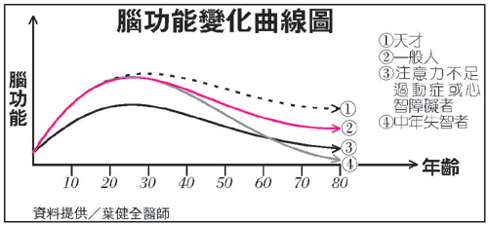

Slide 42
Interesting Observation #2:
≦ 100 students,
Some are very impressed, but some are not. Some of them forget after a while.
Some students who figured out the model by themselves appreciate this course very much.

Slide 43
Important aspects of doing experiments:
Separate meaningful physical quantities from those caused by imperfection of instruments and human operations. Thus, a model is useful.
To examine the assumptions of the model by experiments.

Slide 44
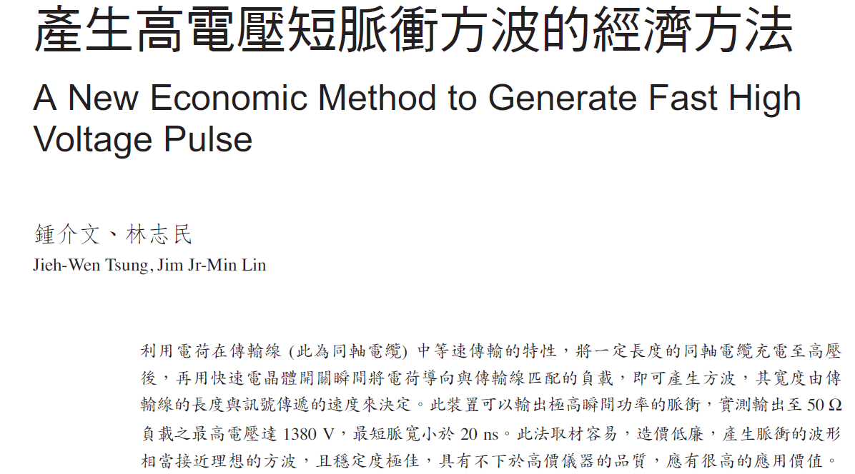


Slide 46
Important aspect of education:
Too easy is not interesting, but
too difficult is scaring.
Partial solution:
Provide necessary background knowledge (math).

Slide 47
Thanks to
those students who spent a lot of time and
thought
on
these experiments.

