Slide 1
Instrument Design:
Mechanical Design
Optical, Electronic, ...
Jim Jr-Min Lin 林志民
Institute of Atomic and Molecular Sciences
Academia Sinica, Taipei, Taiwan 106
中央研究院 原分所
台大化學系 合聘

Slide 2
One may be born with talent.
No one was born experienced.
But accumulating experiences makes large differences
a few years later.

Slide 3
Outline:
Drawing concepts
Tolerance & Fit
Materials
Joint methods
Distortion & Stress

Slide 4
A very useful book:
Building Scientific Apparatus
A practical guide to design and construction
by Moore, Davis, and Coplan

Slide 5
Projection views
√
√
√

Slide 6
Section view
direction of view
To see the inside more clearly

Slide 7
Section view
Don’t forget anything behind the section surface

Slide 8
mm is the ONLY unit of machining in Taiwan!
Inch (25.400 mm) is the unit in USA.

Slide 9
Tolerance: A Rod in a Hole
distribution
φ20
+0
-0.02
φ20
+0.02
+0
Minimum gap 0
Maximum gap 0.04
High chance to be locked
diameter
distribution
φ20
+0
-0.01
φ20.02
+0.02
+0
Minimum gap 0.02
Maximum gap 0.05
Smooth fit
diameter

Slide 10
Two fixed rods in two holes
Rods:
(2) φ10 rods separated by 80 ± 0.01
+0
-0.001
(2) φ10.01 separated by 80 ± 0.01
Holes:
+0.02
+0.
May Not Fit! Minimum gap = − 0.01

Slide 11
Two fixed rods in one hole and one slot
Easier to fit in
and better accuracy

Slide 12
Tolerance: geometric

Slide 13
Machining tools:
銑方形孔?
車
鑽 銑
鋸 銼
切削
磨 (砂輪 砂紙)
衝
壓
板金
彎曲形變
線切斷 (放電)
水刀
非機械接觸
蝕刻

Slide 14
Material Concern:
Physical properties:
electric conductance, thermal conductance, thermal expansion, magnetic
Mechanical properties:
strength, rigidity, hardness, 切削性, 可彎曲程度
Chemical properties:
surface oxide, absorption, corrosive resistance, chemical interference
Temperature range: -196ºC, 0ºC, 100ºC, 200ºC, 1000ºC, etc.

Slide 15
Common materials used in a lab:
Pure metal is often much softer than its alloy
Unless necessary, pure copper and aluminum are rarely used.
light, strength, easy to cut
surface oxide
Anodized surface is non-conductive
Al 6061-T6: common
Al 7075-T6: as hard as steel
strength, inert, low magnetic,
low thermal conductance
less easy to cut
SUS304: common
SUS316: more inert, less magnetic
Be copper (鈹銅)
Brass, Bronze
good conductance
dense, chemical compatibility

Slide 16
Ceramic
Al₂O₃: strong, hard, hard to machine
Machinable ceramic:
insulator, brittle
Plastic
limited temperature range
significant water absorption 1~2% w/w
Inert: Teflon, PE (polyethylene), PP (polypropylene),
Kel-F (–CF₂CFCl –)_{n} harder than Teflon
Low temperature: Teflon, Kel-F
High temperature: polyimide (Vespel, Kapton), PEEK
Teflon, filled Teflon (with glass fiber, graphite, etc)

Slide 17
Rubber (O-ring)
elasticity
NBR (Nitrile Butyl Rubber)
Viton (Fluorinated Rubber)
Kalrez (perfluoro elastomer)
1~10
10~100
1000~
NT$
inert
high temp
15% compression is good for sealing
Don’t exceed 20%
Don’t compress volume of O-ring

Slide 18
Thermal expansion concern:
SUS304 α = 1.7x10⁻⁵ /ºC
If ΔT = 100ºC, 100ºC x 1.7x10⁻⁵ /ºC = 1.7x10⁻³ = ΔL/L
For length of 100 mm, 100mm x 1.7x10⁻³ = 0.17 mm = ΔL
big movement for precision alignment, ...

Slide 21
Example:
Al₂O₃ α = 8x10⁻⁶/ºC
If ΔT = 111ºC,
111ºC x (1.7−0.8)x10⁻⁵ /ºC = 1x10⁻³ = 0.1%
SUS α = 1.7x10⁻⁵ /ºC
if d=100 mm, gap decrease by 0.1 mm
Very important when making Glass-Metal Joint or Ceramic-Metal Joint

Slide 22
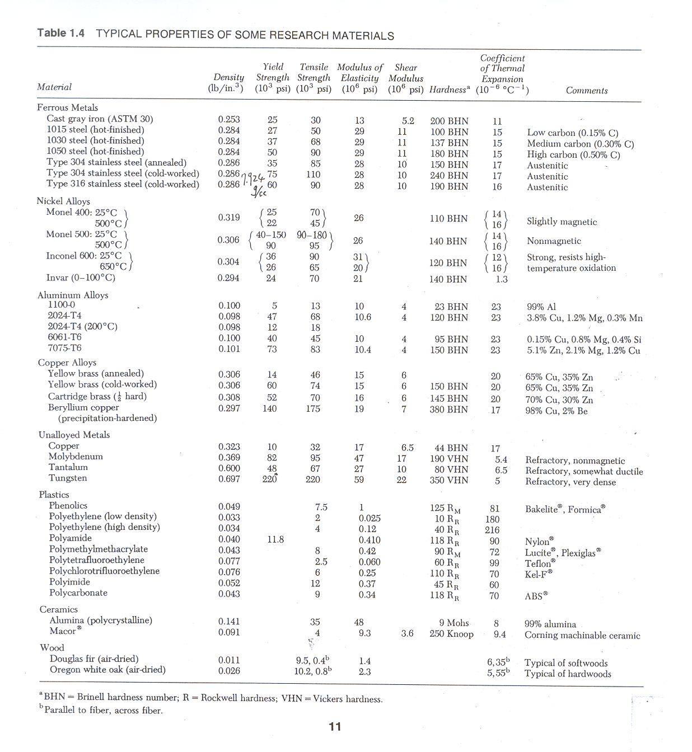

Slide 23
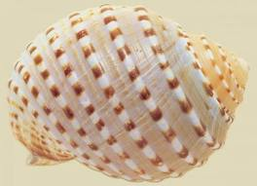
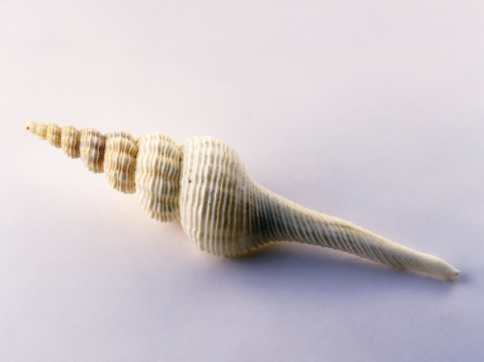
Joint methods:
Screw, Bolt & Nut
Right
handed
Metric thread with Major diameter = 6 mm
and Pitch = 1 mm
M6 x 1.0
American thread with major diameter = 1/4 inch
and pitch = 1/20 inch
1/4 − 20
#8 − 32
M5 x 0.8 Vs. #10 − 32
25.4/32=0.79375

Slide 24
Work = Force * Length
hand force * 2 π r = screw force * 1 pitch
hand force

Slide 25
Joint Force:
Screw, bolt & nut
For a frictionless screw of M6x1.0, it moves 1 mm after one turn.
If the length of the wrench is 100 mm, the level arm is
2π*100mm = 628 mm
and if the force is 10 kgw, then the force delivered by the screw is
10 kgw * 628mm/1mm = 6.3 x 10³ kgw
It’s a tremendous force. A screw may break.
When using screws to hold an optics, plastic cushion (washer, spacer) is necessary.

Slide 26
Approximate coefficients of friction from Wiki
Materials |  | Static friction,
 |  | Dry and clean | Lubricated
Aluminium | Steel | 0.61
Copper | Steel | 0.53
Brass | Steel | 0.51
Cast iron | Copper | 1.05
Cast iron | Zinc | 0.85
Concrete (wet) | Rubber | 0.30
Concrete (dry) | Rubber | 1.0
Concrete | Wood | 0.62¹⁰
Copper | Glass | 0.68
Glass | Glass | 0.94
Metal | Wood | 0.2–0.6¹⁰ | 0.2 (wet)¹⁰
Polyethene | Steel | 0.2¹¹ | 0.2¹¹
Steel | Steel | 0.80¹¹ | 0.16¹¹
Steel | PTFE | 0.04¹¹ | 0.04¹¹
PTFE | PTFE | 0.04¹¹ | 0.04¹¹
Wood | Wood | 0.25–0.5¹⁰ | 0.2 (wet)¹⁰

Slide 27
www.rpmmech.com
1000 kgw
It’s still a very large force.
Don’t over tight a screw.

Slide 28
www.rpmmech.com
Tightening Torque = K * D * P
K = 0.2 (dry, unlubricated)
Clamp Load (P) = 75% of the Proof Load
D = Nominal Thread Size
The values presented in these tables are representative and have been compiled for the user’s benefit. Results can be influenced by any number of variables including 1) excessive lubrication, 2) excessive design clamp load, 3) nicked or binding threads, 4) non-parallel mating surfaces, and 5) inadequate torque control, to name a few.

Slide 29
Weld: base material melts.
Common for SUS
hard for Al alloy (oxide formation, high thermal conductivity)
hard for copper (high thermal conductivity)
Brazing, soldering: base material doesn’t melt, only brazing alloy or solder melts.
Flux can be used to reduce surface oxide
Very hard for Al alloy (surface oxide)
Vacuum brazing is preferred when making SUS-Copper joint (sealing)
Glue: epoxy, crazy glue, etc. good for small parts

Slide 30
Welding concern
Melted and then solidified (very large contraction, ΔT > 1000 ºC)
welding
After welding: shorter, smaller diameter near welding and may be tilted.

Slide 31
Welding concern
less tilted

Slide 32
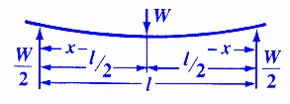
Strength
w¹ t³ L⁻²
scale to a known case
w
t
L
Rigidity is more often of concern than strength,
distortion at machining is often more severe than distortion at use.
Hardness and smoothness is important when there is a motion between two contact surfaces, e.g. precision fit, bearing

Slide 33
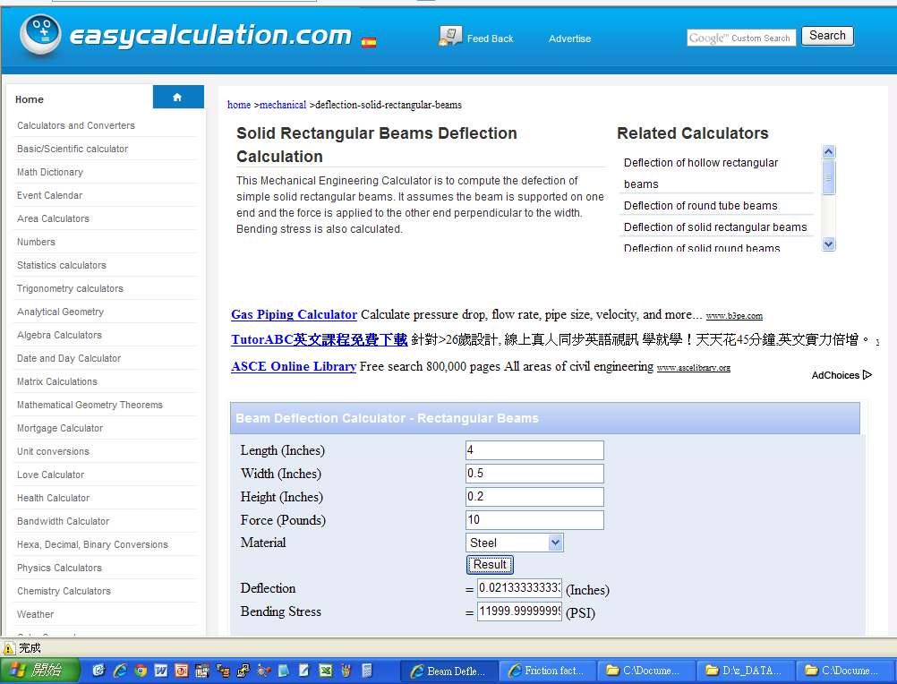

Slide 34
Formula:
MI for solid rectangle = ((Height³ * Width) / 12)
Deflection = (Length³ * Force) / (3 * E * MI)
Bending Stress = (Force * Length) / (MI / (0.5 * Height))
Where,
MI = Moment of Inertia
E = Modulas of Elasticity in psi

Slide 35
Stress & stress release
Stress depends on its history

Slide 36
Heat Treatment
Anneal to release stress
Tempering to increase Strength and Hardness

Slide 37
先 能 有 中 生 有
後 能 無 中 生 有
Make it work,
especially under constraints.
時間、材料、精度 …

Slide 38

A Stainless Steel tube is confined tightly by a very rigid stone as shown in the Figure. If one heats up the tube by 40 degree C, the tube would exert a force to the stone (the tone is not heated). How large is the force?
For SUS304, the thermal expansion coefficient is 1.7x10⁻⁵ /degree; the modulus of elasticity is 2.8x10⁷ psi.
A SUS304 tube, OD = 20 mm, t = 2 mm, L = 60 mm
A very rigid stone

